Slide 1


Texas Oil & Gas Association Upstream Sub-Committee
TXOGA ANNUAL Ad Valorem Tax Committee Conference
February 10-11, 2026

Slide 2
Committee Members
Lauro Porto- ExxonMobil (chair)
Scott Emanis – Chevron
Drew Harrold – Merit Advisors
Roland Headley – Devon
Michael Horne – Occidental
Todd Metzgar – Conoco Phillips Co
Amy Rutledge – EOG Resources
Notes:
Identify new members

Slide 3
Mineral Sub Committee Activity
Schedule meetings with the Appraisal Firms
Meet to discuss valuation parameters & processes
HB9
DOI
Summarize meeting discussions
Report to the Membership
Firm Summary File to be emailed once complete

Slide 4
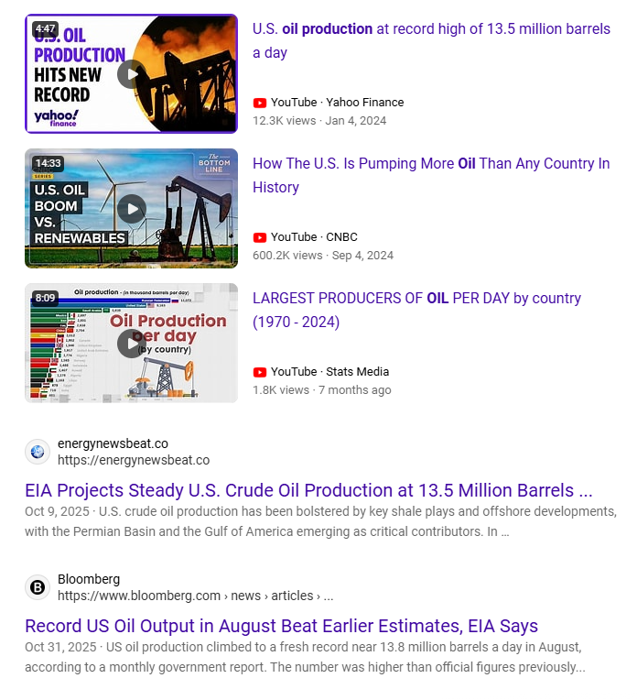
US Crude Production

Slide 5
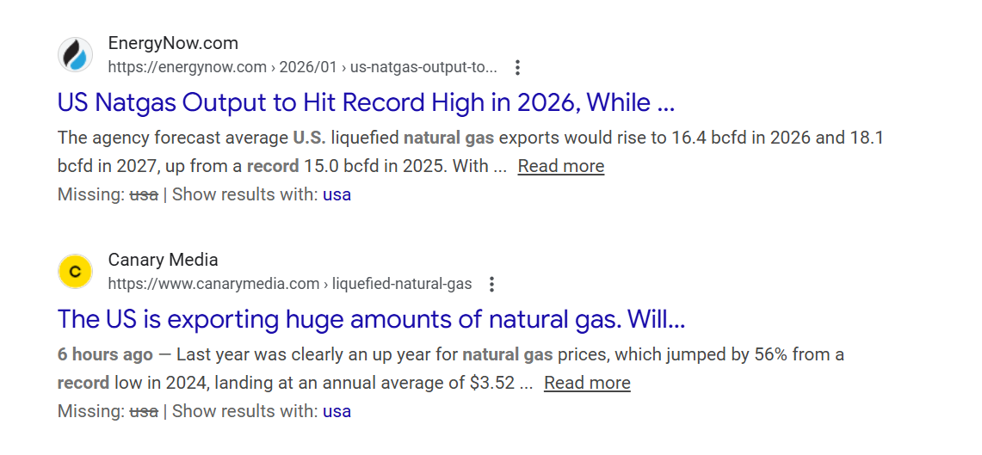
Natural Gas Production

Slide 8
EIA Annual Energy Outlook
Next release date – Spring 2026
§23.175 Texas Property Tax Code
Appraisal Districts must use the EIA AEO data to calculate the Price Adjustment Factors for oil & gas if published by March 1, 2026
Notes:
Years ago, there was a year when EIA issued the AEO before 3/1

Slide 9
EIA January Short Term Energy Outlook
Released on January 13, 2026
§23.175 Texas Property Tax Code
Appraisal Districts must use the EIA January STEO data to calculate the Price Adjustment Factors for oil & gas if most recent AEO published before December 1st of preceding year (12/1/25)

Slide 10
Price Adjustment Factors
EIA - STEO Report released Jan 13, 2026 - Price Adjustment Factor Calculation
Table 1 Prices in Nominal Dollars |  |  |  |  | Table 1 Prices in Nominal Dollars
Oil - WTI Spot Price |  |  |  |  | Natural Gas - Henry Hub Spot
2026 Price |  | $ 52.21 |  |  | 2026 Price |  | $ 3.46
2025 Price |  | $ 65.40 |  |  | 2025 Price |  | $ 3.53
PAF |  | 0.79832 |  |  | PAF |  | 0.98017

Slide 11
Producer Price Index
BLS - PPI Calculation for Oil & Gas - Full Year 2025
 | X = index figure for current year (Base year 1982 assumed to be 100)
 | Y = number of years between 1982 base year and current year
 | To determine average inflation rate over any particular time span:
 | Inflation (%) = (X / 100)^ (1 / Y) - 1
 | Crude Oil |  |  |  |  | Natural Gas
Factor |  | 187.9 |  |  |  |  | 99.5
Year |  | 2025 |  |  |  |  | 2025
Escalator |  | 1.4776% |  |  |  |  | -0.0117%

Slide 12
2026 Pricing Escalators
Notes:
WTI & HH refe points. Use average price received per lease.

Slide 13
EIA STEO ANALYSIS

Slide 14
EIA STEO ANALYSIS

Slide 15
Appraisal Firm Meeting Notes
Firms will use the Jan 2026 STEO to determine the PAF for Oil & Gas Pricing.
Escalation from BLS – years 2-6
2025 Lease Operating Expenses – expectations are flattish over 2024 actuals
Firms expect oil lease values to decrease, while gas should see increase
Circuit breaker – still in place until end of 2026
DOI – provide information as soon as available

Slide 16
Capitol Meeting Notes
Appraisers primarily work from home
Office space still in place to meet with agents/reps
In person negotiations are available – schedule with Appraiser.
Discount rate – 2026 base rate still being evaluated.
Expenses – Similar as previous years (fixed & variable)
If you use Misc category 10% reduction
Mineral appraisers – LeLaina Taylor- Mineral Div. Mgr.
Assignments on website.

Slide 17
P&A Meeting Notes
Pricing – Jan STEO for PAF Calculation
Oil pricing – Start with County Average
Gas Pricing – Start with lease actual average price.
LOE – flat Y1 escalation at appraiser discretion thereafter
Discount Rates – same range as last year. Oil – 10 – 24% gas 12 – 16%

Slide 18
Thos. Y Pickett Meeting Notes
2026 Valuations –Expect oil decrease
LOE for 2025 appraisals – still being evaluated flattish . May consider additional escalation
Discount rate – 17% base rate plus the Ad Val rate
Check website for appraisal cut-off dates
Company hacked 8/2024 - 2025 season was a challenge but fully recovered

Slide 19
Wardlaw Meeting Notes
Mineral equipment value – Moved to F2
Maintaining 2025 process
Base Discount Rate – 15%
Price – Marketing costs to be handle in LOE
Plan to send notices by April 15th. Schedule appointments ASAP
April 15 – May 22 window to provide additional information
LOE escalation – still reviewing (inclined to keep it flat)
Requests LOE Detail in EXCEL format
No intention to use variable cost.

Slide 20
Other Firm Notes
Hugh Landrum – Contracts – No change in contracts.
Provide DO in excel format (if possible)
Encouraged to provide information ASAP
Notices to be sent mid April

Slide 21
Questions?
Thank You

Slide 22
Circuit Breaker Discussions BACK UP 2024)
SB 2 Circuit Breaker Appraisal Cap and Industry
Oil & Gas Properties (mineral valuations) are “Non-Homestead Real Property” which makes them subject to the 20% appraisal cap.
What was the legislature’s intent regarding mineral valuations?
What is the definition of a “new improvement” as related to a producing mineral lease?
How will well workovers be treated?
How will oil well additions be valued on an existing lease?
How is a sale of an oil & gas property impacted?
How will this impact unknown royalty interests or corrections to the division of interest?
How will right of ways be impacted for midstream assets?
Could downstream assets be impacted?
How do we ensure the circuit breaker will be equally interpreted among appraisal districts?
Summer 2023 – Ad Hoc Circuit Breaker Committee formed to review law and how to apply to mineral, midstream & downstream appraisal and assessment

Slide 23
Circuit Breaker Discussions
February 2024 – Conclusions and recommendations by the Mineral Sub-Committee:
Oil & Gas interests are subject to and qualify under Section 23.231
Applied on and individual account or ownership parcel level
Application will follow jurisdictional boundaries of County / Appraisal District
2023 account value is the base year. 2024 value < $5MM – lessor of FMV or the 2023 value times 1.2 (20%).
Change in Operator per RRC Records – reset of base year.
Corporate restructure or subsidiary does not constitute a reset.
Changes is royalty ownership – reset base year.
Repairs, w/o, fracks, lift mechanisms does not constitute a new improvement
New wells in a combined oil lease – part of the property and NOT a new improvement. (Cannot be identified through public production or pricing info.)

Slide 24
Circuit Breaker Discussions
February 2024 – Conclusions and recommendations by the Mineral Sub-Committee (continued):
All 2024 lease values if under $5MM - – lessor of FMV or the 2023 value times 1.2 (20%).
Gas leases – one lease = RRC # new wells would be set as a base year.

Slide 25
Circuit Breaker Discussions – Firm Meeting Notes
In general the firms agreed with the Committee recommendations.
Notes from committee meetings
CAG –
Talked with Law Firms for opinion.
Met with other Firms to address issues.
WAG –
Agreed new wells in an existing lease is subject to CAP (Reserve right to analyze)
Rescinded BPP rendering requirement for production equipment
2023 value * 1.2 will be 2024 comparable value. Over $5 MM, excluded from measurement
Any 2023 value greater than $4,166,667 would not be subject to Circuit Breaker.
P&A –
Oil & Gas Individual accounts based on tax roll.
TYP –
Limited by software capabilities.

