Slide 1
Texas Real Estate Markets
February 11, 2026
Texas Oil & Gas Association
Ad Valorem Tax Conference
Dr. Lynn Krebs
Research Economist

Slide 2
Texas Real Estate Markets
US Macroeconomic Backdrop
Texas Demographic, Employment and Economic Trends
Select Texas RE Markets (Office, Industrial, Rural)
Macro Review and Texas Real Estate Forecast
Not speaking on behalf of TAMU, opinions are my own.

Slide 3
Macroeconomics
Factors that most affect real estate markets, inflation, interest rates, and other financial conditions
3

Slide 4
What is Inflation?
Inflation is always and everywhere a monetary phenomenon, in the sense that it is and can be produced only by a more rapid increase in the quantity of money than in output.
Milton Friedman
Effective Demand vs. Supply
Notes:
Build, remodel, demo; buy/sell

Slide 5
Inflation slowing, but above historic levels (CPI, year over year pct. change)
All Urban | Housing
2017-20 Average = 2.0% | 2017-20 Average = 2.9%
Source: Texas Real Estate Research Center analysis of BLS data.

Slide 6
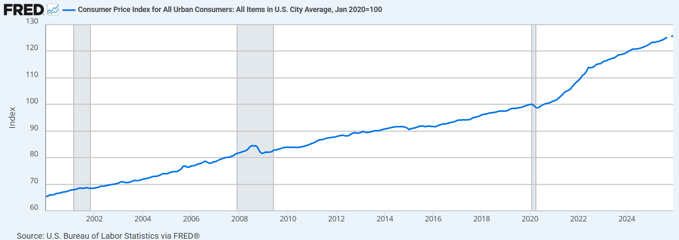
Consumer Price Index (Index 2020=100)
Dec 2025
125.8
Jul 2022
113.8
6
Notes:
Focus more on commercial costs: construction, labor, operations.

Slide 7
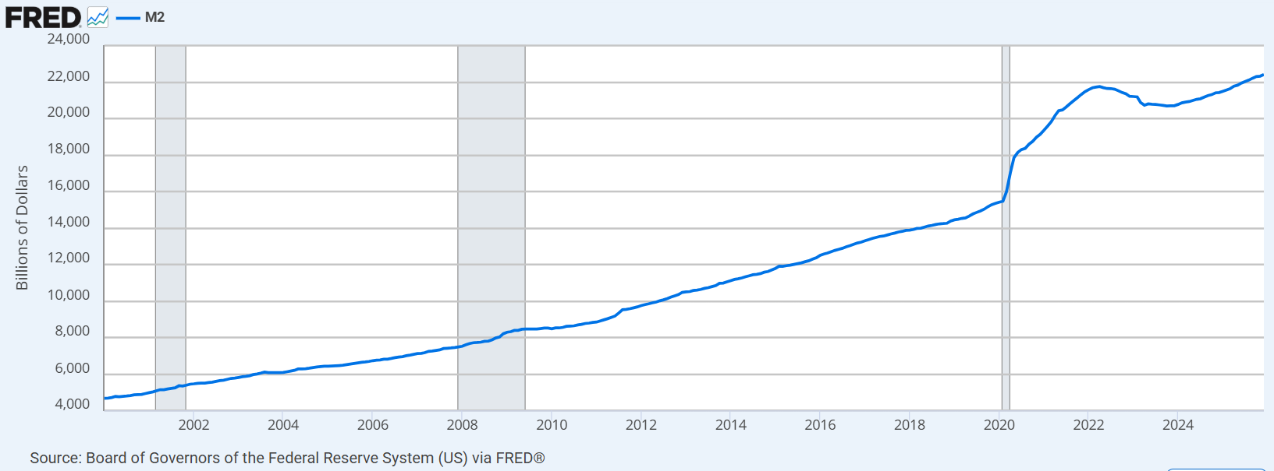
M2 – Money Supply
4Q2025 $22.23T
1Q2020 $15.42T
7

Slide 8
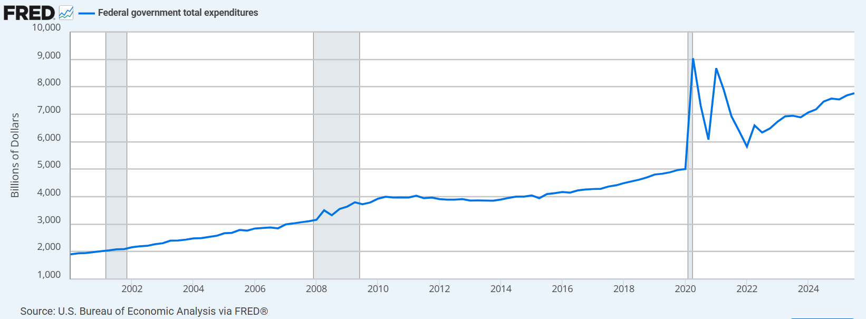
Total Federal Government Current Expenditures
3Q2025 $7.77T
1Q2020 $4.86T
8

Slide 9
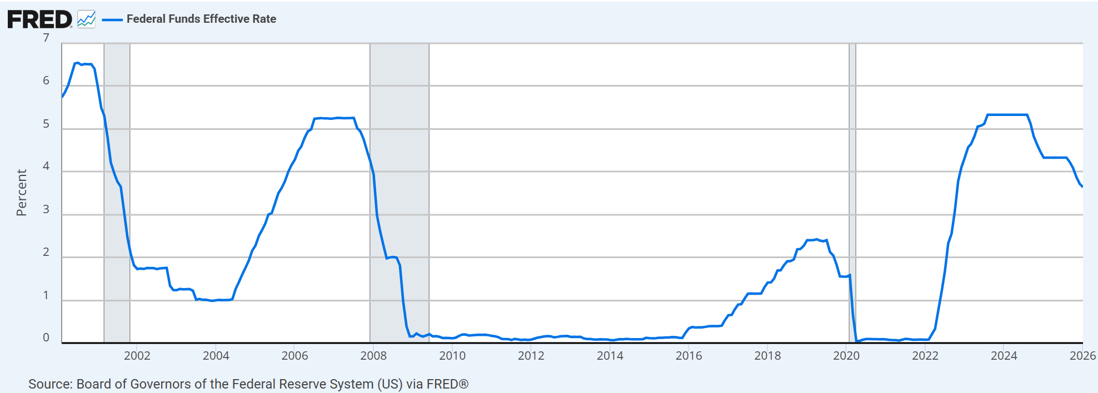
Fed Funds Effective Rate
6.5%
5.25%
5.33%
3.64%
2.42%
9

Slide 10
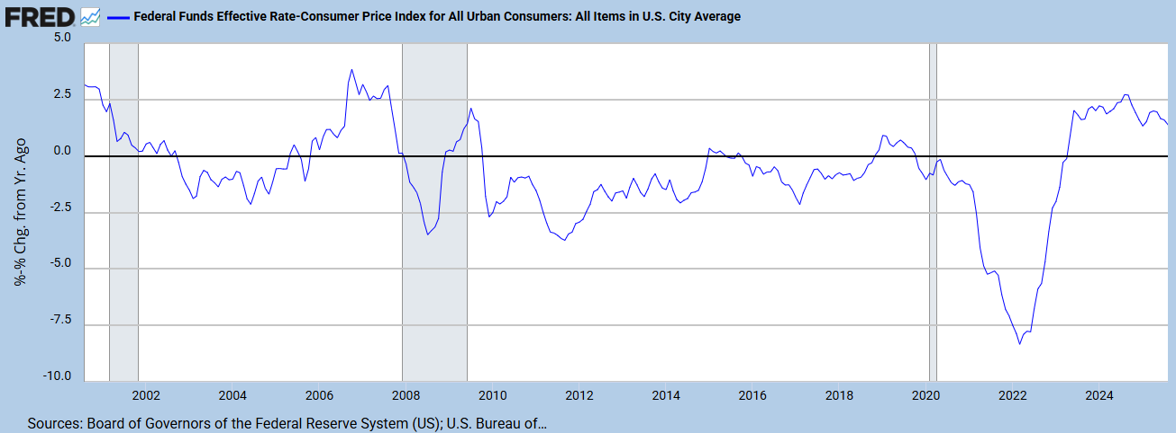
“Real” Fed Funds Rate (FFE Rate minus CPI)
10

Slide 11
Market yield on 10-year treasury securities from 1970 to 2024
11

Slide 12
Market yield on 10-year treasury securities from May 2013 to June 2025
12

Slide 13
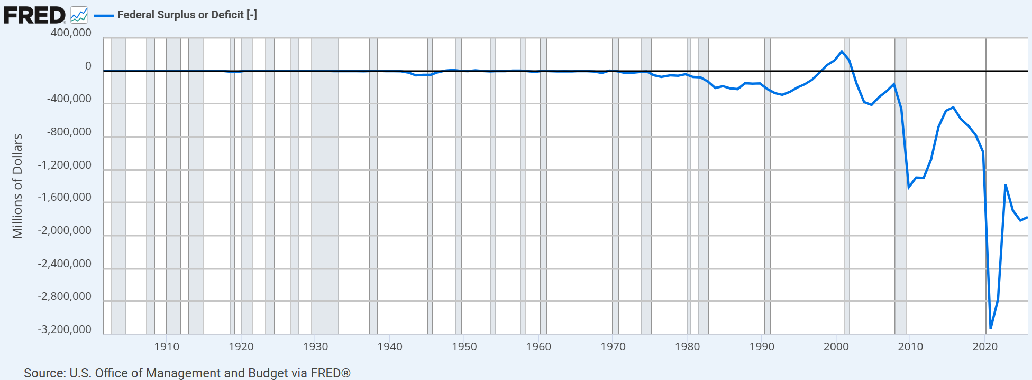
Federal Surplus or Deficit
13

Slide 14
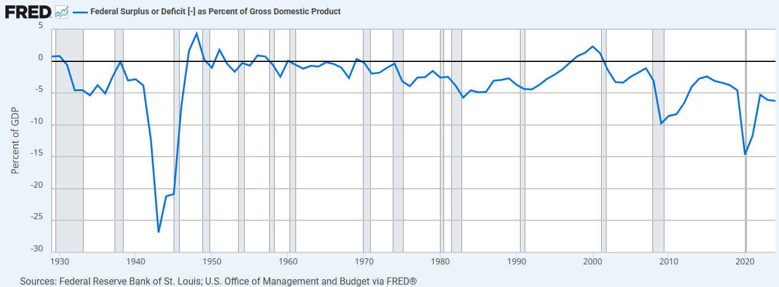
Federal Surplus or Deficit as Percent of GDP 2024 = 6.4%; 2025 Est = 5.9%
14

Slide 15
Texas Economy: Demographic, Employment and Economic Trends

Slide 16
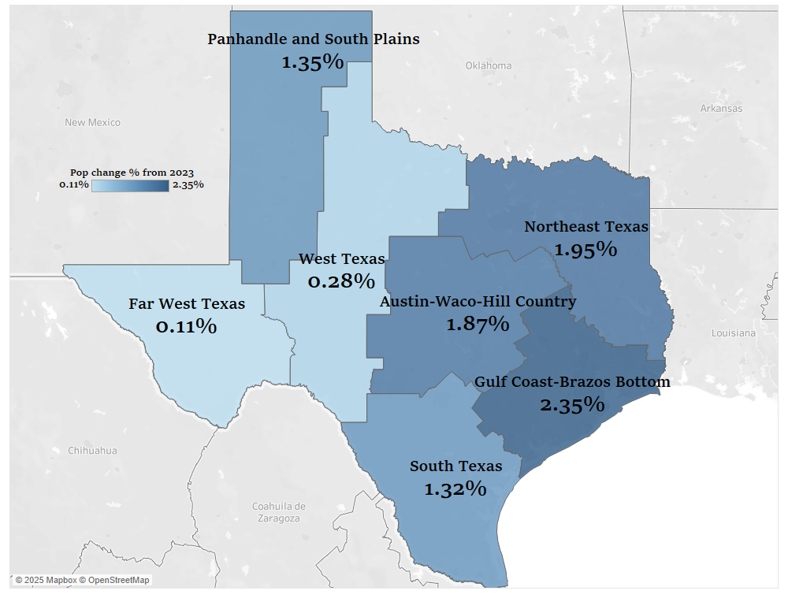
SE TX grew fastest, all regions grew (Annual percent population change, 2024)

Slide 17
Accelerating population growth slowed in 2025 (Total population growth by source, YE 6-30)
599,040
598,297
540,347
392,485
337,222
86,873
Natural | Domestic | International
Source: TRERC analysis of US Census data.

Slide 18
87% of population growth in the Big-4* (5-yr change; Pct. of total change)
*Other MSAs = 22 smaller metro areas. Micros = 41 micropolitan areas, Rural = remaining 121 counties
Source: TRERC analysis of Census Bureau data.
Notes:
Big 4 are 68% of total

Slide 19
Total payroll employment up, but concentrated* (Change since March 2020, 1,000s; Pct. of total)
*Other MSAs = 21 smaller metro areas. Rest of State = 177 remaining non-metro counties.
Source: TRERC analysis of BLS data.

Slide 20
TX economic growth slows on shifting industry contributions (Compound annual GDP growth rates)
One Year Growth Contributions*
Positive Impact:
Real Estate
Manufacturing
Prof/Sci/Technical
Negative Impact:
Accom/Food Services
Other Services
Mgmt./Companies
*Mining/Oil & Gas has been flat
Source: Texas Real Estate Research Center analysis of BEA data.
Notes:
Down 35 percent

Slide 21
TX’s slowing GDP returning to long-term trend (YoY Pct Change)
Source: Texas Real Estate Research Center analysis of BEA data.
Notes:
Down 35 percent

Slide 22
TX job growth rate also down, by almost 1/3rd (Compound annual payroll employment growth rates)
One Year Growth Contributions*
Positive Impact:
Health Care & Social Assistance
Government
Leisure and Hospitality
Negative Impact:
Manufacturing
Information
Professional & Business Services
*Mining/Logging with some growth (1.9%)
Source: Texas Real Estate Research Center analysis of BEA data.

Slide 23
New Single Family construction cost index has been relatively flat since 2022 (Producer Price New Construction Index (Left=YoY Pct, Right = Index)
39 percent increase
3/20 to 10/22
Source: TRERC of Census Bureau data.

Slide 24
Select Texas Real Estate Markets
A mixed bag with oversupply in most assets
24

Slide 25
CRE construction costs flattened, up 46% since 2020 (Producer Price New Construction Index (Left=YoY Pct, Right = Index)
Warehouse | Office
Source: Texas Real Estate Research Center analysis of BLS data.

Slide 26
DFW Office job growth 2X Houston or Austin* (Last five years 1,000s; Pct. of total)
*Other MSAs = 21 smaller metro areas. Rest of State = 177 remaining non-metro counties.
Source: TRERC analysis of BLS data.

Slide 27
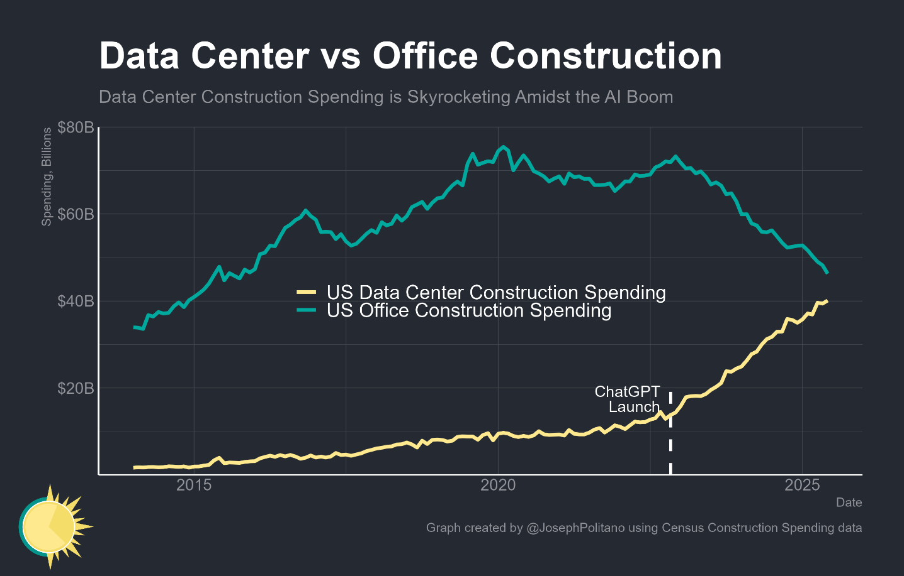
More space for AIs than people – a bubble?
“When bubbles happen, smart people get overexcited about a kernel of truth… That’s not rational behavior. Someone’s gonna get burned there, I think.” – S. Altman
There’s a major new technology that certainly will change the world and be successful. But some people are confusing that with the investments being successful. – R.Dalio
Notes:
Altman, OpenAI
Dalio, Bridgewater Associates

Slide 28
Office conditions better here than nationally
Source: TRERC analysis of CoStar data.

Slide 29
Office oversupply persists, slight drop Q3 (Texas MSA cumulative supply minus demand, MSF)
 | Percent of Surplus | Percent of Inventory
Austin | 28% | 12%
DFW | 37% | 37%
Houston | 29% | 30%
San Antonio | 6% | 8%
Source: TRERC analysis of CoStar data.

Slide 30
Office sale price leveling, income improves (a little) (Chart = US data, Table = Local Markets)
 | Cap Rate | 12-Mo BP Change | 12-Mo Sales ($M) | Latest Per SF
Austin | 7.8% | 21 | $911 | $103
DFW | 8.6% | 16 | $1,271 | $408
Houston | 10.1% | 7 | $681 | $259
San Antonio | 10.5% | 1 | $127 | $165
Source: TRERC analysis of CoStar data.

Slide 31
Texas will outperform a generally weak office sector
Texas benefited from record office job growth – but hiring slows (AI impact or excuse?)
Prime space in Austin and Dallas are relocation opportunities
– Texas still ahead in the HQ relocation game (48% of national total, 12 of CA’s 17 losses.)
Limited residential conversion opportunities (for now)

Slide 32
Industrial: Dallas, Houston lead job gains* (Last five years 1,000s; Pct. of total)
*Other MSAs = 21 smaller metro areas. Rest of State = 177 remaining non-metro counties.
Source: TRERC analysis of BLS data.

Slide 33
Industrial DFW, Houston, San Antonio top performing markets
Source: TRERC analysis of CoStar data.

Slide 34
Industrial oversupply still increasing (Texas MSA cumulative supply minus demand, MSF)
 | Percent of Surplus | Percent of Inventory
Austin | 12% | 6%
DFW | 42% | 42%
Houston | 20% | 29%
San Antonio | 10% | 7%
Source: TRERC analysis of CoStar data.

Slide 35
Industrial cap rates down on weaker income (Chart = US data, Table = Local Markets)
 | Cap Rate | 12-Mo BP Change | 12-Mo Sales ($M) | Latest Per SF
Austin | 7.5% | -24 | $333 | $125
DFW | 6.3% | -24 | $2,218 | $128
Houston | 7.6% | 1 | $1,605 | $107
San Antonio | 7.9% | 13 | $217 | $34
Note: Cap rate, sale price and NOI indices = 1.00 in 2009 Q2.
Source: TRERC analysis of CoStar data.

Slide 36
Texas industrial markets still waiting
Excess supply still ticking up
Distribution not as vulnerable to tariffs as some expect
Manufacturing may play a more important role if Trump Administration policies work

Slide 37
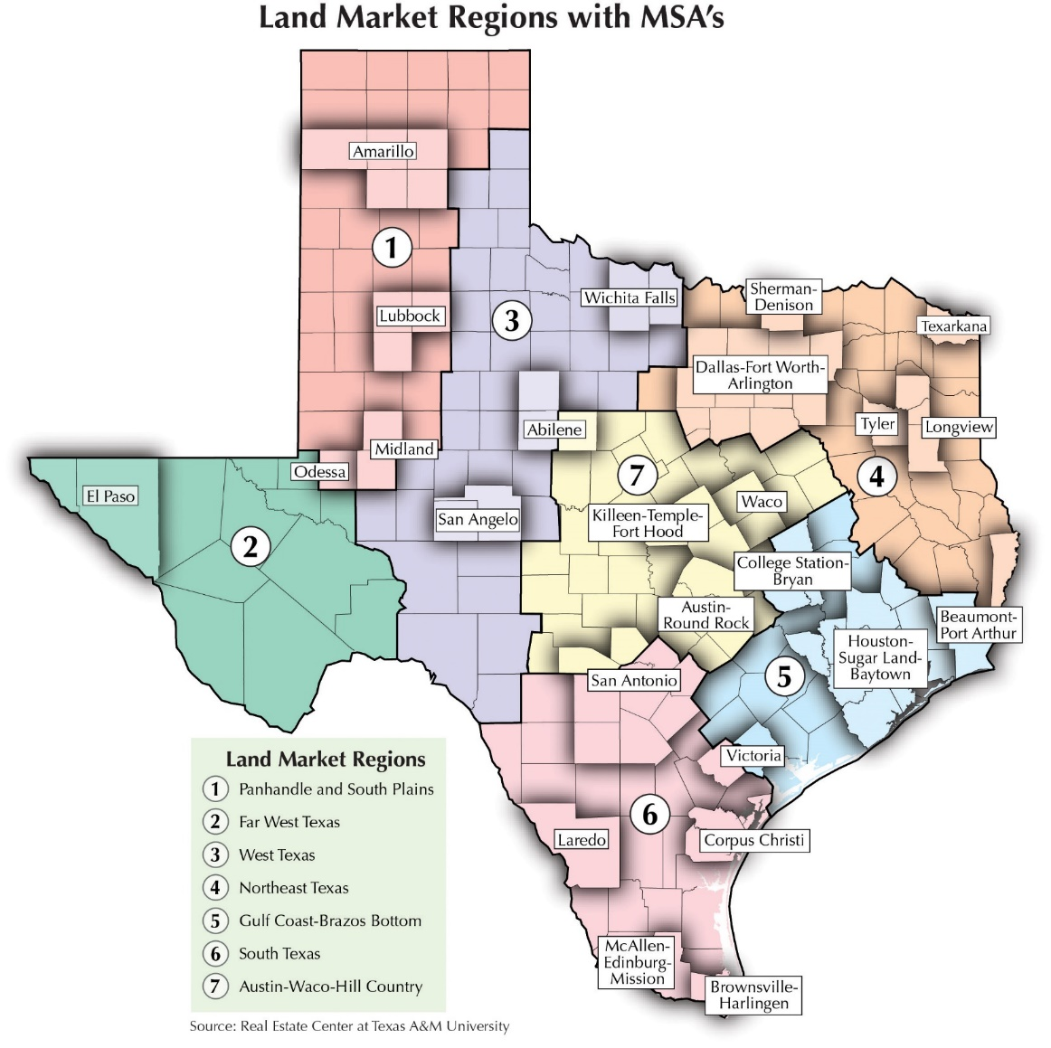
Texas Rural Land Markets

Slide 38
Texas Land Markets Size Segments (excluding 10 acres or less)

Slide 39
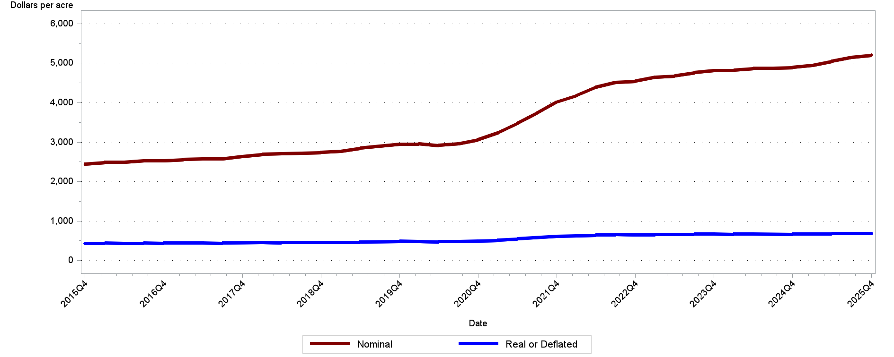
Texas Rural Land Prices
4Q2025 $5,214
Per acre

Slide 40
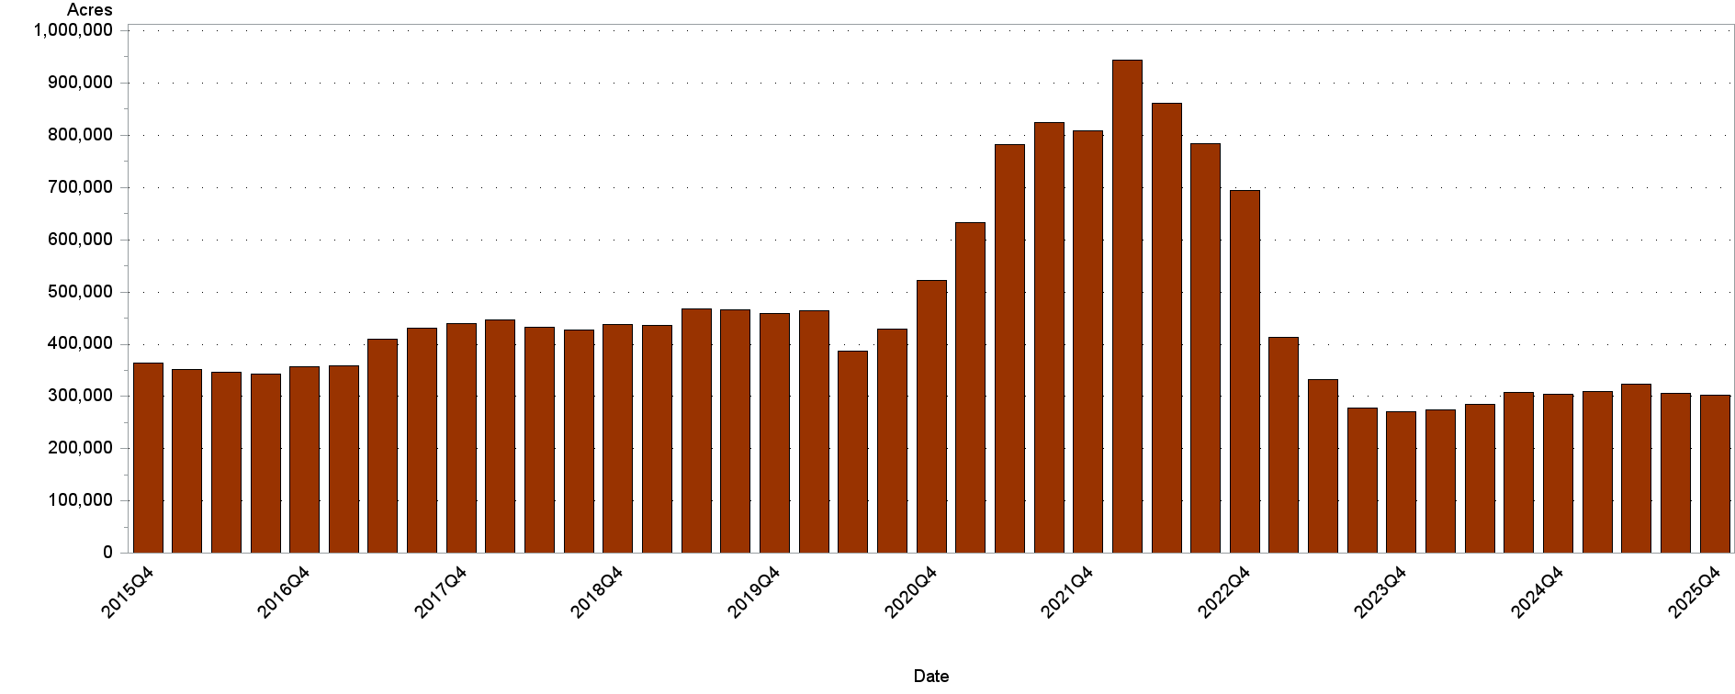
Total Acres Sold Texas Rural Land Statewide

Slide 41
Texas Rural Land Market Large Tracts
Measure | YoY | YE 2025
Price | 6.56% | $5,214
Typical Tract Size | -- | 121
Sales Volume | -8.16% | 3,852
Total Dollar Volume | 6.22% | $1.58B
Total Acres | -0.32% | 303,148
*** Price and Volume Regained Momentum ***

Slide 42
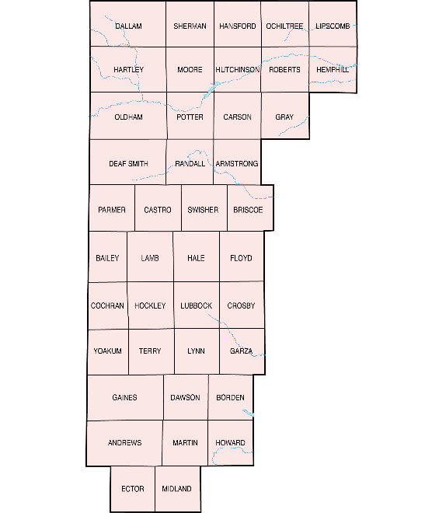
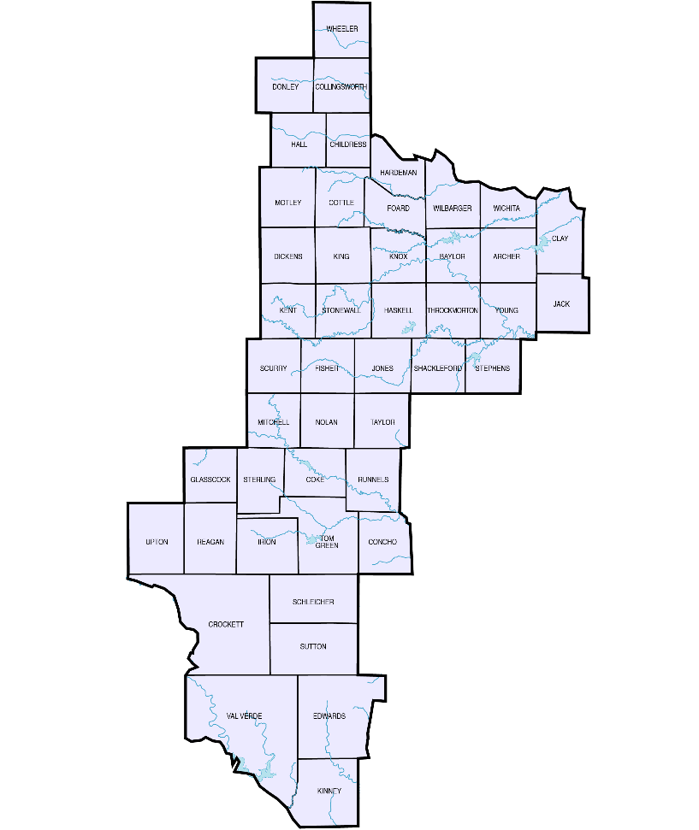
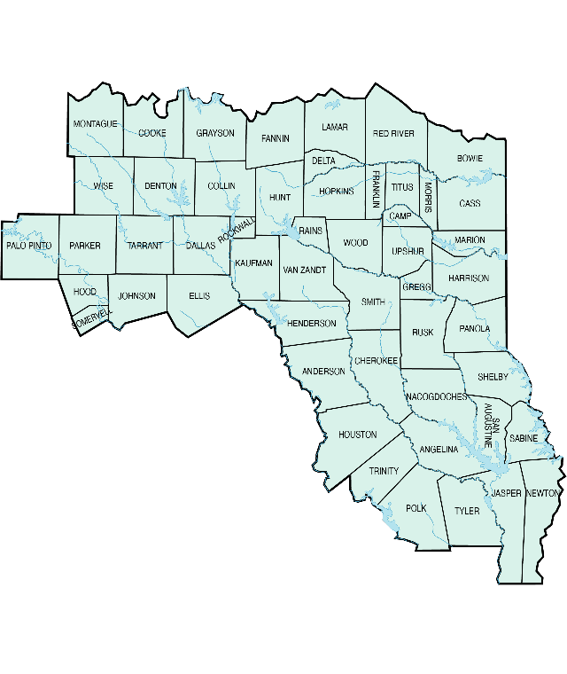
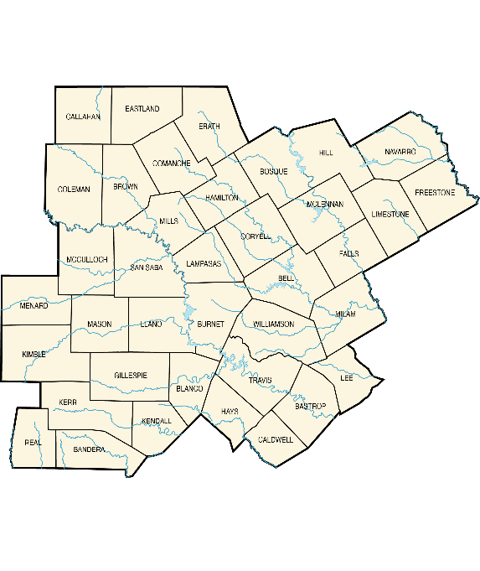
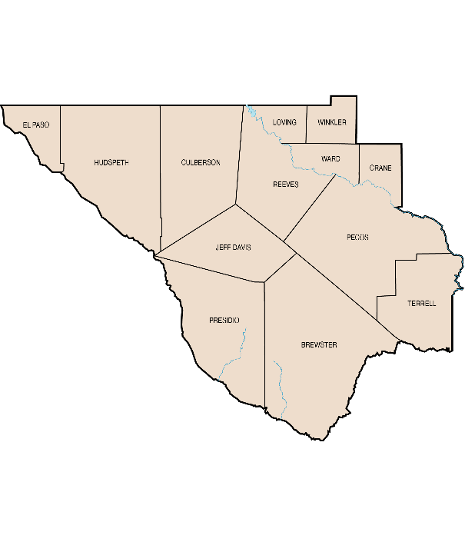
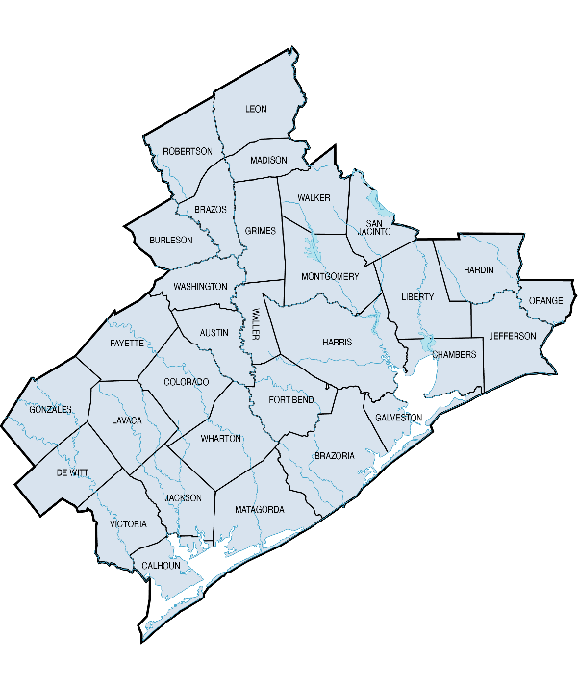
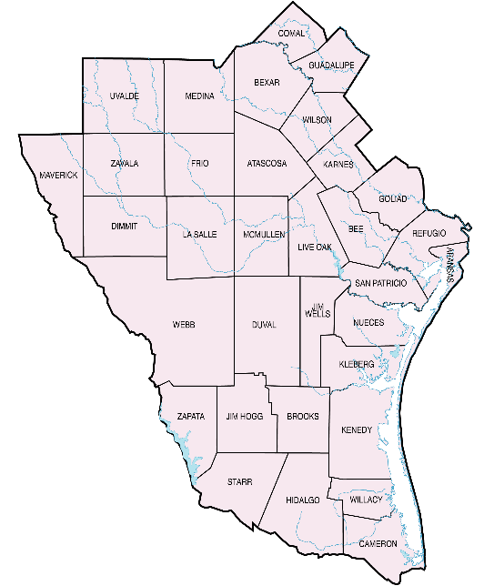
Texas Rural Land Prices by Region 2024 to 2025
Reg. 1 $5,214
-1.6%
Reg. 3 $2,878
13.5%
Reg. 2 $751
20.4%
Reg. 4 $9,159
2.2%
Reg. 7 $7,911
8.2%
Reg. 5 $11,502
10.6%
Reg. 6 $6,107
4.1%

Slide 43
Texas Real Estate Research Center (TRERC)
Save the Date!
Outlook on Texas Rural Land Markets
Annual Conference
April 8-10, 2026
Hyatt Hill Country Resort – San Antonio

Slide 44
Macro Review and
Texas RE Forecast

Slide 45
Macro Review and Outlook
Despite the Fed’s recent rate cuts, long-term borrowing costs remain elevated compared to the last two decades
Real estate, construction, and other rate-sensitive segments are likely to continue to face pressures
Nonetheless, expect higher GDP growth in 2026
Federal Debt still a growing problem, potential for major trouble in next 5-15 years (rates, dollar weakness, etc.)
For now, watch Deficit to GDP Ratio and 10-Year Treasury yields
45

Slide 46
Federal Surplus or Deficit as Percent of GDP 2024 = 6.4%; 2025 Est = 5.9%
46

Slide 47
Economic forecast through December 2026
Do not assume any significant changes in macro economic or geopolitical events that would result in a major shift in recently prevailing trends.
No recession or major increase in growth rates.
Economic Output (GDP) U.S.: 2.0% to 2.6% TX: 2.4% to 2.9% | Jobs (Payroll) U.S.: 0.8% to 1.2% TX: 1.3% to 1.7% | Income (Personal Income) U.S.: 5.0% to 5.5% TX: 5.0% to 5.5% | Inflation (CPI) 2.4% to 2.8% | Interest Rates Fed Funds Target Range: 3% to 3.5% 30-Year Fixed Mortgage Rate: 5.0% to 5.6%

Slide 48

Real Estate Forecast (Ending December 2026)
Single Family | Multifamily | Office | Industrial | Retail | Rural Land

Slide 49
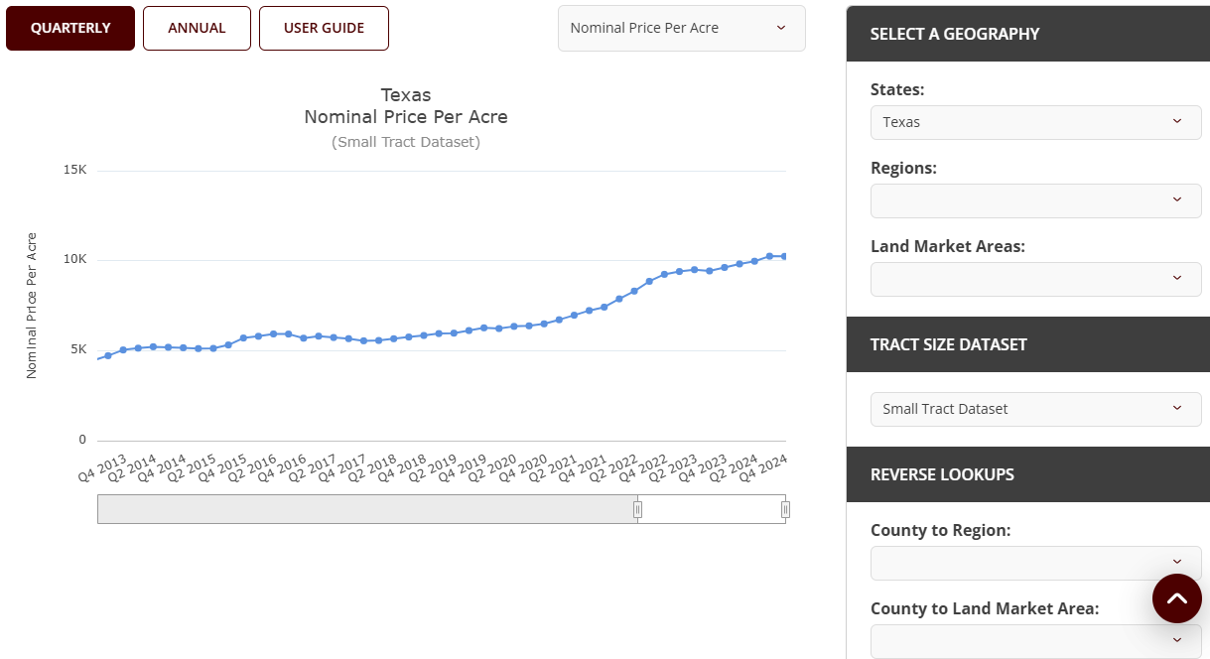

Texas Real Estate Research Center (TRERC) Rural Land Data

Slide 50


Texas Real Estate Research Center (TRERC)
Subscribe
LinkedIn

Slide 51

Texas Real Estate Research Center (TRERC)
Created by Texas Legislature in 1971
Advisory board of real estate professionals approves research agenda
Texas A&M University, Division of Research
Rural
Land
Special
Projects
Residential
Legal
Commercial

Slide 52
Lynn D. Krebs, Ph.D.
Dr. Lynn Krebs
Research Economist
Specializations: Rural land markets and property taxation (all property types)
Lkrebs@tamu.edu
979.845.7972

