Slide 1


AD VALOREM TAX COMMITTEE ANNUAL CONFERENCE | FEB. 10, 2026
Todd Staples, President of the Texas Oil & Gas Association
Notes:
TY and glad to be with you.​

Slide 2





Who We Are
Founded in 1919, the Texas Oil & Gas Association (TXOGA) is a statewide trade association representing every facet of the Texas oil and gas industry.
The mission of the Texas Oil & Gas Association is to promote a robust oil and natural gas industry and to advocate for sound, science-based policies and free-market principles.
Notes:
oldest and largest...
we represent every sector of the oil and natural gas industry
Exploration & Production
Pipelines
Processing
Ports
AND Service Companies

Slide 3



Who We Are
TXOGA Workers’ Comp. Safety Group
TXOGA Association Health Plan
Up-front premium discount of 12.4%
Choose the plan that works for you
Opportunity to receive two dividends*
Access to large network of providers
$48M+ in group dividends since 2001
Affordable group health coverage for:
TXOGA Safety Talks & safety resources
Companies with 2-50 employees
Annual members of TXOGA
*Dividends are based on performance and not guaranteed
Companies aligned to the oil and natural gas industry
Learn more at txogainsurance.com

Slide 4
27
495
31
Notes:
If you don’t remember anything else I say today, I hope you remember these three numbers:
27: in FY 2025, this industry paid $27 billion dollars in state and local taxes and state royalties (the highest total in Texas history)
495: 495,501 Texans just like all of you have a direct job in this industry
and 31: this industry, when you add both direct and indirect impacts, represents nearly 31 percent of the Texas private sector Gross State Product.
LETS DIVE DEEPER INTO THESE NUMBERS, starting with $27 billion.

Slide 5


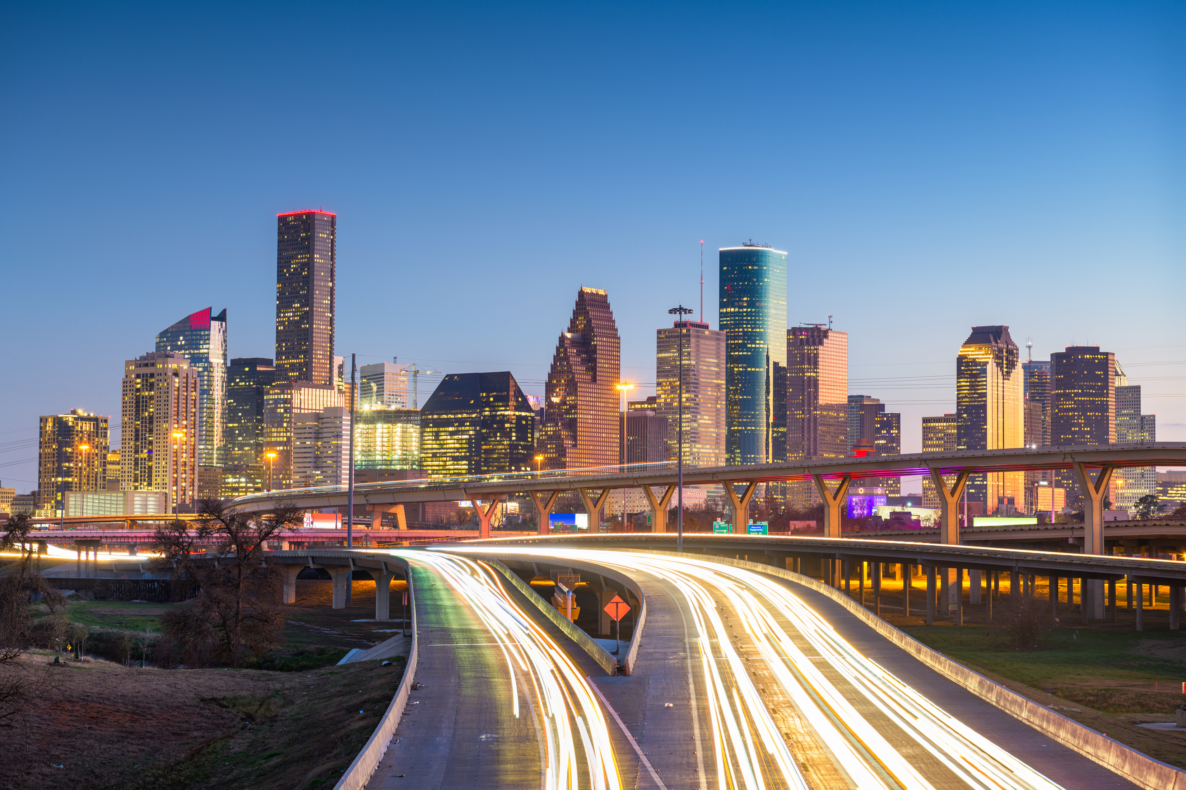

$27.0 BILLION
Notes:
For context, the $27 billion dollars is greater than 34 states’ entire tax revenues, and translates to a whopping $74 million dollars each day
These dollars directly funds our public schools, universities, roads, first responders and other essential services for every Texan.

Slide 6
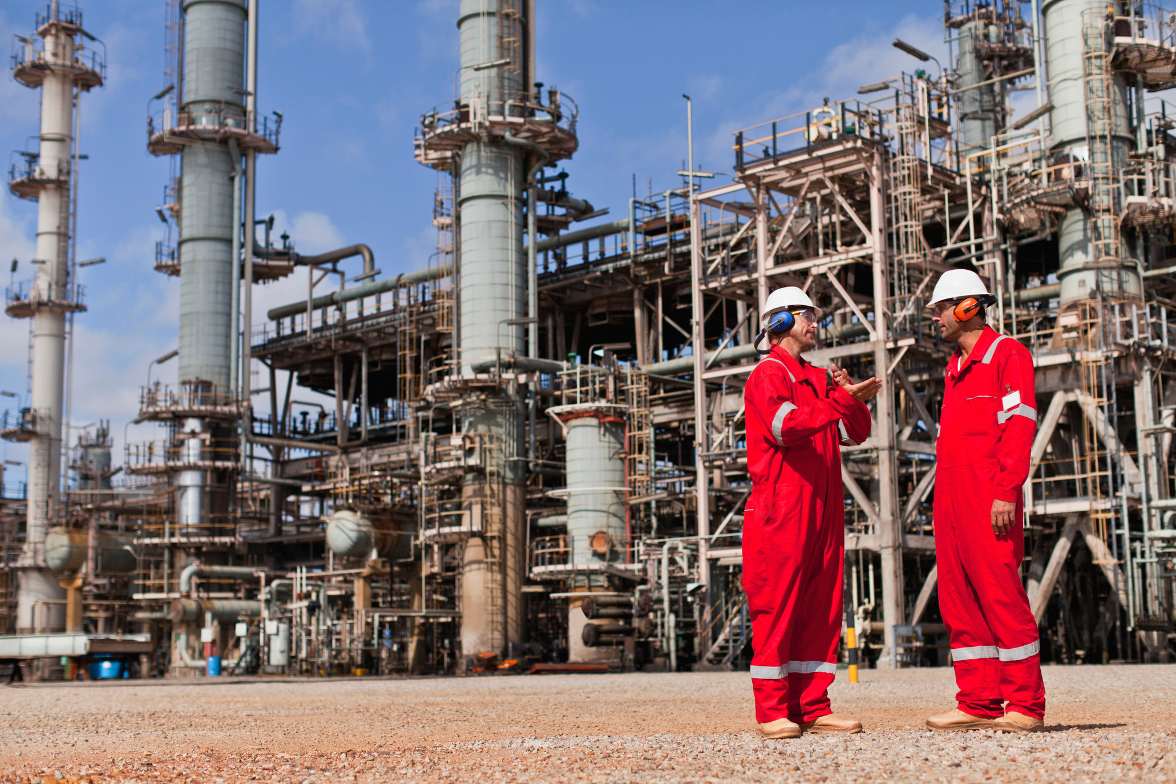

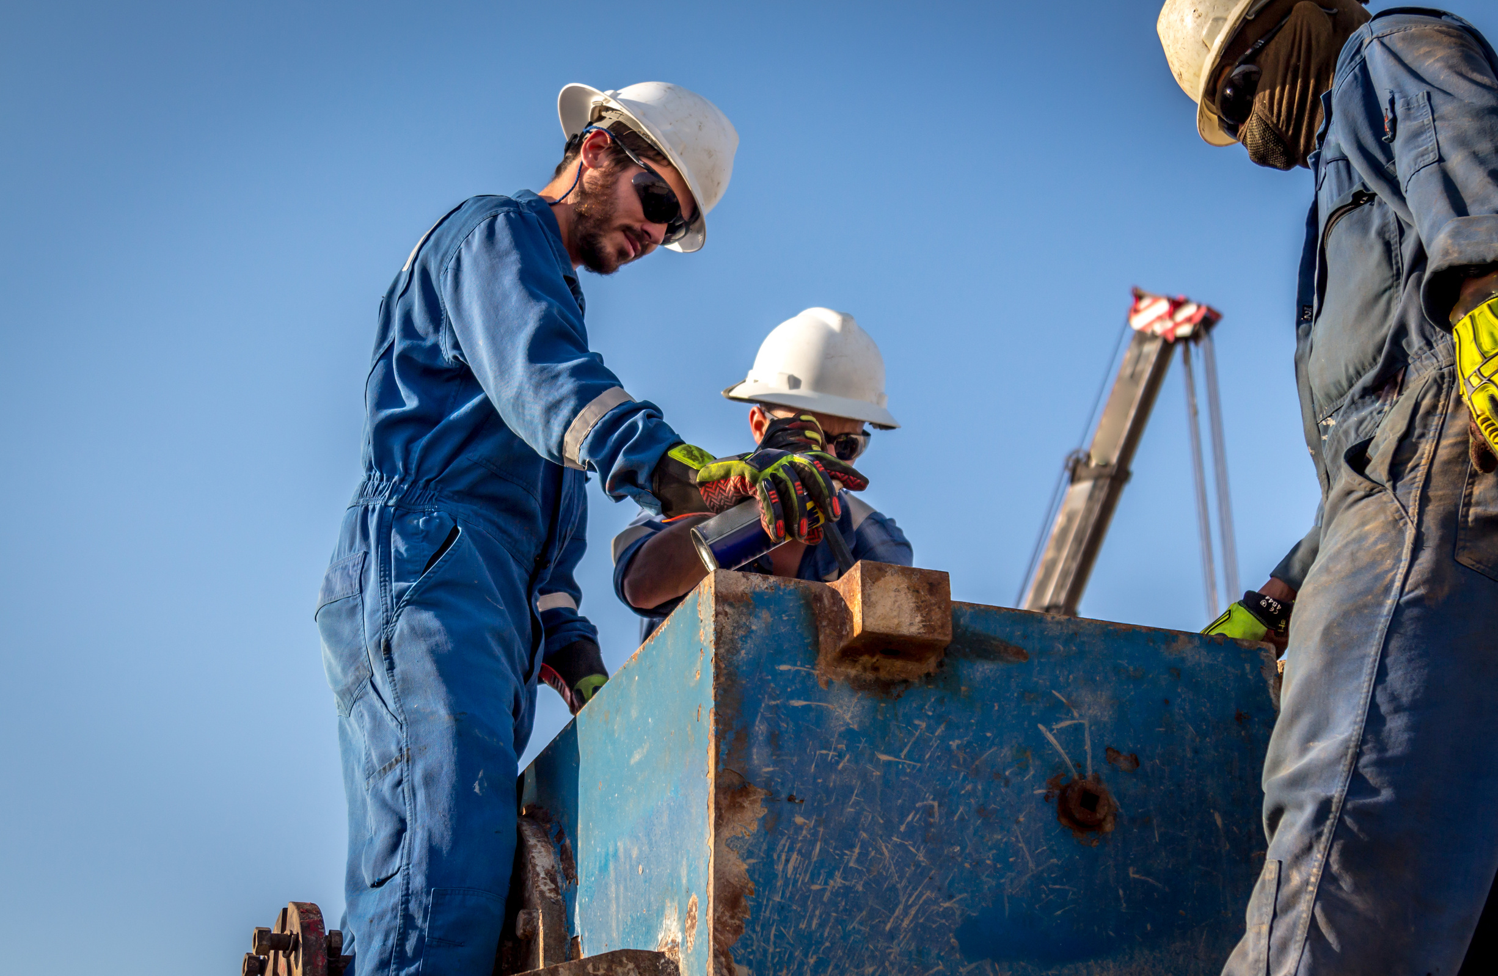
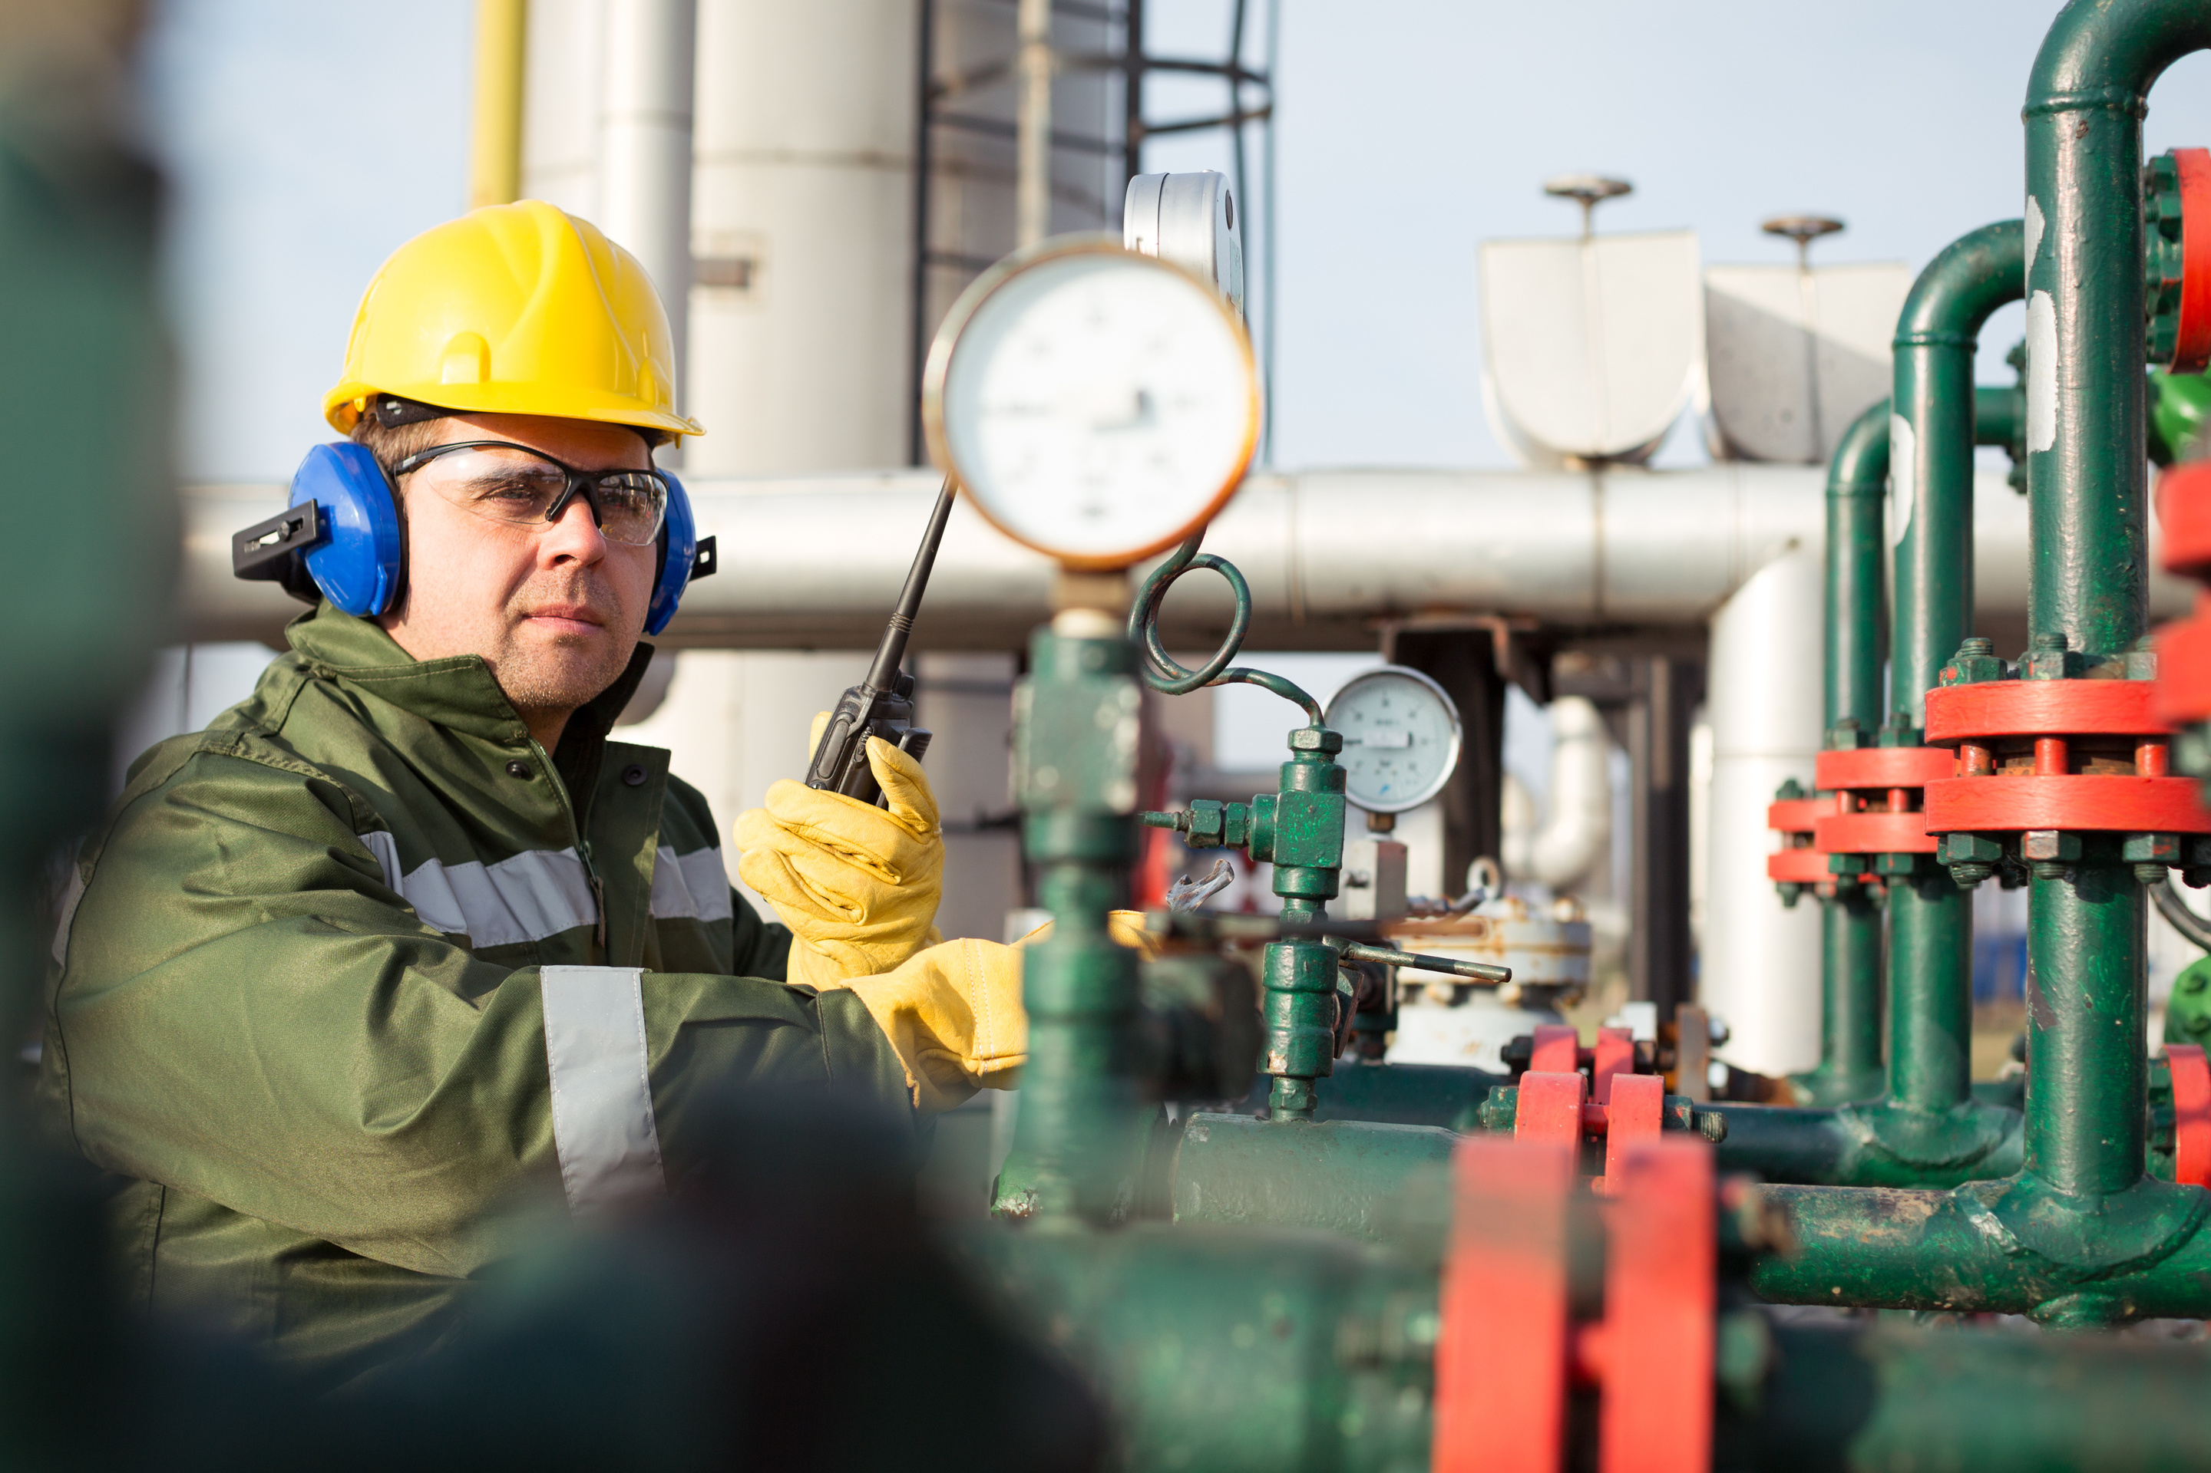
495,501
Notes:
Nearly HALF a MILLION Texans employed by this industry. And jobs in the Texas oil and natural gas industry are not your ordinary job.
And these are good paying jobs. Those employed by this industry earn an average of $133,095 a year – 68% more than the average paid by the rest of Texas’ private sector
Conservative estimates indicate that each of these jobs generates approximately two more jobs, with nearly 1.4 million total jobs supported across the Texas economy. ​
Some economists say this number could be as high as three more jobs supported and total over 2 million jobs in Texas.​

Slide 7

31%
Notes:
Almost 1/3 of the state’s private sector is because of the successes of this industry!
There is no denying the enormous impact and benefits of this industry across the Lone Star State.

Slide 8

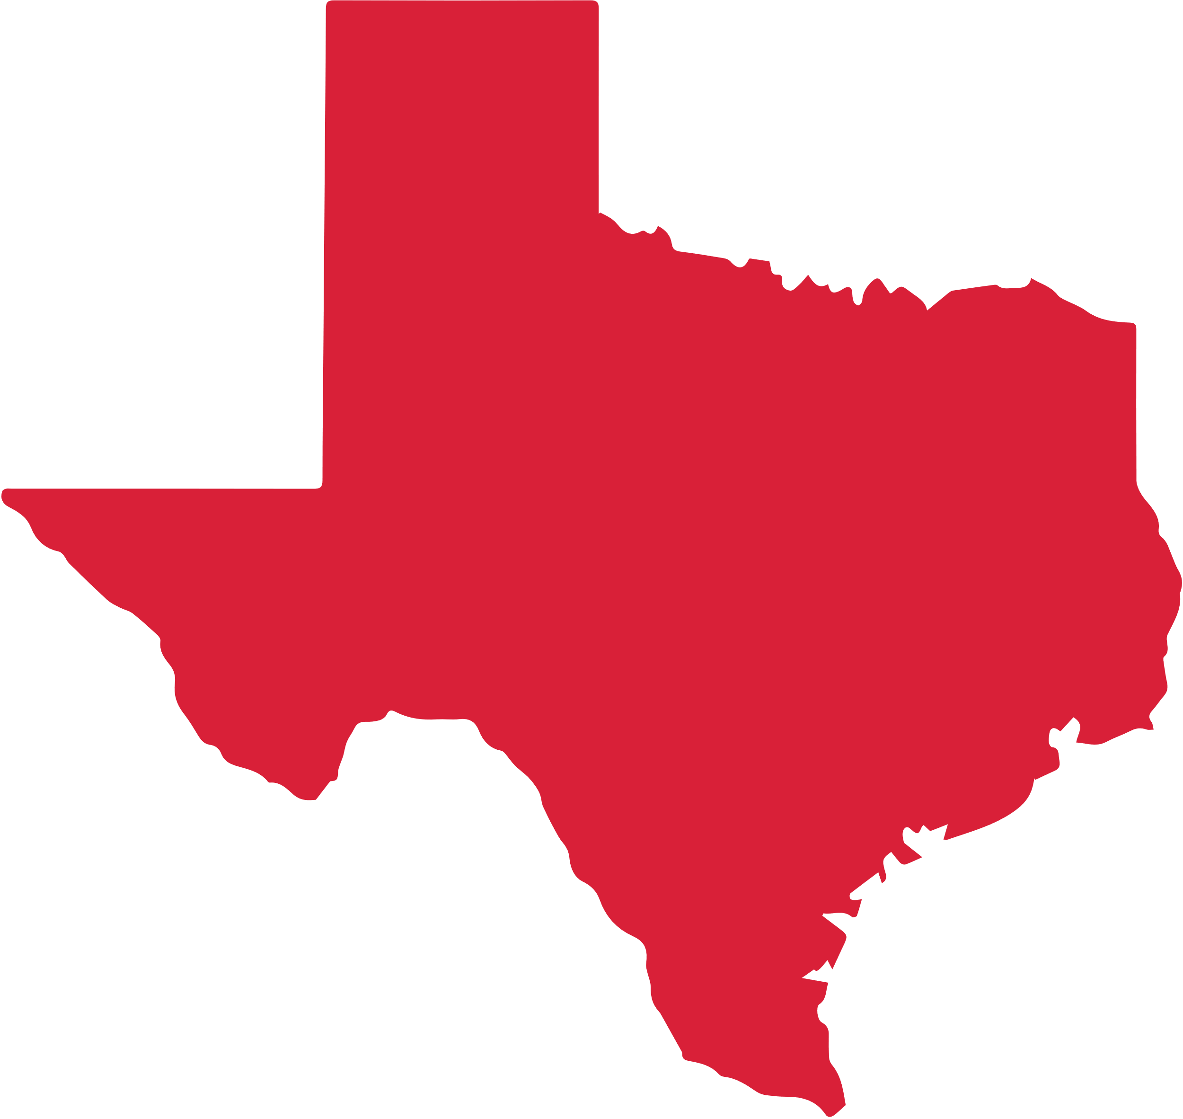
Notes:
Some people look at Texas and see this scene, as to how we fit on the national landscape.

Slide 9
Notes:
When I view Texas role in our country, this is the way the map looks to me!

Slide 10
43%
crude oil
29%
natural gas
34%
refining capacity
23%
pipeline miles
of U.S. totals
Notes:
IN FACT, If Texas were a country, it would be the 3rd largest natural gas producer and 4th largest crude oil producer in the world.
For the first half of 2025, Texas accounted for:
42.9% of U.S. crude oil production
29.6% of U.S. marketed natural gas production
34.4% of U.S. refining capacity
23.2% of U.S. pipeline miles

Slide 11

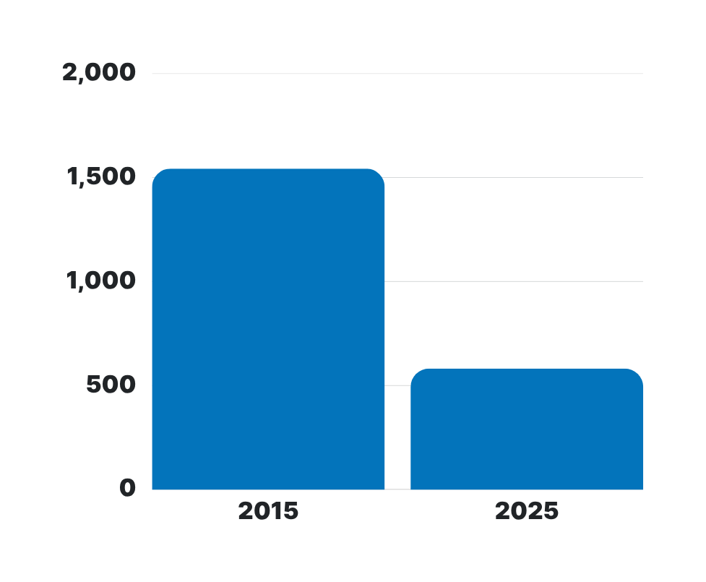
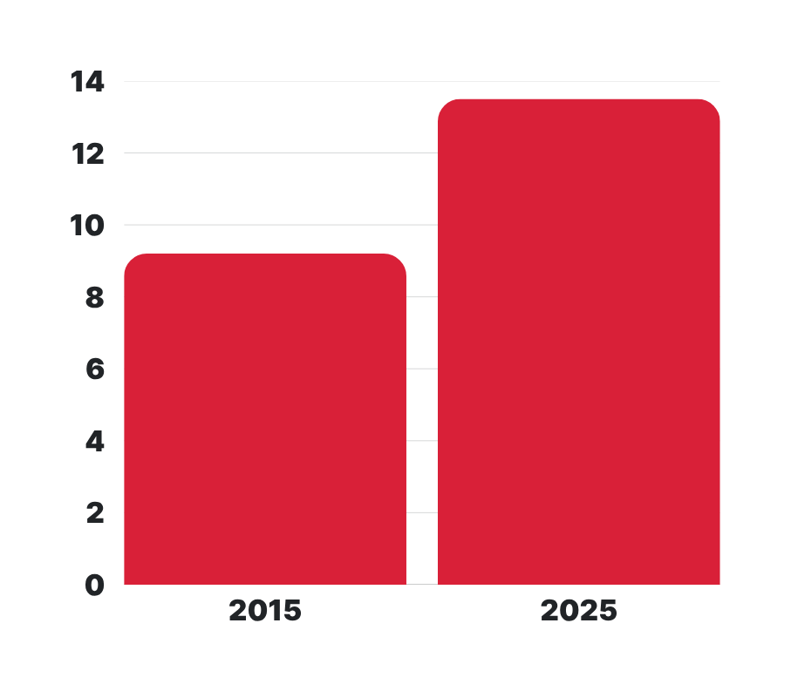
DOING MORE WITH LESS
Oil & Gas Rigs
Million Barrels of Oil per Day
Notes:
Nothing demonstrates better how this industry has advanced than the production and rig count numbers.
In January 2015, 1,543 rigs were running and crude oil production was 9.2 mb/d.
In January 2025, 582 rigs were running producing 13.5 mb/d!
63% fewer rigs running and 47% more production!

Slide 12
NATURAL GAS EXPORTS
CURRENT EXPORTS
NEW FACILITIES
CAPACITY UNDER
CONSTRUCTION
including exports from both pipeline and liquefied natural gas*
liquefaction facilities (trains) located
among three different projects
7
13.0
8.0
bcf/d
bcf/d
*Texas defined based on U.S. International Trade Commission Export Zone Definitions
Notes:
Our state and nation are not the only benefactors of our robust production and infrastructure. Texas is leading the way in natural gas exports, sending 13 billion cubic feet per day (bcf/d) to all corners of the globe.
And with 7 new facilities on the way, our state stands to gain a whopping 8 bcf/d in additional capacity.
These exports don’t just fill demand – they build confidence.
For our allies abroad, Texas’ responsible production, transparency and dependable logistics have made America the reliable supplier the world needs. Texas has proven it can deliver, and demand remains high among our allies who value U.S. energy security and stability.

Slide 13
Natural Gas Pipelines
45.2 bcf/d
OPEN SEASON!
Notes:
New Texas natural gas pipelines announced or under construction:
Total 45.2 bcf/d, including
Under construction (23.7 bcf/d) Approved (12.5 bcf/d)
Pre-applied & Applied (4.8 bcf/d)
Announced (4.1 bcf/d)
Disclaimer: “Many pipeline projects conduct an open season to secure shipper commitments before a final investment decision, but the timing and structure vary by project."

Slide 14
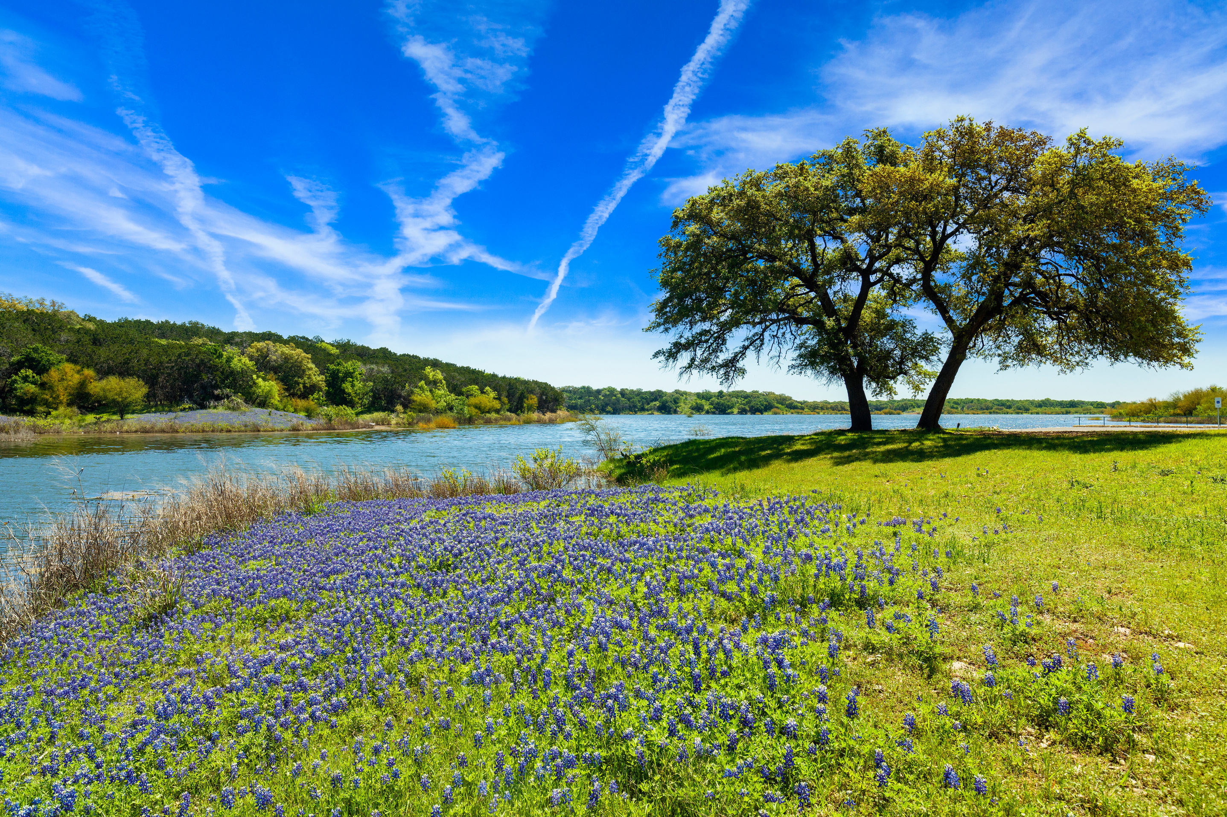
ENVIRONMENTAL PROGRESS
FLARING
INTENSITY
OIL & GAS
PRODUCTION
Notes:
While production is soaring, emissions are down!

Slide 15

ENVIRONMENTAL PROGRESS
50%
REDUCTION IN METHANE
INTENSITY FROM 2022-2024
Notes:
Oil and natural gas operators in the Permian Basin reduced their operations’ methane intensity by more than 50% in the past two years.
This dramatic emissions reduction comes amid soaring production from one of the most prolific basins from the world, responsible for nearly half of U.S. oil production and almost a third of U.S. natural gas production.
SOURCE: https://press.spglobal.com/2025-07-24-Methane-Emissions-Intensity-of-Permian-Basin-Declined-by-More-than-Half-in-Two-Years,-New-S-P-Global-Commodity-Insights-Analysis-Finds

Slide 16
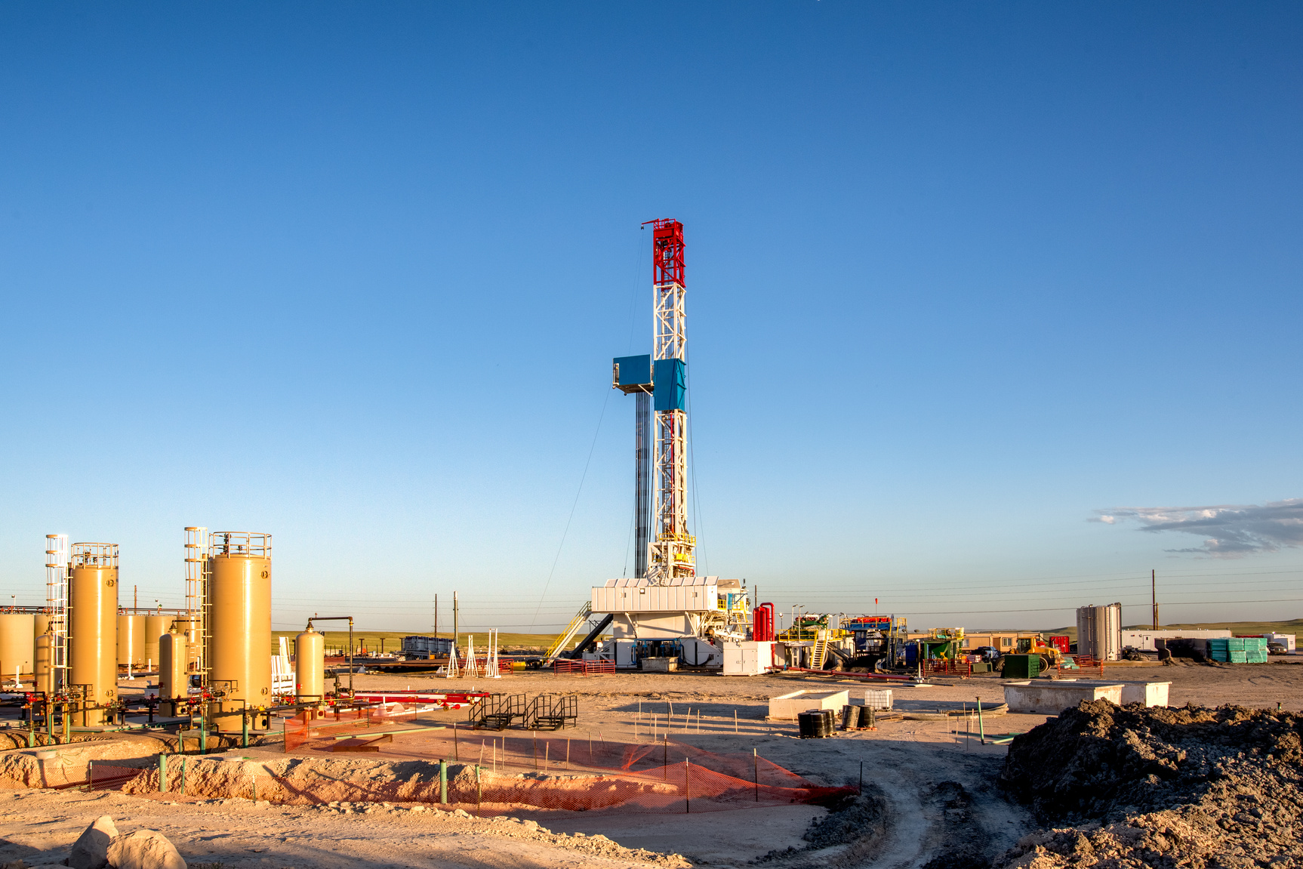
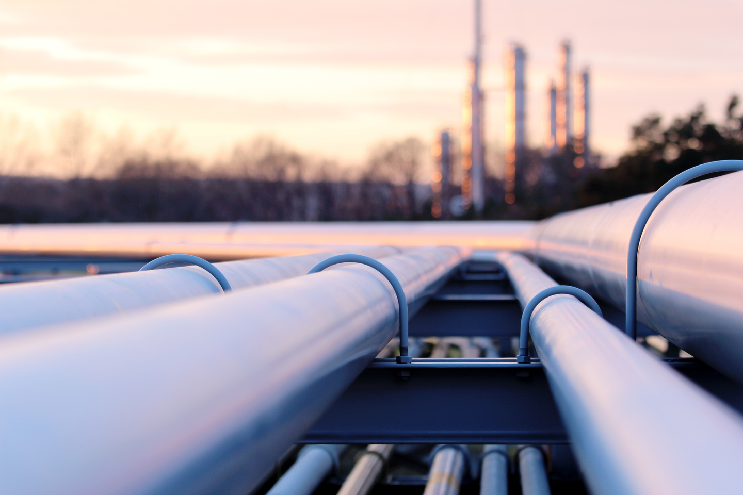
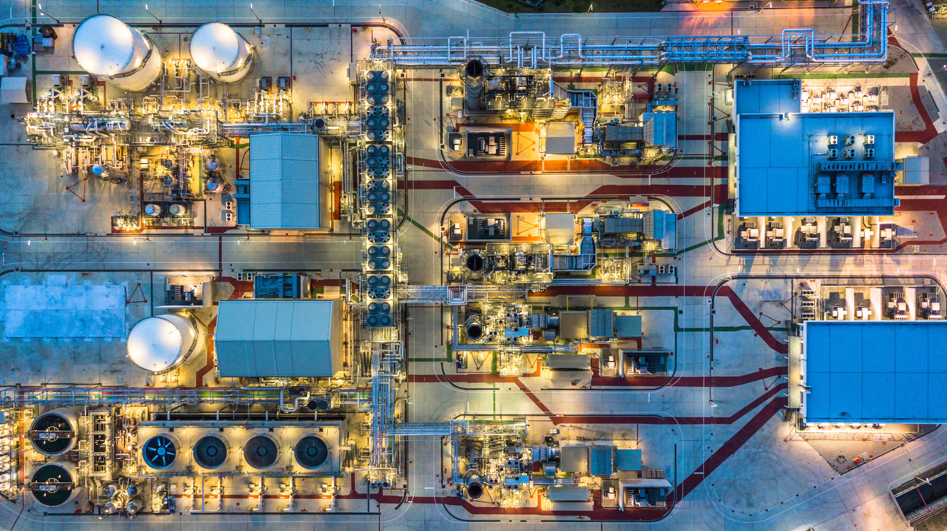
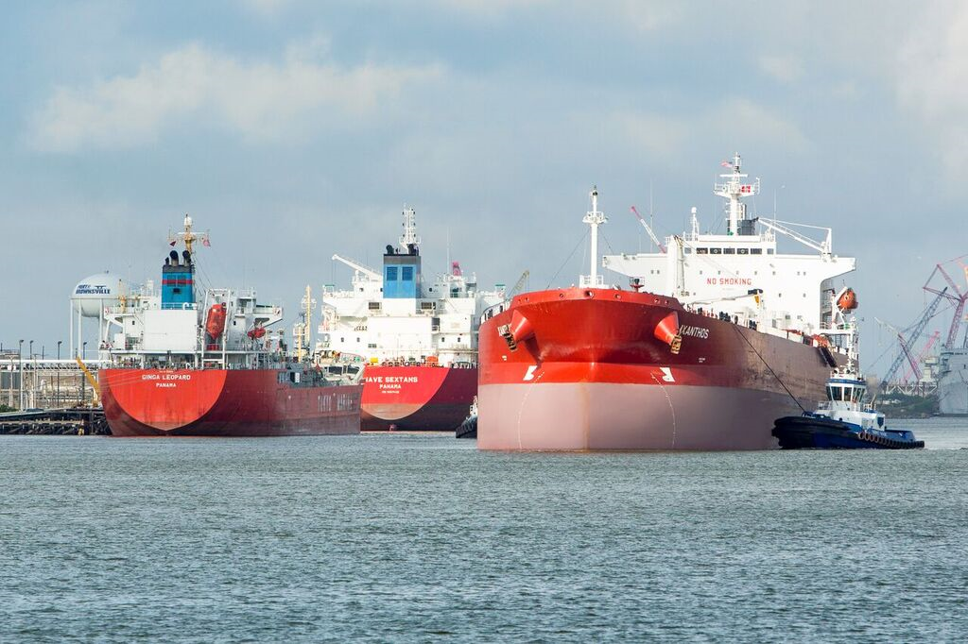
PRODUCTION
PIPELINES
PROCESSING
PORTS
Notes:
All of these amazing numbers are not attributable to just one aspect of our industry. ONLY POSSIBLE BECAUSE OF INFRASTRUCTURE. RIGHT NOW, SAUDI ARABIA, LIBYIA, KUWAIT, UAE, QATAR, RUSSIA ALL TRYING TO PRODUCE MORE SO THAT AMERICA PRODUCES LESS! AMERICA MUST REMAIN THE WORLD’S ENERGY LEADER…AND TEXAS MUST REMAIN THE TIP OF THE SPEAR.
The Four P’s, all work together in a complex and interconnected system. From the initial extraction of resources (Production), to the safe and efficient transportation (Pipelines), the refining and transformation of raw materials (Processing), and finally, the crucial link to global markets (Ports), every step is essential. It's this synergy and collaboration across all four areas that allows us to achieve such remarkable results and deliver the resources the world needs.

Slide 17
WHY IS THIS
IMPORTANT?
Notes:
Oil & Gas plays an outsized role in our economy and the state’s economic performance.​
​
Ad Valorem Taxes are so significant to the industry to you that you have our own conference! But industry’s portion of the property tax pie is becoming greater and greater.​
​
The drive to lower Property taxes is strong! But the focus and easiest route is to exempt value from rooftops. This shifts the property tax burden to business.. ​

Slide 18
Business Tax Burden
63%
58%
Local Property Taxes
State and Local Taxes
Notes:
Based on the Comptroller’s FY25 data, Texas businesses paid 63% of local property taxes and 58% of total state and local taxes.​
​
We must continue to educate lawmakers about the importance of a fair and equitable tax system that keeps everyone together.

Slide 19
WHAT CAN YOU DO?
Notes:
What can we do?

Slide 20
WHAT CAN YOU DO?
VOTE!
Early Voting: Feb. 17 – Feb. 27 | Election Day: Mar. 3
Notes:
VOTE!
Participating in elections is one of the most important things you can do as a Texan.
Find your polling location, do a little research on the candidates, and then make time to go vote:
early in the morning, midday during a lunch break, in the evening after work.
The polls are even open on Saturday and Sunday during early voting.

Slide 21
WHAT CAN YOU DO?
BECOME AN
ENERGY
CHAMPION!
Notes:
ACT!
Visit with your local elected officials.
Become an ambassador for the oil and natural gas industry. It’s not just about taxes…but all policies impact the MATH!
Good Public Support = Good Policies = Good Math

Slide 22








SCAN
TO JOIN
Find us on:
TXOGA.ORG
Notes:
I encourage you to join our community of energy advocates.
All you have to do is scan this QR code and you'll gain access to exciting and useful updates about the Texas oil and natural gas industry and get information about upcoming TXOGA events.

Slide 23



txoga
talks
PODCAST
SCAN TO LISTEN
WHERE ENERGY MEETS INSIGHT
Tune in for candid conversation about our energy needs, our energy security, and your energy future. Texas oil and natural gas have made our nation the world's energy leader, constantly innovating and investing to fuel the economy, protect the environment, and power the world. This industry is fast-paced, hi-tech, and essential to improving modern life, and we're here to talk about it!
Notes:
I promise we won't spam you!
I also encourage you to follow us on social, where we share great information like economic insights, our TXOGA Talks podcast, interesting oil and gas news stories, and more!

Slide 24
Find us on:
TXOGA.ORG

