Slide 1
Indirect Taxes – The Best (and Worst) from a State Tax Policy Perspective
Mark Holmes,
Tax Counsel - COST

Slide 2
Agenda
Introduction to COST/STRI
Business SALT Tax Burden Study
Reason for COST Scorecards
COST’s Scorecards
Administrative Scorecard
Sales Tax Scorecard
Property Tax Scorecard
Unclaimed Property Scorecard
Other Legislative Improvement Efforts
Q & A

Slide 3
Introduction to COST’s Advocacy & Advocacy Staff
What is COST?
The Council On State Taxation (COST) is the premier state tax organization representing taxpayers. COST is a nonprofit trade association consisting of approximately 500 multistate corporations engaged in interstate and international business.
Mission:
COST's objective is to preserve and promote equitable and nondiscriminatory state and local taxation of multijurisdictional business entities.
WA
MT
ND
ME
Dylan Waits
OR
MN
VT
ID
WI
NH
Mark Holmes
SD
MI
NY
MA
WY
CT
NV
NE
IA
PA
NJ
CT
Leonore Heavey
UT
IL
IN
OH
MD
RI
CA
CO
WV
VA
Fred Nicely
Aziza Farooki
KS
MO
KY
NJ
TN
NC
DE
AZ
NM
OK
AR
SC
MD
AK
MS
AL
GA
DC
TX
LA
FL
COST’s advocacy program…
focuses on active engagement in state tax issues that matter to its members
represents corporate taxpayers in legislative, judicial, and administrative arenas
widely respected by groups such as the National Conference of State Legislatures, the Federation of Tax Administrators, the National Governors Association, and the Multistate Tax Commission
serves as a resource to state chambers of commerce, taxpayer associations, and other organizations on business tax matters
shares updates on legislative, judicial, and regulatory developments, coordinates advocacy with members and allies
files amicus briefs, provides testimony, meets with policymakers, and facilitates collaboration among members on targeted issues
HI

Slide 4
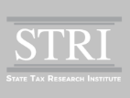
State Tax Research Institute (STRI)
The State Tax Research Institute (STRI) is a 501(c)(3) organization established in 2014 to provide educational programs and conduct research designed to enhance public dialogue relating to state and local tax policy. STRI is affiliated with the Council On State Taxation (COST).
Revisiting the Debate Over State Taxation Of Foreign-Source Income by Frieden & Lindholm, Tax Notes State, June 2025
The Boomerang Effect of the Business ‘Fair Share’ Tax Debate by Frieden, Tax Notes State, February 2025
Total State and Local Business Taxes: State-by-State Estimate for FY23 by Phillips and Sallee, EY, December 2024
A State DAT Relabeled a ‘Digital Barter’ Tax Is Still Bad Tax Policy by Frieden and Lindholm, Tax Notes State, August 2024
Is E-Invoicing Relevant in the US State Sales Tax Context? By Phillips, Roberti, and DeSaplo, EY, May 2024
Wearing Blinders in the Debate Over Business’s ‘Fair Share’ of State Taxes by Frieden, Tax Notes State, April 2024
Mandatory Worldwide Combined Reporting: Elegant in Theory But Harmful in Implementation by Lindholm and Wethekam, State Tax Research Institute, March 2024
State Digital Services Taxes: A Bad Idea Under Any Theory, by Frieden and Lindholm, Tax Notes State, April 2023
Five State Tax Policy Changes That Would Modernize Laws and Ease Administration and Compliance by Farooki and Nicely, Council On State Taxation, April 2023
Where in the World Is Factor Representation for Foreign-Source Income? by Frieden and Donovan, Tax Notes State, April 2019
State Tax Haven Legislation: A Misguided Approach to a Global Issue by Frieden and Hogroian, March 2016

Slide 5

COST Policy Positions
COST's advocacy is governed by a broad set of public policy objectives. When advocating on issues, COST first looks to its official policy statements, which are approved by the Board of Directors. Members interested in participating in the development of COST's policy statements are encouraged to join the Policy Committee, the body that drafts policy statements (in conjunction with COST Staff) for Board consideration. The COST Staff and Policy Committee also develop "Policy Toolkits" for COST Member government affairs personnel to use in their individual advocacy efforts on discrete issues.
Categories:
State tax administrative issues focused on ease of compliance, fairness, efficiency
Corporate income tax issues focused on constitutional overreach, fairness, efficiency
Sales tax issues – taxation of business inputs, fairness, uniformity
Property tax issues – fairness and equitability
Other issues – focused on sound tax policy principles concerning gross receipts taxes, unclaimed property, local taxes
5
Notes:
Not a no tax organization
Fair and nondiscriminatory treatment for multijurisdictional cos.
Lens – 4 categories

Slide 6
COST/STRI FY2024 State and Local Business Tax Burden Study

Slide 7
FY 2024 State and Local Business Tax Burden Study
Composition of State and Local Business Taxes by Type, FY24
United States
How Much Do Businesses Pay?
Businesses paid more than $1.1 trillion in U.S. state and local taxes in FY24, an increase of 4.7% from FY23
State business taxes increased by 4.0% and local business taxes grew by 5.5%
In FY24, business tax revenue accounted for 45.8% of all state and local tax revenue
Property Taxes on Business Property
General Sales Taxes on Business Inputs
Business Income Taxes (CIT+GRT+PIT)
Excise Tax
License and Other Taxes
Unemployment Insurance Tax
Note: Business income taxes include corporate income tax (CIT), gross receipts taxes (GRT), and individual income tax on business income (PIT).
Source: Total State and Local Business Taxes: State-by-State Estimates for FY24, prepared by Ernst & Young for COST and STRI, December 2025

Slide 8
FY 2024 State and Local Business Tax Burden Study
Composition of State and Local Business Taxes by Type, FY24
Texas
How Much Do Businesses Pay?
Businesses paid over $108 billion in Texas state and local taxes in FY24, an increase of 1.8% from FY23
In FY24, business tax revenue accounted for 59.5% of all state and local tax revenue in Texas
Property Taxes on Business Property
General Sales Taxes on Business Inputs
Business Income Taxes (CIT+GRT+PIT)
Excise Tax
License and Other Taxes
Unemployment Insurance Tax
Note: Business income taxes include corporate income tax (CIT), gross receipts taxes (GRT), and individual income tax on business income (PIT).
Source: Total State and Local Business Taxes: State-by-State Estimates for FY24, prepared by Ernst & Young for COST and STRI, December 2025

Slide 9
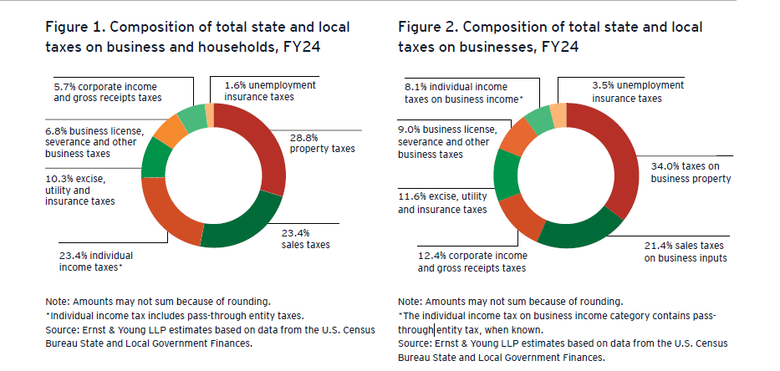

Slide 10
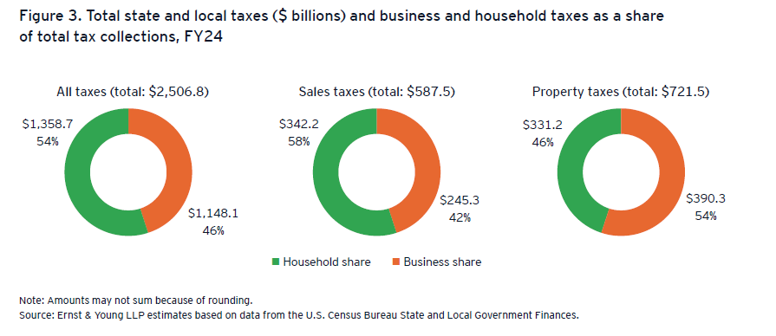

Slide 11
Estimated “Excess” Business Property Taxes and Pyramided Sales Taxes on Business Inputs FY24
Amount the Largest State and Local Business Taxes Exceed Taxes Based on Deviation from Neutral Tax Design, FY24 ($ billions)
 | Estimated Business Tax Paid (EY) | Estimated Tax if Business Property Is Taxed at Homeowner ETR/ tax base; and SUT on Non-Pyramided Business Inputs | Excess Tax Based on Neutral Tax Design
Property Tax on Business Property | $390.3 | $249.0 | $141.4
Sales Tax on Business Inputs | $245.3 | $124.8 | $120.5
Total Selected Taxes | $635.6 | 373.8 | $261.8
Source: Total State and Local Business Taxes: State-by-State Estimates for FY24, prepared by Ernst & Young for COST and STRI, December 2025
Ernst & Young LLP estimates based on data from the Bureau of Economic Analysis, the U.S. Census Bureau Annual Survey of State and Local Government Finances, and the Lincoln Institute of Land Policy/Minnesota Center for Fiscal Excellence 50-state property tax comparison study
See: Karl A. Frieden, “Wearing Blinders in the Debate Over Business’s ‘Fair Share’ of State Taxes”, Tax Notes State, April 8, 2024; and Karl A. Frieden, “The Boomerang Effect of the Business ‘Fair Share’ Tax Debate,” Tax Notes State, February 10, 2025

Slide 12
Reason for COST Scorecards

Slide 13
COST Perspective on Good Administrative Practices
COST presently has 4 Scorecards addressing the states’ administrative practices
Administrative Scorecard
Sales Tax Systems Scorecard
International Property Tax Scorecard (issued with IPTI)
Unclaimed Property Scorecard
Focus is primarily on using objective criteria of important administration with bias towards issues of concern with business taxpayers
Scorecards do not grade subjective personalities of state tax administrators
Letter grading is for comparison purposes with goal to encourage tax policy makers (e.g., legislators) to improve administrative practices
It is acknowledged and understood that tax administration varies significantly state-by-state
COST appreciate input in the process and wish to personally thank all the government administrators that answered our surveys on the states’ administrative practices

Slide 14
COST’s Administrative Scorecard

Slide 15
Scorecard on State Tax Administration: Procedural Elements Evaluated
Even-handed statutes of limitations for refunds and assessments
Equalized interest rates on refunds and assessments
Due dates for corporate income tax returns at least one month beyond the federal due date, with an automatic extension of the state return due date based on the federal extension
Adequate time to file a protest before an independent dispute forum
Reasonable and clearly defined procedures for filing amended state income/franchise tax returns following an adjustment to a taxpayer’s federal corporate tax liability
Transparency in the form of published letter rulings (redacted) and administrative/tax tribunal decisions

Slide 16
Scorecard on State Tax Administration: “Other Issues”
States or localities impinge upon taxpayer due process rights by enacting unreasonable retroactive tax legislation
States or localities participate in the fundamentally flawed State Reciprocal Program under the federal Bureau of the Fiscal Services’ Treasury Offset Program
States or localities fail to provide an effective “safe harbor” (at least 30 days) before personal income tax liability and withholding requirements attach for nonresident employees temporarily traveling in a state for work purposes
Contract with third-party auditors on a contingent-fee basis
Apply qui tam (false claims act) actions to state tax disputes
Impose any other burdensome, inequitable, or ineffective administrative practices or procedures

Slide 17
Scorecard on State Tax Administration: Top-Ranked States & Bottom-Ranked States
Top-Ranked States
Bottom-Ranked States
State | Grade
Illinois | A
Indiana | A
Montana | A
Arizona | A-
New Mexico | A-
Virginia | A-
Louisiana | B+
Ohio | B+
Wisconsin | B+
Wyoming | B+
State | Grade
District of Columbia | D-
Maryland | D-
North Dakota | D-
Delaware | D
Hawaii | D
Idaho | D
Nebraska | D
South Carolina | D
South Dakota | D

Slide 18
Scorecard on State Tax Administration: State Grades
A | 3 to 5 points
B | 6 to 8 points
C | 9 to 11 points
D | 12 to 14 points
F | More than 15 points
WA
B
MT
ND
ME
A
D-
B-
OR
MN
VT
B
ID
SD
B
NY
NH
D
D
WI
MI
C
MA
WY
B+
B-
CT
B+
RI
NE
IA
PA
NV
D
C+
B-
NJ
C
UT
IL
IN
OH
MD
DE
CA
CO
A
A
B+
WV
CT: C-
B
B-
KS
C
VA
DE: D
C+
B
MO
KY
A-
C+
B
DC: D-
NC
MD: D-
TN
C+
C
AZ
NM
OK
MA: C-
A-
B-
AR
SC
NH: C+
A-
B
D
NJ: B-
MS
AL
GA
AK
C
C-
B-
RI: C-
B-
TX
LA
VT: B-
HI: D
B-
B+
FL
C

Slide 19
COST’s Sales Tax Scorecard

Slide 20
Issues with and Methods to Keep States Focused on Correctly Expanding the Sales Tax Base
Ideally, Sales/Use Taxes should apply primarily to final household consumption and exempt business inputs
Sales tax base expansion efforts should focus on B-to-C transactions and avoid taxation of additional B-to-B transactions
Uniform definitions make the administration and collection of the tax for both business and the states more efficient and accurate
Centralized tax administration reduces administrative burdens
Some states have too many local jurisdictions
Some states have separate local sales tax bases

Slide 21
State Sales Tax Systems: COST Categories for Grading States
The Best & Worst of State Sales Tax Systems: COST Scorecard on Sales Tax Simplification, Uniformity and the Exemption of Business Inputs
December 2022 (Update coming)
Scorecard Categories
Exemption for Business Inputs
Taxation of Software and Digital Products
Sales Tax Simplification and Uniformity
Centralized Sales Tax Administration
Fair Sales Tax Processes
Reasonable Tax Payment/Credit Administration
Fair Audit and Refund Procedures
What the Scorecard Does Not Grade
Tax Rate Differences
Tax Base Breadth (other than Taxing B-to-B Inputs)

Slide 22
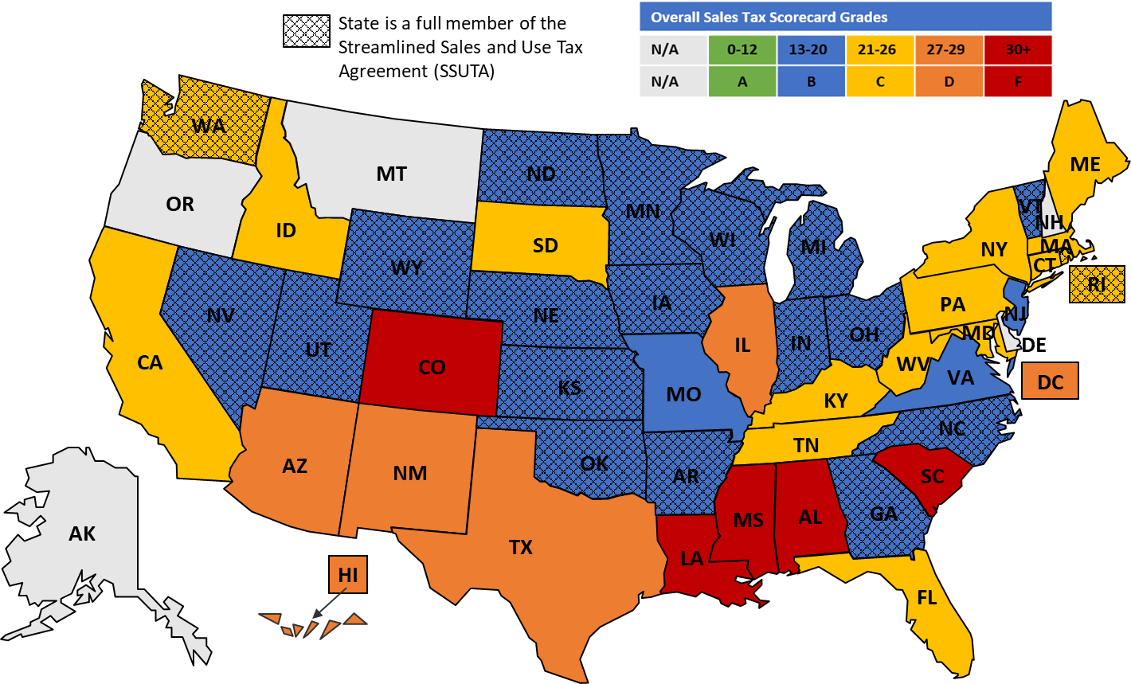
States Overall Grade on COST’s Sales Tax Scorecard

Slide 23
State Taxation of Business Inputs

Slide 24
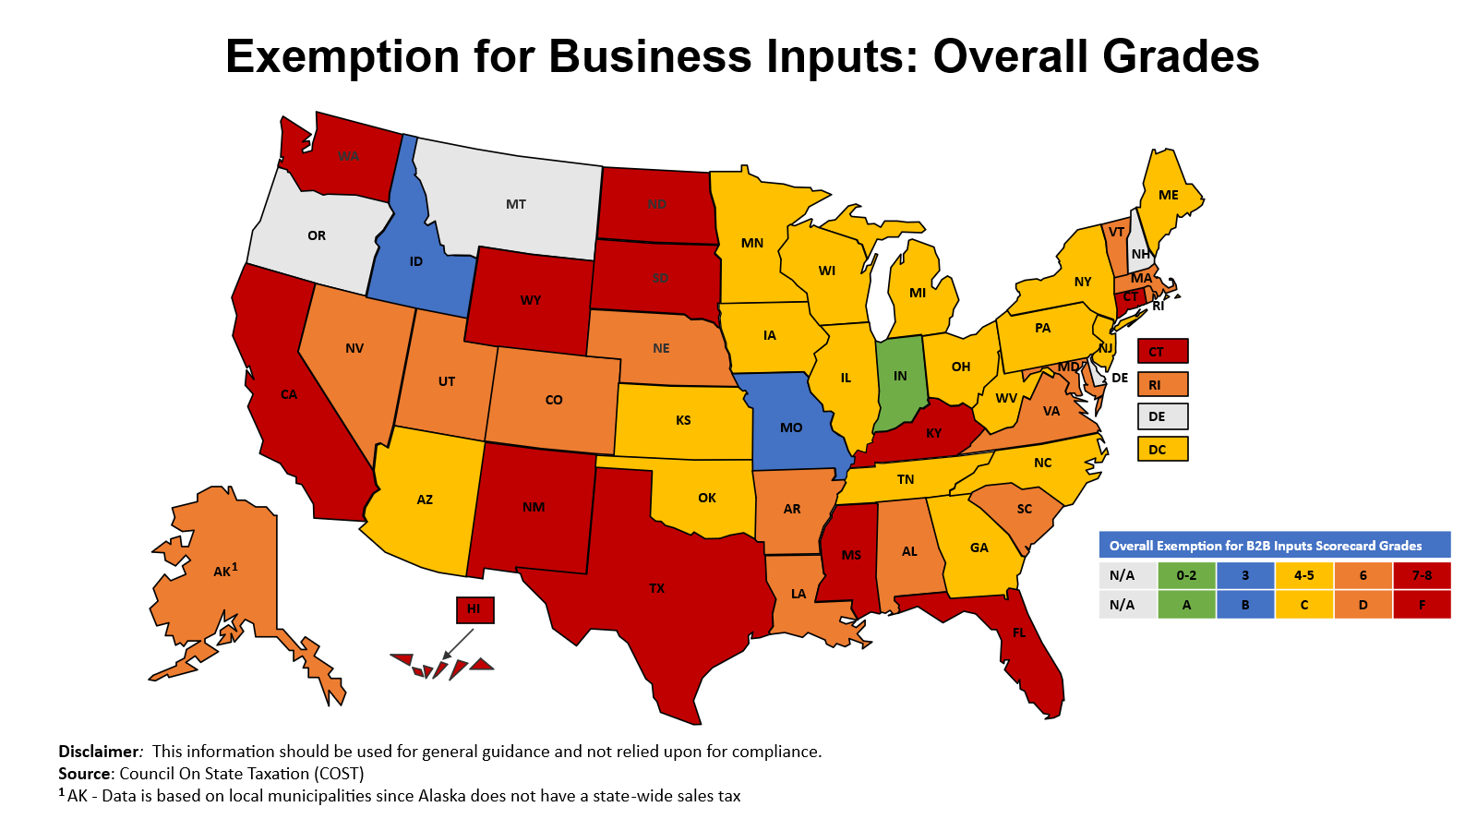

Slide 25
The Sales Taxation of Business Inputs
For the last four decades, the sales tax on business inputs contributed slightly over 40 percent of all state and local sales tax revenue.
The business inputs share of sales tax revenue ranged from a low of 32 percent (Idaho and Indiana) to a high of 58 to 60 percent (South Dakota, Wyoming, and New Mexico).

Slide 26
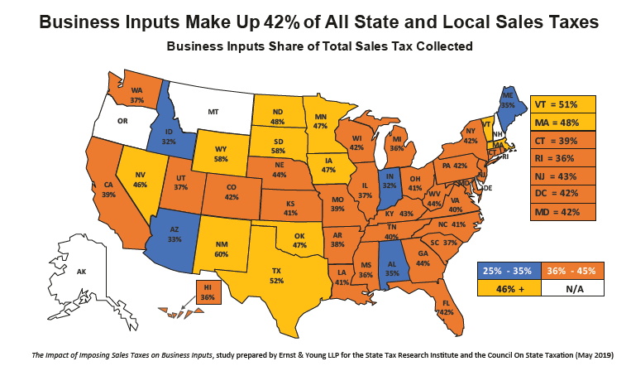

Slide 27
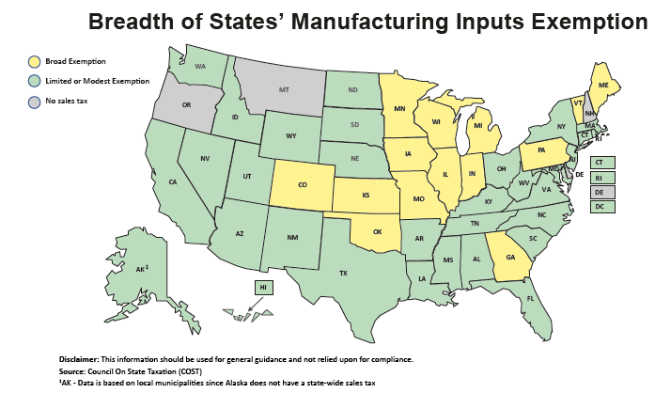

Slide 28
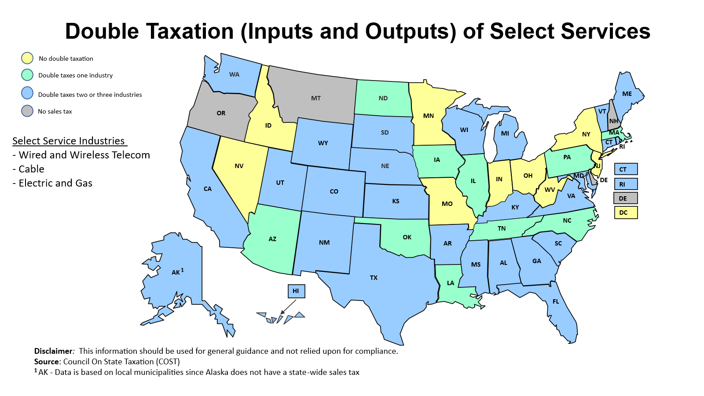

Slide 29
Taxation of Software & Digital Products

Slide 30
The Sales Taxation of Digital
Business Inputs
COST researched the sales taxation of both consumer and business purchases of software and digital products in six categories:
Canned software (including electronic delivery)
Custom software
Digital software accessed remotely (SaaS)
Digital information services
Data processing services
Specified digital products (video, audio, books)
The sales taxation of business inputs is not unique to digital commerce – but as states look to expand their tax bases to more digital products and services – the negative consequences of taxing digital business inputs need to be better understood.

Slide 31
The Sales Taxation of Digital
Business Inputs
Key finding: the sales taxation of business purchases of digital products (e.g. digital business inputs) is not just commonplace, but the overwhelming norm among states that tax software and digital products.
In each of the six categories of software and digital products, over 90% of the taxing states include both business and consumer purchases in the sales tax base.
In each category, no more than two states provide an exemption for digital products purchased by business.
Currently only one state (Iowa) has a broad exemption for business purchases of software and digital products, three states have narrow exemptions (Maryland, New Jersey and Washington), and one state has a reduced rate for business purchases (Connecticut).

Slide 32
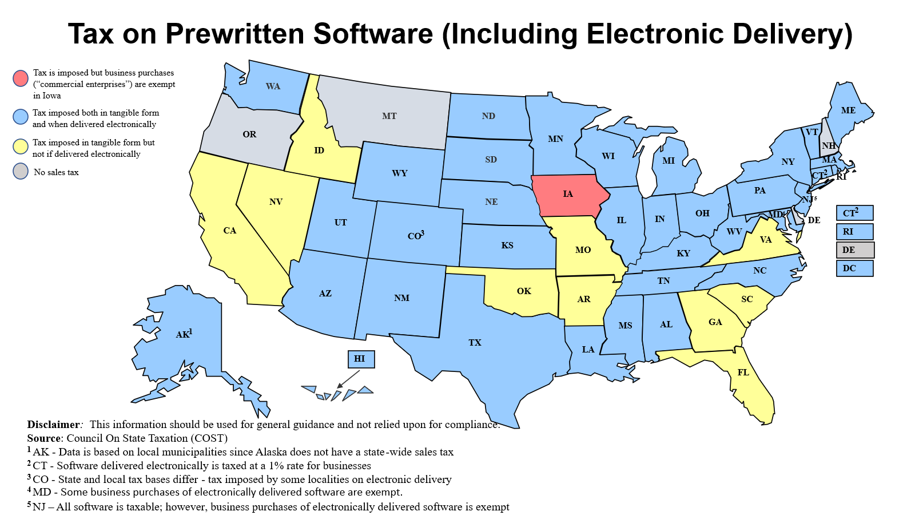

Slide 33
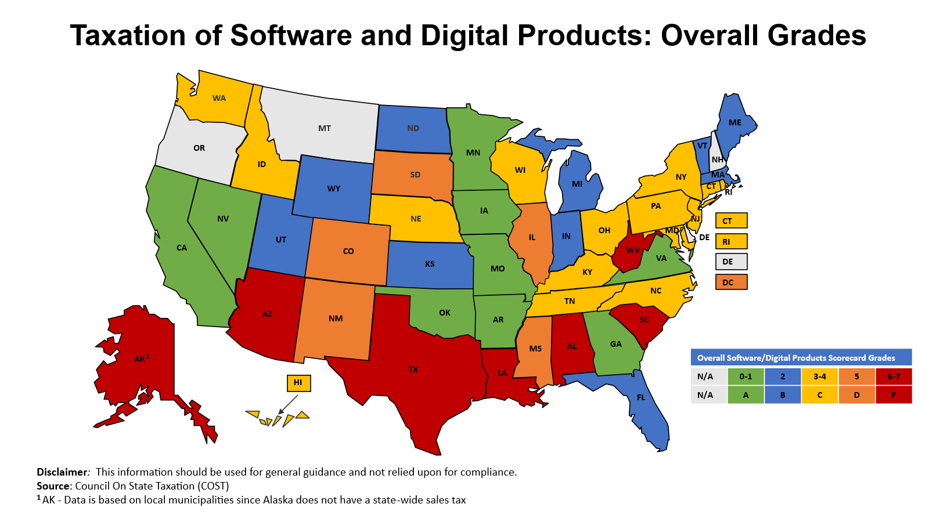

Slide 34
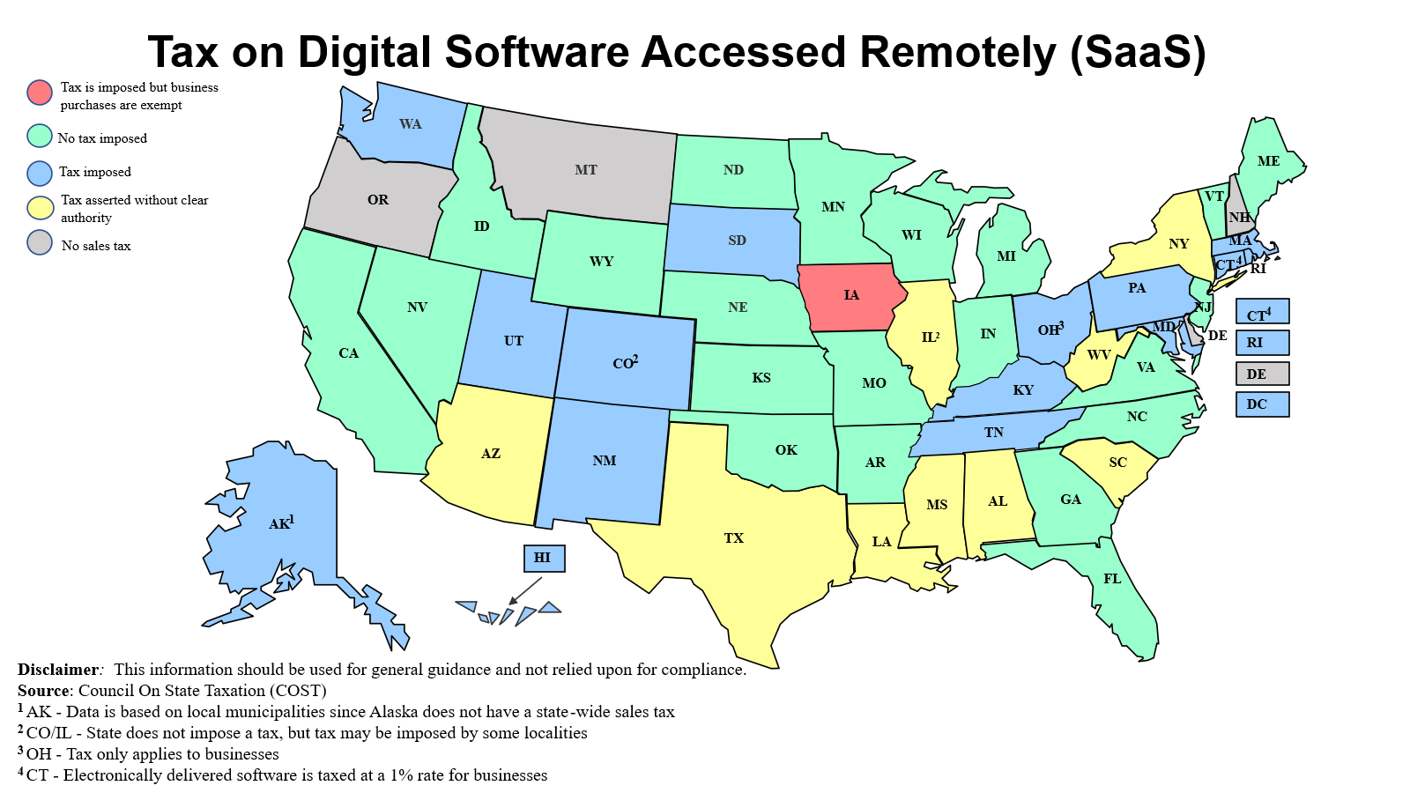

Slide 35
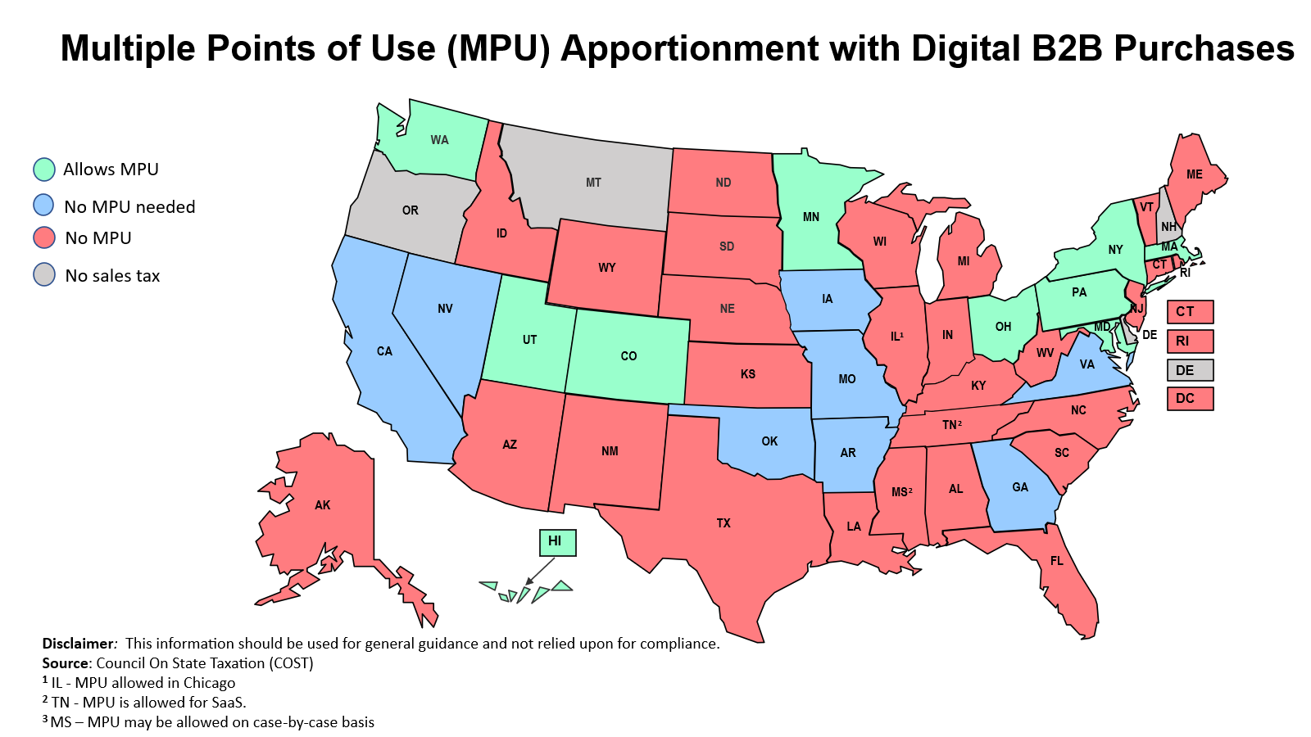

Slide 36
Sales Tax Simplification and Uniformity

Slide 37
Simplification and Uniformity Issues
The simplification and uniformity category of the Scorecard reflects the participation of states in the SSUTA and the adherence of states to model marketplace facilitator laws.
SSUTA states have committed themselves to working with other states and the business community to ease the burdens imposed on sellers to collect the states’ sales taxes.
All states have enacted marketplace facilitator legislation. In our analysis of a state’s marketplace facilitator law, we looked to the National Conference of State Legislatures model legislation as our guide.
Each state’s remote dollar and transaction threshold for imposing a collection responsibility on remote sellers was also reviewed.
A dollar threshold should exclude sales for resale —by using retail or taxable sales—and not use gross sales. A state should also not use a transaction threshold, as it creates complexity in the collection process for both small retailers and tax administrators’ collection and remittance of de minimis tax amounts.

Slide 38
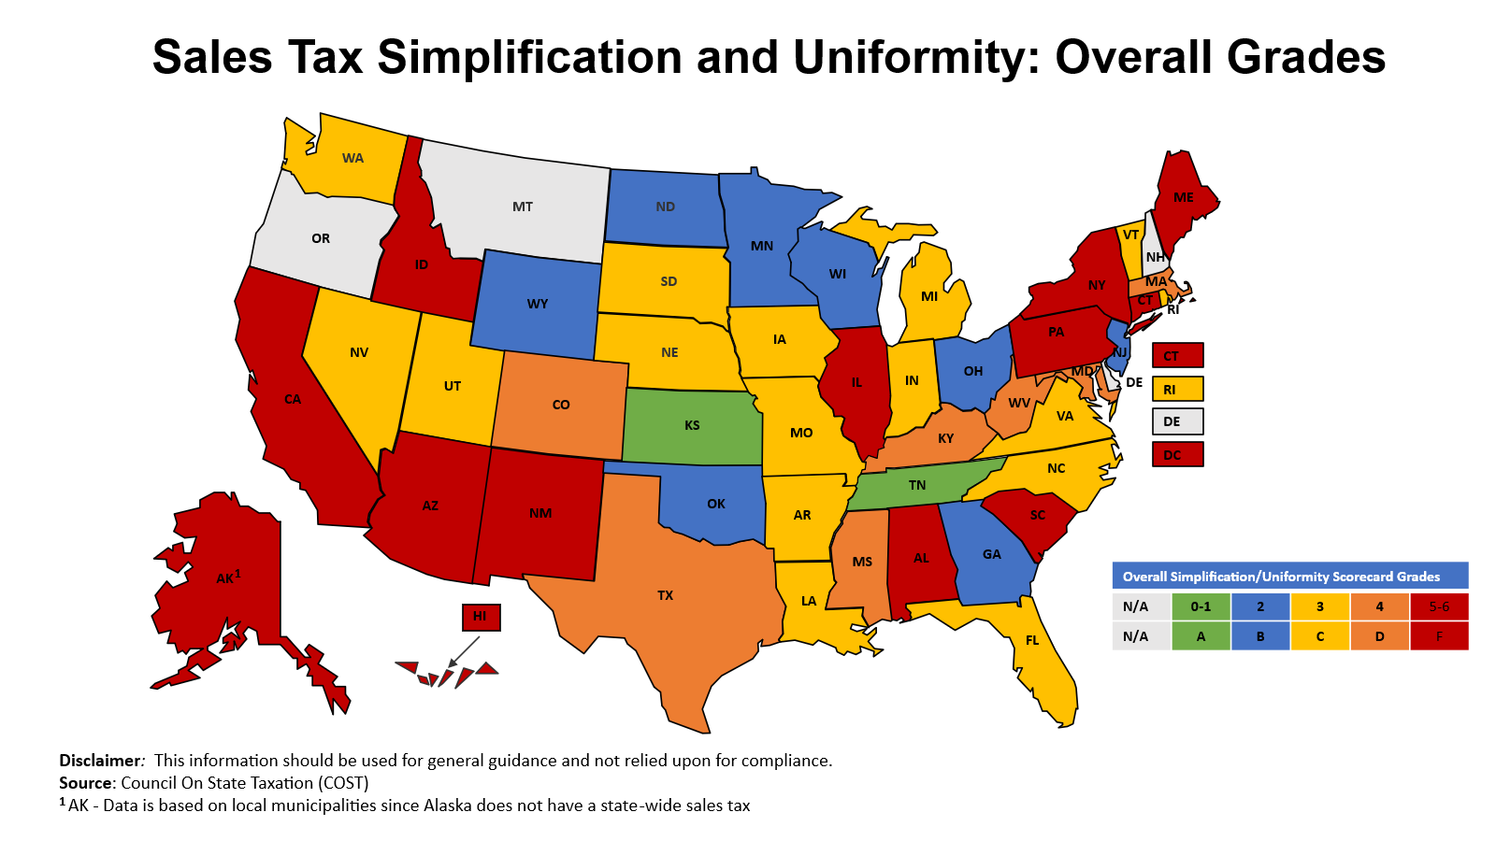

Slide 39
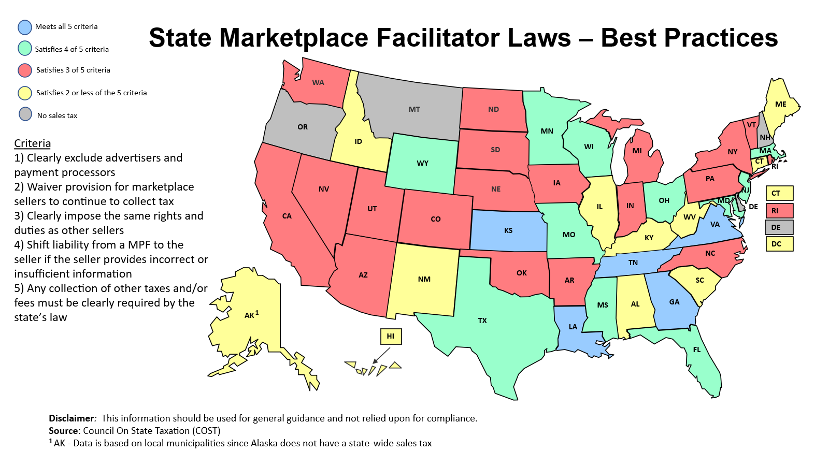

Slide 40
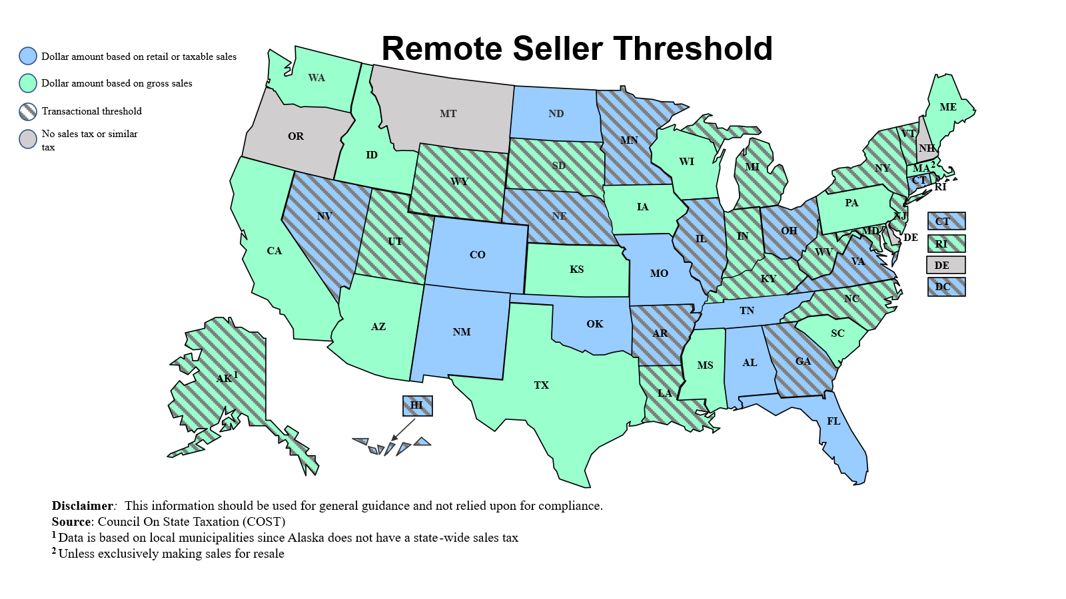

Slide 41
Centralized Sales Tax Administration

Slide 42
Centralized Sales Tax Administration Issues
One of the biggest burdens on sellers is the wide divergence among states in tax bases, taxable product definitions, and the rules and administrative procedures for collection and remittance.
This task is compounded by those states that allow local taxing jurisdictions to use a different tax base, separately administer the tax, and/or allow a multitude of local jurisdictions.
States with local administration of sales taxes (e.g., Alabama, Colorado, and Louisiana), switches to central administration (with uniform bases) would generally improve their score by at least one grade.

Slide 43
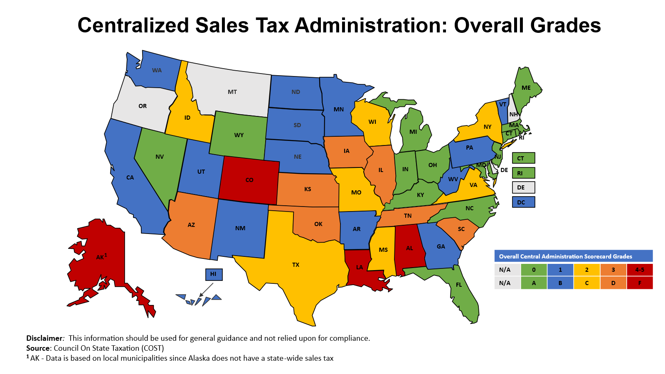

Slide 44
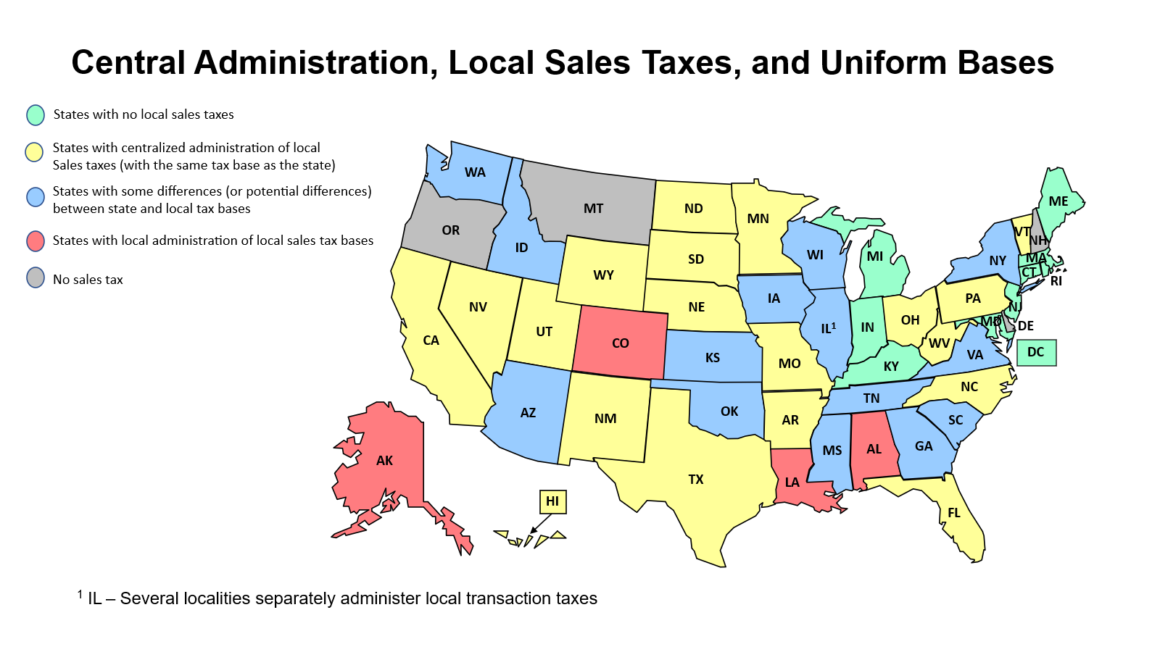

Slide 45
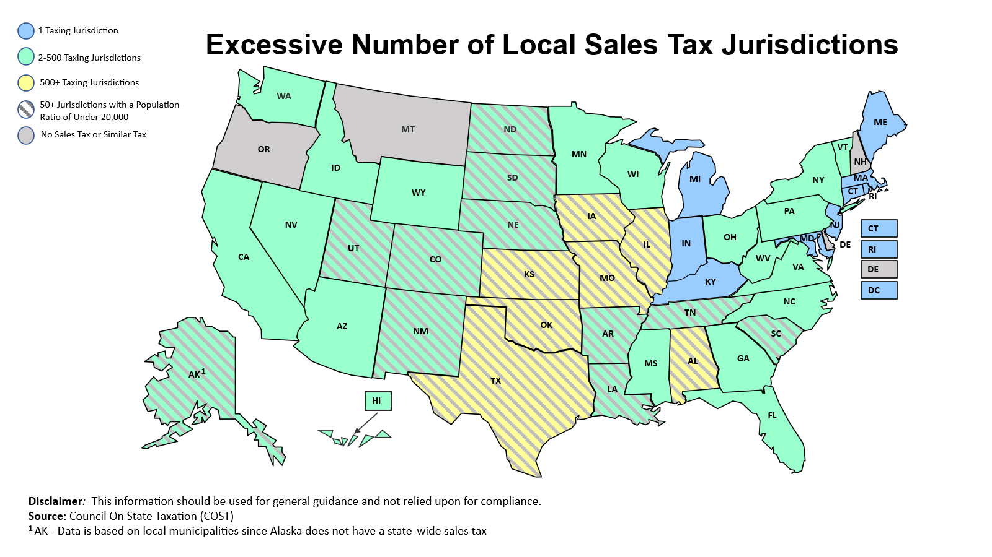

Slide 46
Fair Sales Tax Processes

Slide 47
Fair Sales Tax Processes Issues
States’ acceptance of uniform exemption certificates;
Provide reasonable seller compensation;
Ability for certain purchasers to use direct pay provisions to self-accrue the tax; and
Liability relief for reliance of tax agency guidance

Slide 48
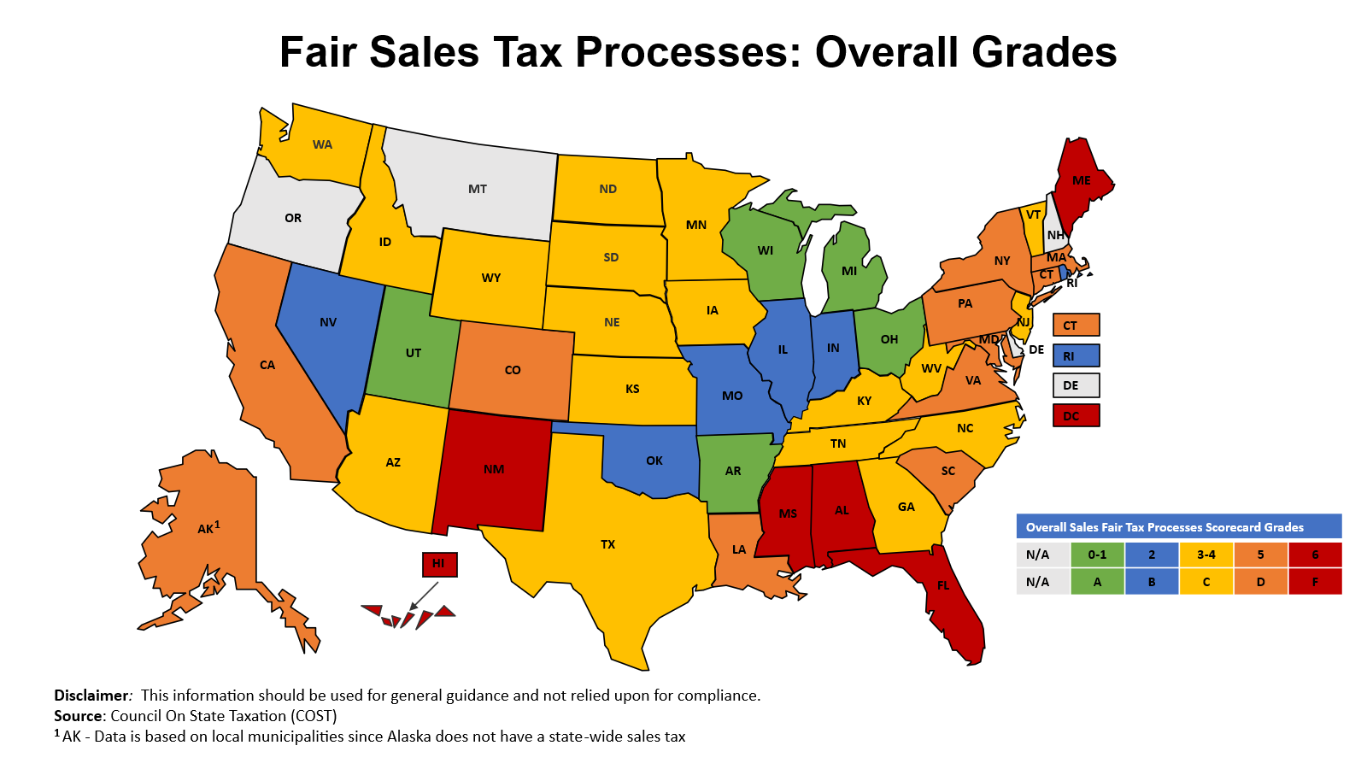

Slide 49
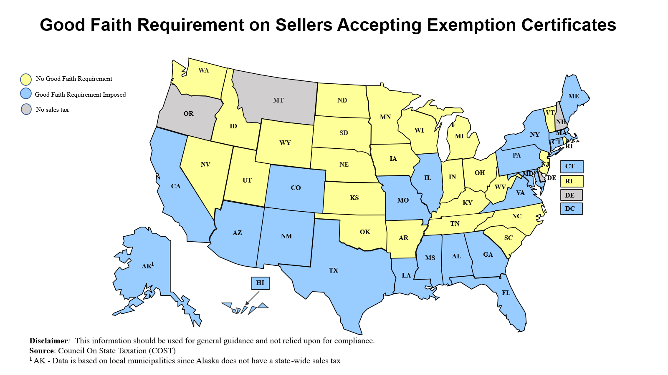

Slide 50
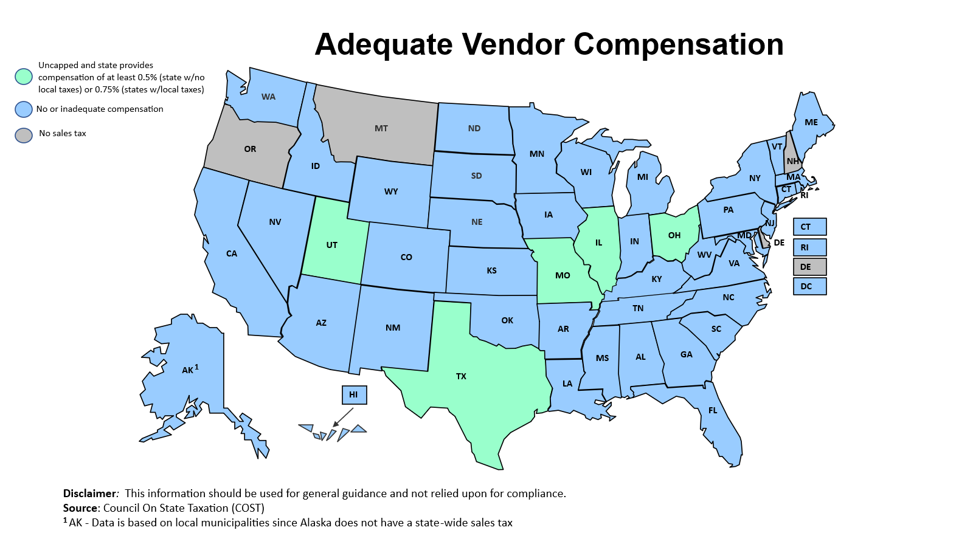

Slide 51
Reasonable Tax Payment/Credit Administration

Slide 52
Reasonable Tax Payment/ Credit Administration Issues
Avoiding or simplified advance payments;
Allowing credits for similar taxes paid to another state/jurisdiction; and
Providing a bad debt deduction for private label credit cards

Slide 53
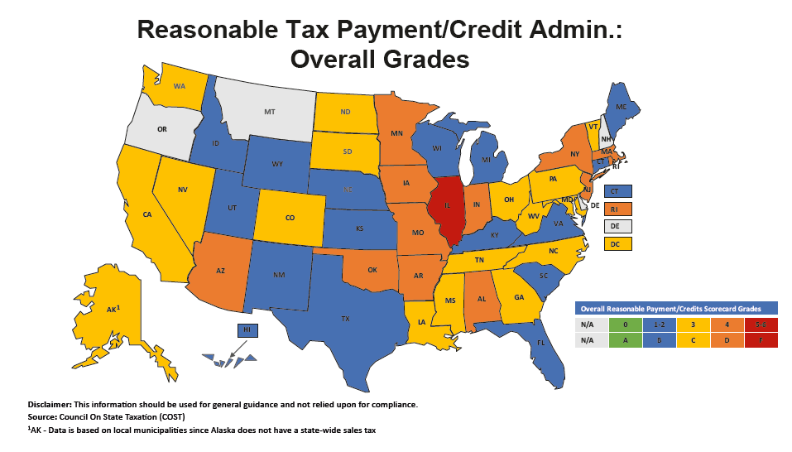

Slide 54
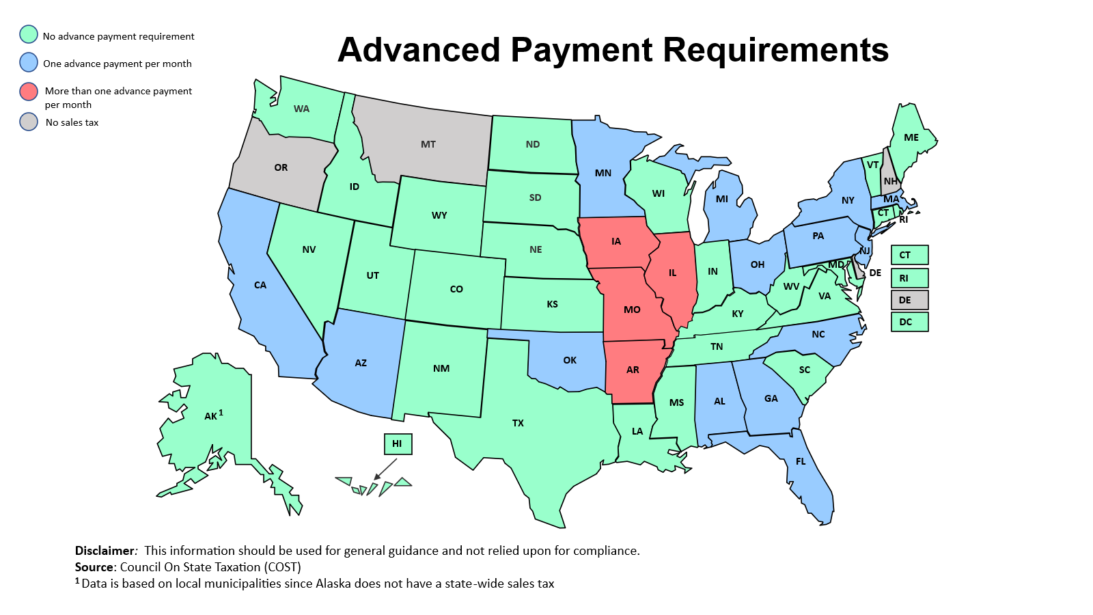

Slide 55
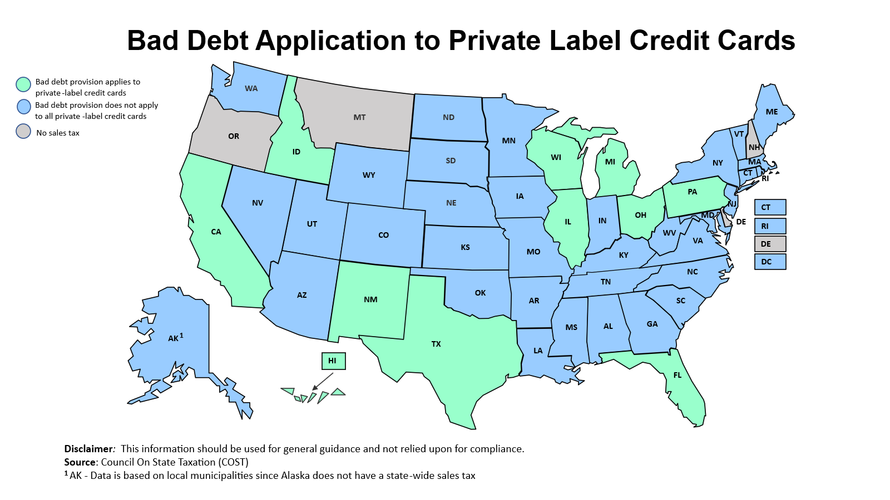

Slide 56
Fair Audit and Refund Procedures

Slide 57
Fair Audit and Refund Procedure Issues
The states’ use of even-handed sampling procedures;
Avoidance of contingent fee and/or private auditing;
Allowance for purchasers to directly file refunds claims; and
An exclusion for sales taxes from false claims act laws and/or class action suits.

Slide 58
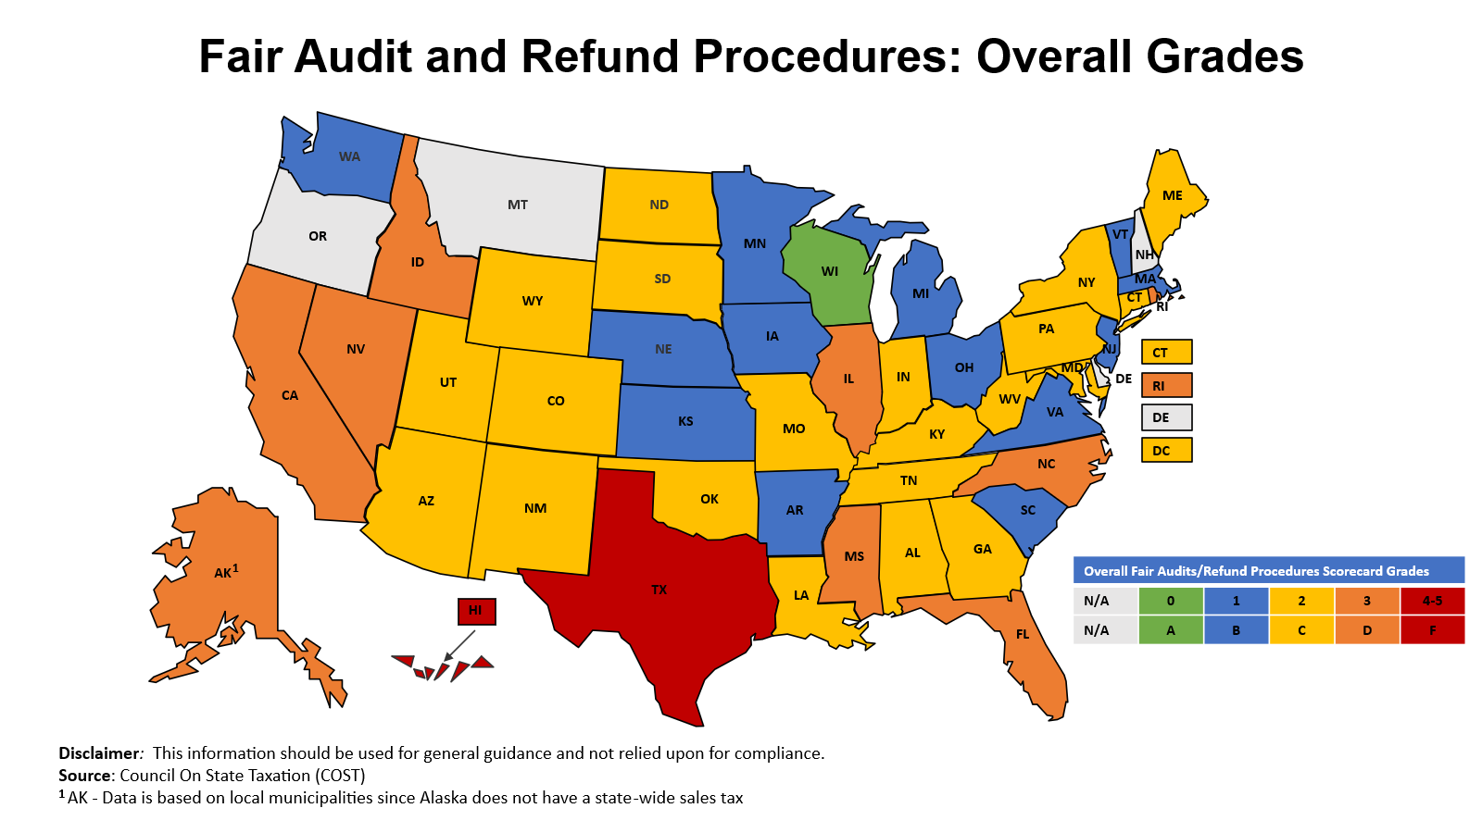

Slide 59
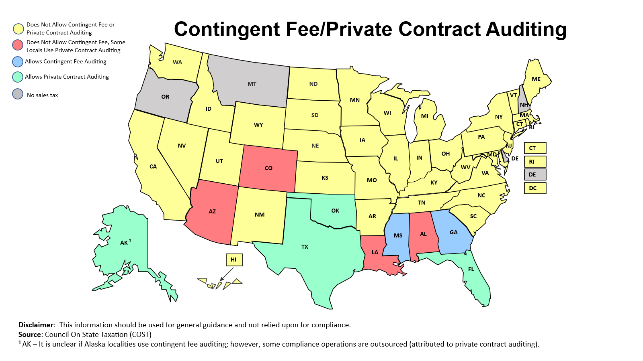

Slide 60
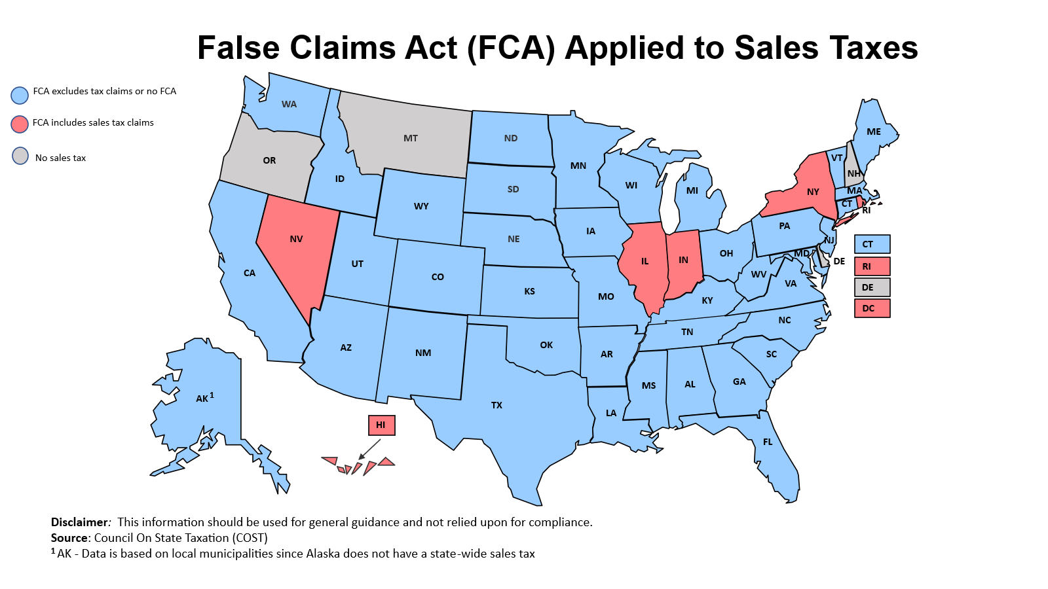

Slide 61
COST’s Property Tax Scorecard

Slide 62
COST/IPTI – Good Administrative Practices
COST & IPTI have issued two scorecards on international property tax administration (initial COST Scorecard only on US property tax administration)
Focus is primarily on using objective criteria of important property tax administration with bias towards issues of concern with business taxpayers
Grading is for comparison purposes
It is acknowledged and understood, especially in the U.S. that property tax administration can vary significantly locality by locality – in general, to the extent a state allows a locality to use what is considered a poor administrative practice – that was used as the scoring basis even though all the localities in a jurisdiction may not use that practice
Tax rates, other than disparate rates/valuations, not evaluated

Slide 63
Best Practices Criteria – Three Buckets
Transparency
Laws adequately explained on website
Adequate notice of proposed valuation
Ability to compare values placed on other properties
No disclosure of income and expenses
Frequent revaluations
Consistency
Tax forms, assessment ratios, training
Centralized oversight of local assessors' practices
Procedural Fairness
Sufficient time for taxpayers to file appeals
Balanced burden of proof review before independent arbiter
Ability to partially pay disputed tax
Interest rate paid on refunds matches rate on underpayments

Slide 64

Overall Grades for U.S. States and Puerto Rico
A
B
C
D
F
WA
MT
ND
ME
OR
MN
VT
ID
WI
NH
SD
MI
NY
MA
WY
CT
IA
PA
RI
NV
NE
NJ
IL
IN
OH
MD
DE
CA
UT
CO
WV
KS
MO
VA
DC
KY
TN
NC
AZ
NM
OK
AR
SC
GA
PR
AK
MS
AL
HI
TX
LA
FL
Source: The Best (and Worst) of International Property Tax Administration, COST & IPTI, June 2019

Slide 65
Overall Grades for Canada

Slide 66
Specifics of Grading System - Transparency
Centralized Website
Does a central agency, normally the state’s revenue agency, provide a clear explanation of property tax system for both a lay person and an expert?
Are the state’s property tax laws and regulations in one central area on the website for all to access?
Are property tax forms available on the website to use at both the state level and the local level
Valuation Notice
Actual notice should be provided to property owners on all revaluations even if no change
Clear information on how the property was valued and how to appeal should be provided with valuation notice
Valuation Practice
All real property valuation should take place 1 to 3 years with some type of physical inspection
Tax rate information and how tax used should be provided
Recognized valuation practices (e.g. USPAP) should be used and not unduly restricted

Slide 67
Specifics of Grading System - Consistency
Central Agency Oversight
It is important that a central agency has oversight of local assessors and can require them to follow uniform practices
Forms for exemptions and personal property tax filings should not vary by locality
Equal Assessment Practices
There should be consistent due dates for returns, payments, appeals, and filing of exemption forms
Tax rate, assessment ratios, and caps should be uniform across the state and not vary based on the type of property owner (residential/commercial/industrial)
Interest rate should be based on time value of money and not vary based on tax due v. refund
Assessor Training and Outreach
Assessors should be required to possess recognized professional qualifications
There should be continued training/professional development requirements
Public should be informed by assessors of valuation information on regular basis

Slide 68
Specifics of Grading System - Procedural Fairness
Initial Review
There should be a “known to all” formal or informal review process with property owner before value finalized
Property owner should have at least 60 days to file an appeal from valuation notice
Assessor should be required to explain and provide documentation on basis of a valuation
Independent Tribunal
Burden of proof should be equal or on assessor – unlike other taxes, assessor often in better position to know property valuation fluctuations in its district
Review should be de novo with ability to introduce new facts
Appeal from assessment board to independent tribunal should be at least 60 days
Other Procedural Fairness Issues
There should be no fee or a minimal fee to file an appeal – all levels of appeal
Disputed tax should not be required to be paid or at least escrowed
Third party appeal rights should be limited – assessors should be held accountable

Slide 69
COST’s Unclaimed Property Scorecard

Slide 70
Unclaimed Property Scorecard
RUUPA
ABA Draft Model Unclaimed Property Act
Updated scorecard in 2026

Slide 71
UP Scorecard Criteria
Exemption for business-to-business transactions
Businesses are in the best position to determine whether another business holds their property
Large businesses typically operate through thousands of commercial accounts
Credit balances frequently do not represent unclaimed property
If a business does not pursue a credit balance on another business’ books, it is likely that the discrepancy was already resolved or did not exist

Slide 72
UP Scorecard Criteria
Reasonable statute of limitations
Reporting requirements should correspond with the recordkeeping requirements of the IRC, state tax laws, and normal business practices
Some states have no statute of limitations
Beware of restricting a statute of limitations to items specifically identified in a report - effectively no statute of limitations!

Slide 73
UP Scorecard Criteria
Independent administrative appeals process for holders
Independent tribunal
Administrative appeals
Use of contingent-fee auditors
Encourages auditors to be overly aggressive, interpret laws to their own advantage, cherry pick audit targets, and ignore holder errors resulting in lower assessments

Slide 74
UP Scorecard Criteria
Exemption of gift cards
Role of expiration dates – if none, holder is perpetually on the hook
Purchaser likely not the ultimate owner
Gift cards are typically redeemable for merchandise only – states should only acquire the rights of the owner
Reasonable penalties for noncompliance
Reasonable interest

Slide 75
Other Legislative Improvement Efforts

Slide 76
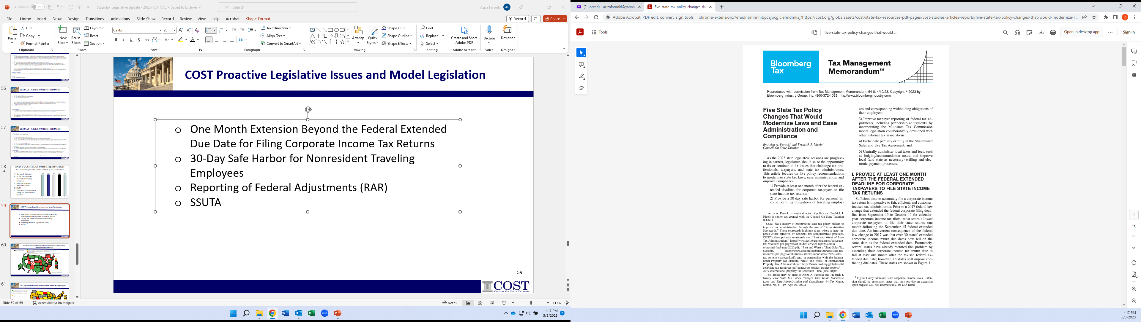
COST’s Proactive Legislative Issues and Model Legislation
One Month Extension Beyond the Federal Extended Due Date for Filing Corporate Income Tax Returns
30-Day Safe Harbor for Nonresident Traveling Employees
Reporting of Federal Adjustments (RAR)
SSUTA
Centrally administer local taxes and fees, such as lodging/accommodation taxes, and improve local (and state as necessary) e-filing and electronic payment processes.

Slide 77
Questions and Answers?
Mark Holmes: mholmes@cost.org
www.cost.org

