Slide 1
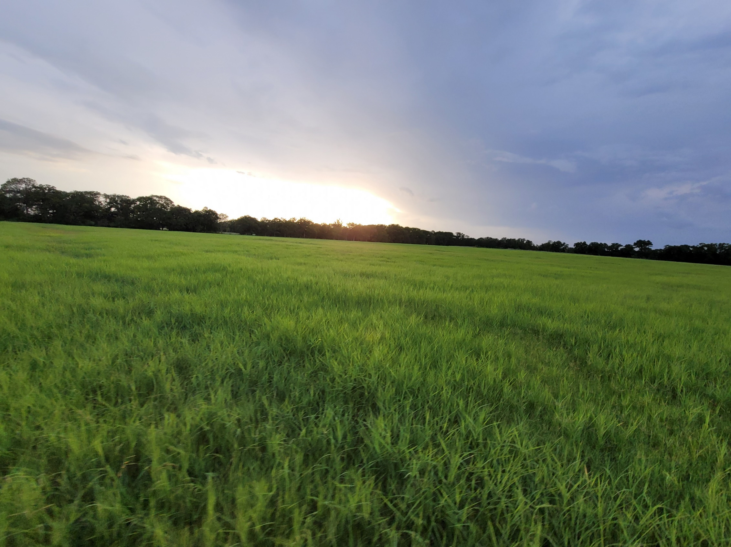
TCEQ Property Tax Exemptions for Pollution Control Property “Prop 2” and Low Carbon Solutions
Bryan W. Shaw, Ph.D., P.E.
Shaw Engineering
Notes:
Good afternoon. I’m Bryan Shaw, a former professor from Texas A&M and former Chairman of the TCEQ. I am currently President of Shaw Engineering where I assist clients with permitting, enforcement, and policy issues. I’m a consultant for TXOGA on a wide variety of environmental issues.
Today I will be speaking about Property Tax Exemptions for Pollution Control Property known as “Prop 2” since it came into existence through a Texas Constitutional Amendment. It was Proposition 2 on the ballot, on November 2, 1993.
For several years there has been interest in exempting property used to reduce GHC/CO2 emissions. I will attempt to give an update on recent actions that allow some Low Carbon Solution projects to gain at least some property tax exemption. In order to better understand the nuisances that affect the eligibility of Low Carbon Solution projects, I will first discuss some of the criteria that apply to all Prop 2 applications.

Slide 2
Property Eligible for Prop 2
Pollution Control Property:
facility, device, or method for the control of air, water, or land pollution
Certain property may be eligible if wholly or partly used to comply with environmental laws, rules, or regulations:
Of any environmental protection agency of the United States, Texas, or political subdivision of Texas
For prevention, monitoring, control, or reduction of air, water, or land pollution
Notes:
Regardless of the type of pollution reduction equipment, key issues that determine if your project is eligible for Prop 2 exemptions include things like, what type of property is eligible and whether its use is to meet or exceed a regulatory requirement. For example, you can not get a positive use determination for simply removing pollutants from the air. Must have law or rule requirement to cite. While the criteria seem pretty broad and inclusive in theory, in practice, it can be more challenging and uncertain.

Slide 3
Property Eligible for Prop 2
Two step process:
Facility must obtain a determination from TCEQ that the property is used for pollution control to comply with environmental laws, rules, or regulations – this “Use Determination” will include the percentage of the property value that is for pollution control
The applicant submits this use determination to the local appraisal district to obtain the property tax exemption

Slide 4
Excluded Property
Property wholly to produce good or service
I.E., incineration for a fee…
Not used to meet or exceed a law, rule, or regulation…
If the environmental benefit is derived from the use or characteristics of the good or service provided.
I.E., equipment to produce clean-burning fuel
This has typically been interpreted as requiring the environmental benefit to be at the pollution source site to be eligible for Prop 2

Slide 5
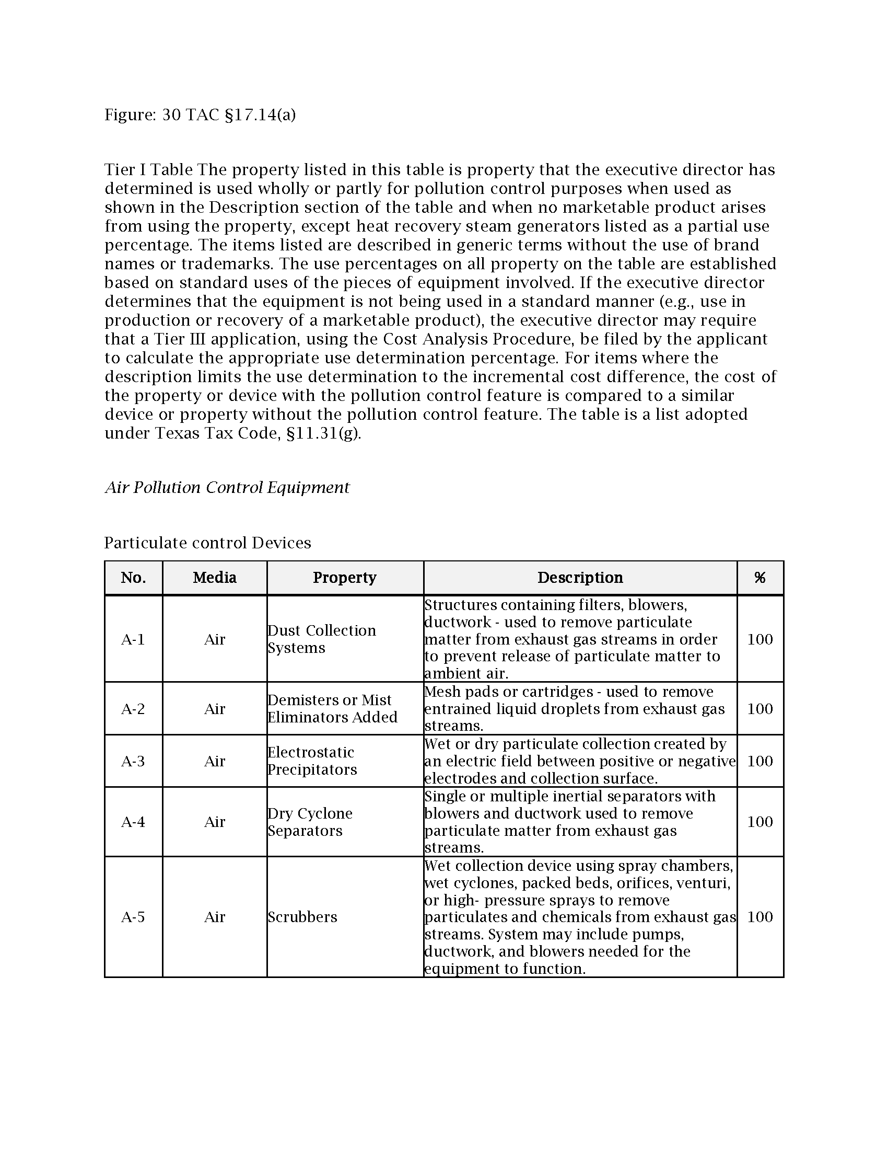
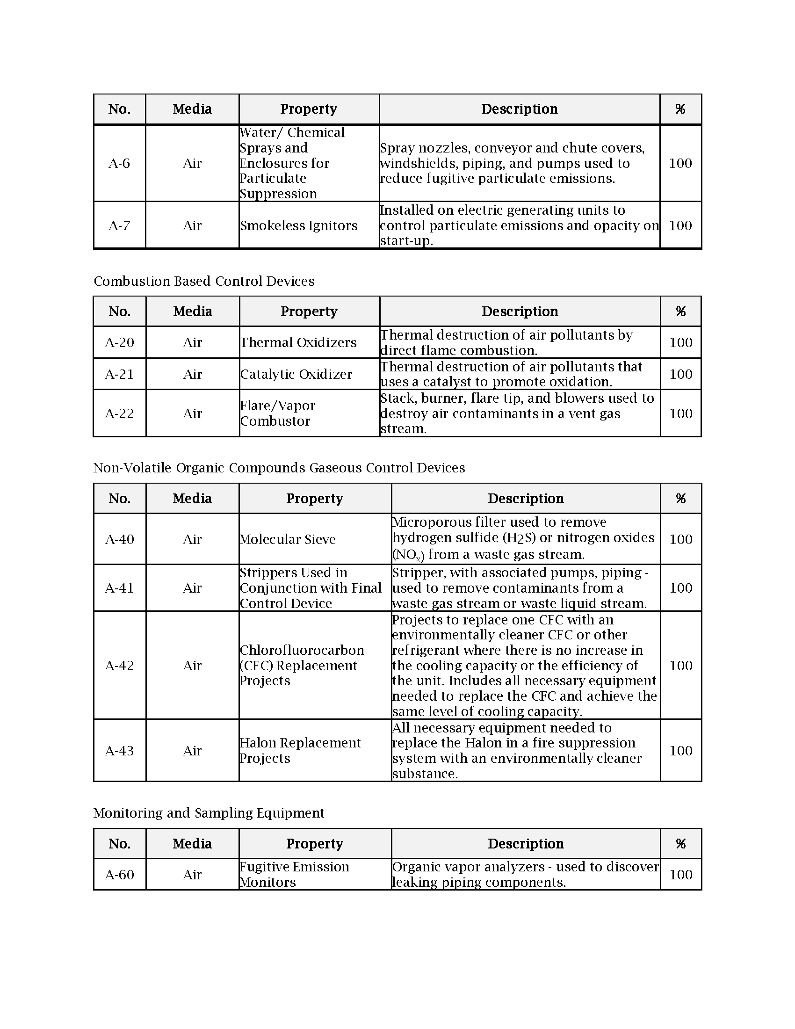
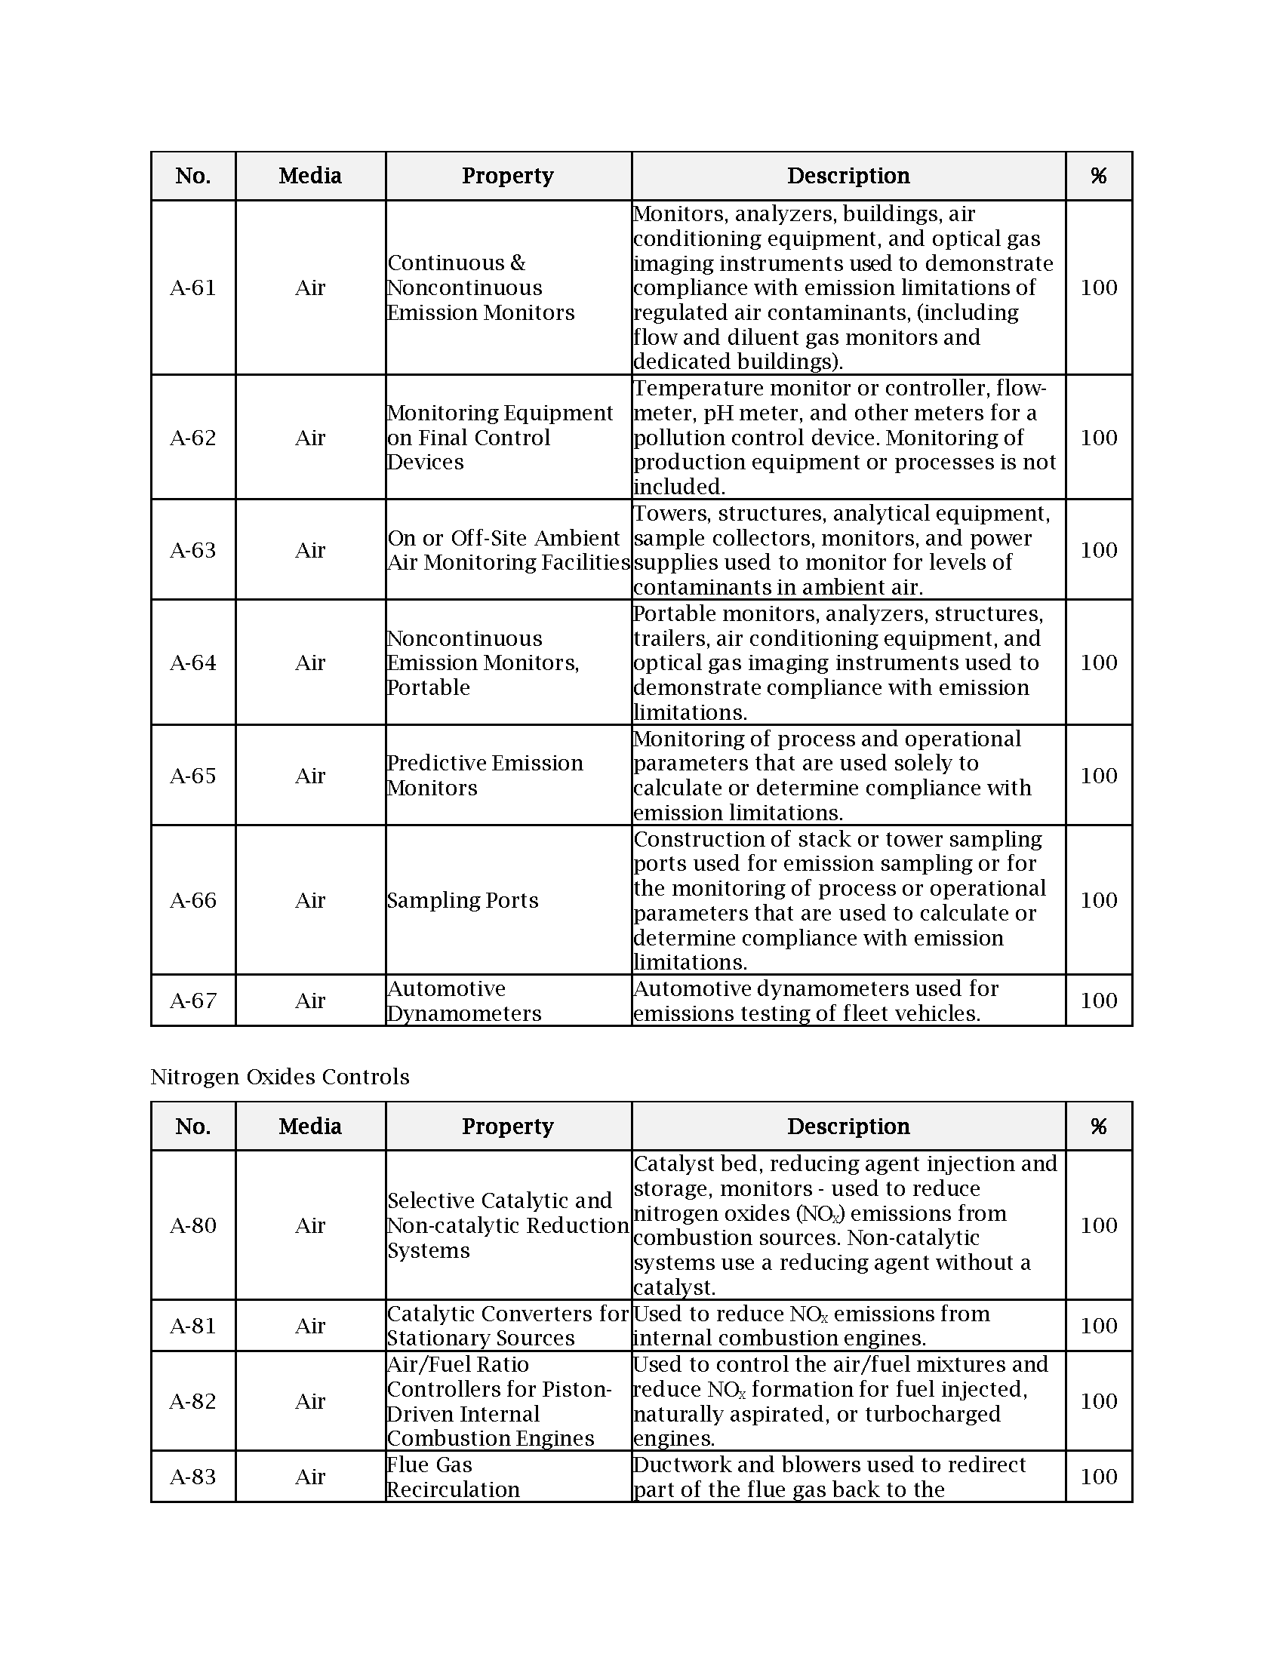
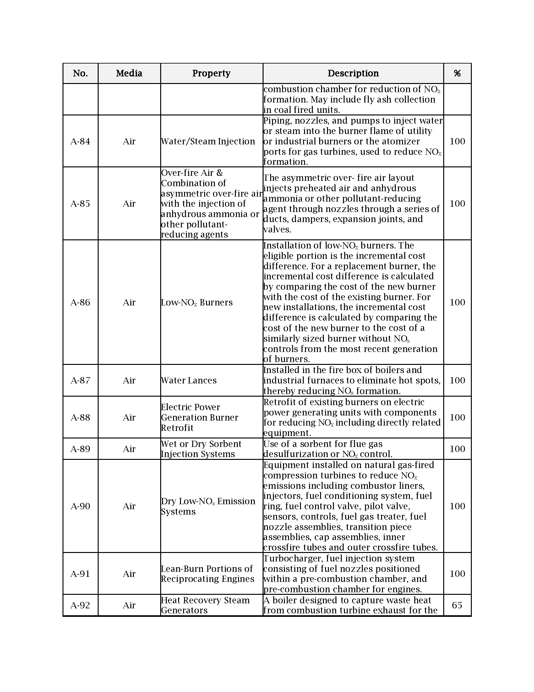
Tier I Property
For some pollution control equipment, this process is mostly straightforward: Tier I Table Property – TCEQ has determined that this property is eligible at a standard use percentage typically 100%.
Applicant must demonstrate property is used as described in the table and will get the positive use determination
Notes:
~186 on the Tier I Table
Only non 100% is HRSGs at 65%

Slide 6
Tier II Property
Tier II Property – 100% use for pollution control but not on the predetermined table
Applicant must demonstrate:
100% pollution control use
No production benefits
Installed to meet or exceed environmental regulation

Slide 7
Tier III Property
Tier III Property – Partial Use Determinations
Applicant must:
Specify the percentage of pollution control use
Demonstrate that was installed to meet or exceed environmental regulation
Can have production, safety, and/or other benefits

Slide 8
Expedited Review List
Texas Tax Code, §11.31(k)
(k) The Texas Commission on Environmental Quality shall adopt rules establishing a nonexclusive list of facilities, devices, or methods for the control of air, water, or land pollution, which must include:
(k)(8) heat recovery steam generators
(k)(16) if the United States Environmental Protection Agency adopts a final rule or regulation regulating carbon dioxide as a pollutant, property that is used, constructed, acquired, or installed wholly or partly to capture carbon dioxide from an anthropogenic source in this state that is geologically sequestered in this state

Slide 9
Expedited Review List
Texas Tax Code, §11.31(k)
(m) Notwithstanding the other provisions of this section, if the facility, device, or method for the control of air, water, or land pollution described in an application for an exemption under this section is a facility, device, or method included on the list adopted under Subsection (k), the executive director of the Texas Commission on Environmental Quality, not later than the 30th day after the date of receipt of the information required by Subsections (c)(2) and (3) and without regard to whether the information required by Subsection (c)(1) has been submitted, shall determine that the facility, device, or method described in the application is used wholly or partly as a facility, device, or method for the control of air, water, or land pollution and shall take the actions that are required by Subsection (d) in the event such a determination is made.

Slide 10
2019 Texas Supreme Court Case
The Texas Supreme Court effectively indicated that any property the Legislature put on the k-list necessarily meets the statutory definition of pollution control equipment – unless TCEQ determines it should be removed from list
Therefore, HRSG must receive some non-zero use determination as long as it is on the k-list

Slide 11
Expedited Review List
Texas Tax Code, §11.31(k)
(k) The Texas Commission on Environmental Quality shall adopt rules establishing a nonexclusive list of facilities, devices, or methods for the control of air, water, or land pollution, which must include:
(k)(8) heat recovery steam generators
(k)(16) if the United States Environmental Protection Agency adopts a final rule or regulation regulating carbon dioxide as a pollutant, property that is used, constructed, acquired, or installed wholly or partly to capture carbon dioxide from an anthropogenic source in this state that is geologically sequestered in this state

Slide 12
What about CCS/CCUS?
Due to the HRSG Supreme Court decision, TCEQ has determined that in certain cases CCS property is eligible
In December 2023, TCEQ issued a Tier II (100%) use determination for CCS property
Cited: 40 C.F.R. §52.21 and 30 TAC §116.164 Prevention of Significant Deterioration Applicability for Greenhouse Gases Sources
TCEQ has indicated that sources can be eligible for Prop 2 using CCS to stay below the 25,000 metric tpy GHG reporting threshold
Tier III – there is a pathway for property used less than 100% for pollution control - Cost Analysis Procedure (CAP) determines the percentage used for pollution control

Slide 13
Cost Analysis Procedure (CAP)

Slide 14
What about CCS/CCUS?
(k)(16) if the United States Environmental Protection Agency adopts a final rule or regulation regulating carbon dioxide as a pollutant, property that is used, constructed, acquired, or installed wholly or partly to capture carbon dioxide from an anthropogenic source in this state that is geologically sequestered in this state
Must be an anthropogenic source – in Texas
Must be sequestered in Texas
This addresses the common issues with requiring that the environmental benefit be at the site of pollution control equipment…
However, Texas is still waiting on approval of RRC Primacy to permit Class VI Carbon Sequestration wells

Slide 15
What about CCS/CCUS?
What if capture in Texas but sequester out-of-state?
Untested
Would not qualify for k-list Expedited Review
What if project controls other pollutants as well as CO2?
You can cite multiple “meet or exceed” regulations
What if CCS project will receive incentives or premiums associated with CCS? I.E., 45Q tax credits.
These do not count against your CAP calculations…
What if you have a PAL or Flex Permit
Prop 2 does not require you to give up your flexible operating permit

Slide 16
Other Considerations
Novel projects benefit from having meetings with TCEQ staff prior to submitting a proposal for Prop 2 Use Determination
Submit Prop 2 applications before January 31 to get priority processing and have use determination for that tax year

Slide 17
Questions?

