Slide 1

TXOGA Property Tax – Refining Sub-Committee

Slide 2
Committee Members
Chaney Moore – Chevron Phillips
Molly Briggs - Chevron
Debra Gibson – Citgo
Jeff Farish – ExxonMobil
Brent Stewart – Flint Hills
Chip Twomey – Marathon Petroleum
Chris Cisneros – Phillips 66
Karl Bartholomew - Shell
Marty Loeber – Valero
Greg Maxim – CummingsWestlake (for LyondellBasell)

Slide 3
Meetings with Appraisers
February 28 – Jefferson CAD and Capitol Appraisal, Dave Popelar and Noel Wilcoxson
March 19 – HCAD
Roland Altinger – Chief Appraiser
Jason Cunningham – Deputy Chief Appraiser
Hal Long – Associate Chief Appraiser - Industrial
Adam Bogard – Manager/Coordinator for Litigation
Loren Williams – Manager Industrial Properties

Slide 4
TCEQ Prop 2 Advisory Committee
Bob Adair was reelected chair of the committee for 2024.
No formal advice has been submitted by the committee to Commissioners since December 2022.
CCUS (carbon capture, utilization, and sequestration ) - The committee had preliminary discussions last year regarding eligibility for Prop 2 of carbon capture, utilization, and sequestration. Industry members of the committee decided to informally table further discussion of this item after TCEQ approved (in December) a Tier 2 application (100%) for a CCS project at a power plant in Baytown. This approval caused quite a buzz in business associations and companies.
In December 2023, six of the 13 members of the committee were reappointed to another four-year term to expire 12/31/2027: Lloyd Graham, Adam Haynes, Justin Hyland, Greg Maxim, Mike Nasi, and Cyrus Reed.

Slide 5
Refining And Petrochem Market
Karl Bartholomew compiled the following presentation for the meetings with Capitol and HCAD.

Slide 6
For HCAD
2024 – Refining & Petrochemical Outlook

Slide 7
TXOGA Antitrust Statement

Slide 8
Key Refining Industry Considerations
1

Slide 9
Refining market drivers in 2023
The start of the year continued 2022 margins, that fell off in the fourth quarter
  Ukraine war not causing as big an impact on supply and demand, margins
  Rate of inflation still higher than Fed target, prices still substantially higher than 2020
  White House and EPA continue to push forward on EV mandate, new regulations
  Most important, buyers aren't buying refineries

Slide 10
Preliminary 2023 Refining Earnings Indicators
Sources: Investor websites, EIA, Platts, author analysis

Slide 11
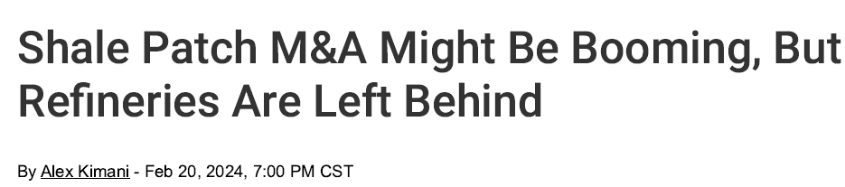
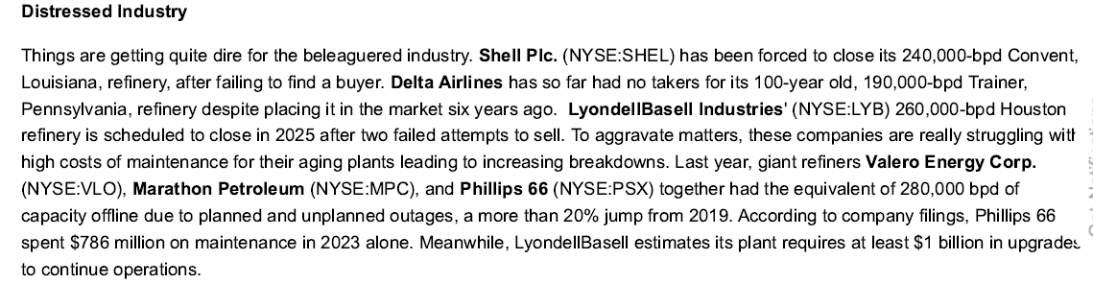
Transactions & Market Indicators
  No new refinery transaction since Houston Refining announcement in 2023
  Houston Refining shut down delayed until first quarter 2025; plan still is to convert to hydrogen hub
Sources: Investor websites and public releases, author analysis

Slide 12
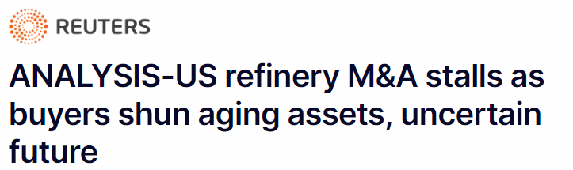
  Refiner evaluations are down ~1/3 since the financial crisis of 2008
  Several refiners have had assets on the market for years but no sales
    Delta Trainer on/off market since 2018
    New Philips 66 divestiture program may include small refineries
    LyondellBasell on market two separate times before deciding to convert to hydrogen hub
  Maintenance costs to keep older plants online have also deterred refinery buyers
    Price tag to upgrade Houston Refining was estimated to be greater than $1 billion
Source: Reuters, February 16, 2024

Slide 13
What should we consider in near-term?

Slide 14
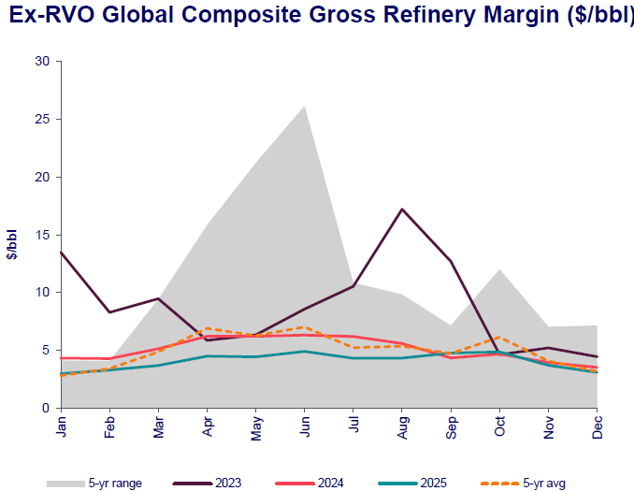
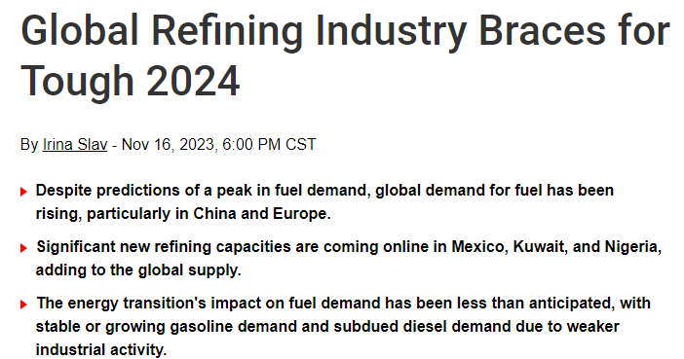
Significant new refining capacity outside the U. S. affects margins
  Margin outlook collapses back to historical five-year average with new capacity in Nigeria, Kuwait, Mexico
  New supply offsets demand increase
    Global jet fuel demand remains below 2019 level
Sources: Wood Mackenzie, Oilprice.com

Slide 15
RINs continue to be a cost problem (at a lower level)
Source: Valero Investor Relations

Slide 16
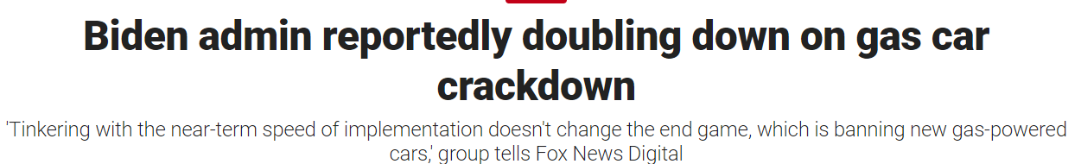
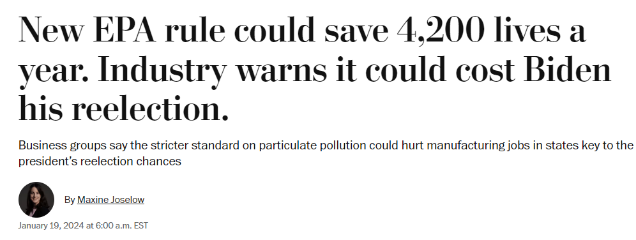
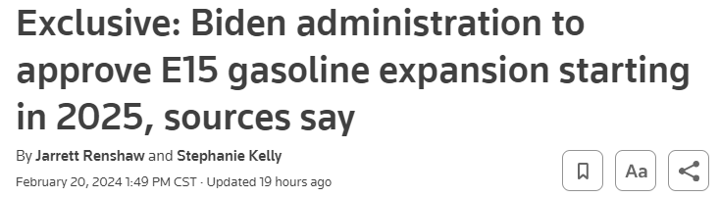
Continuing Government Actions
:Sources Reuters, Washington Post

Slide 17
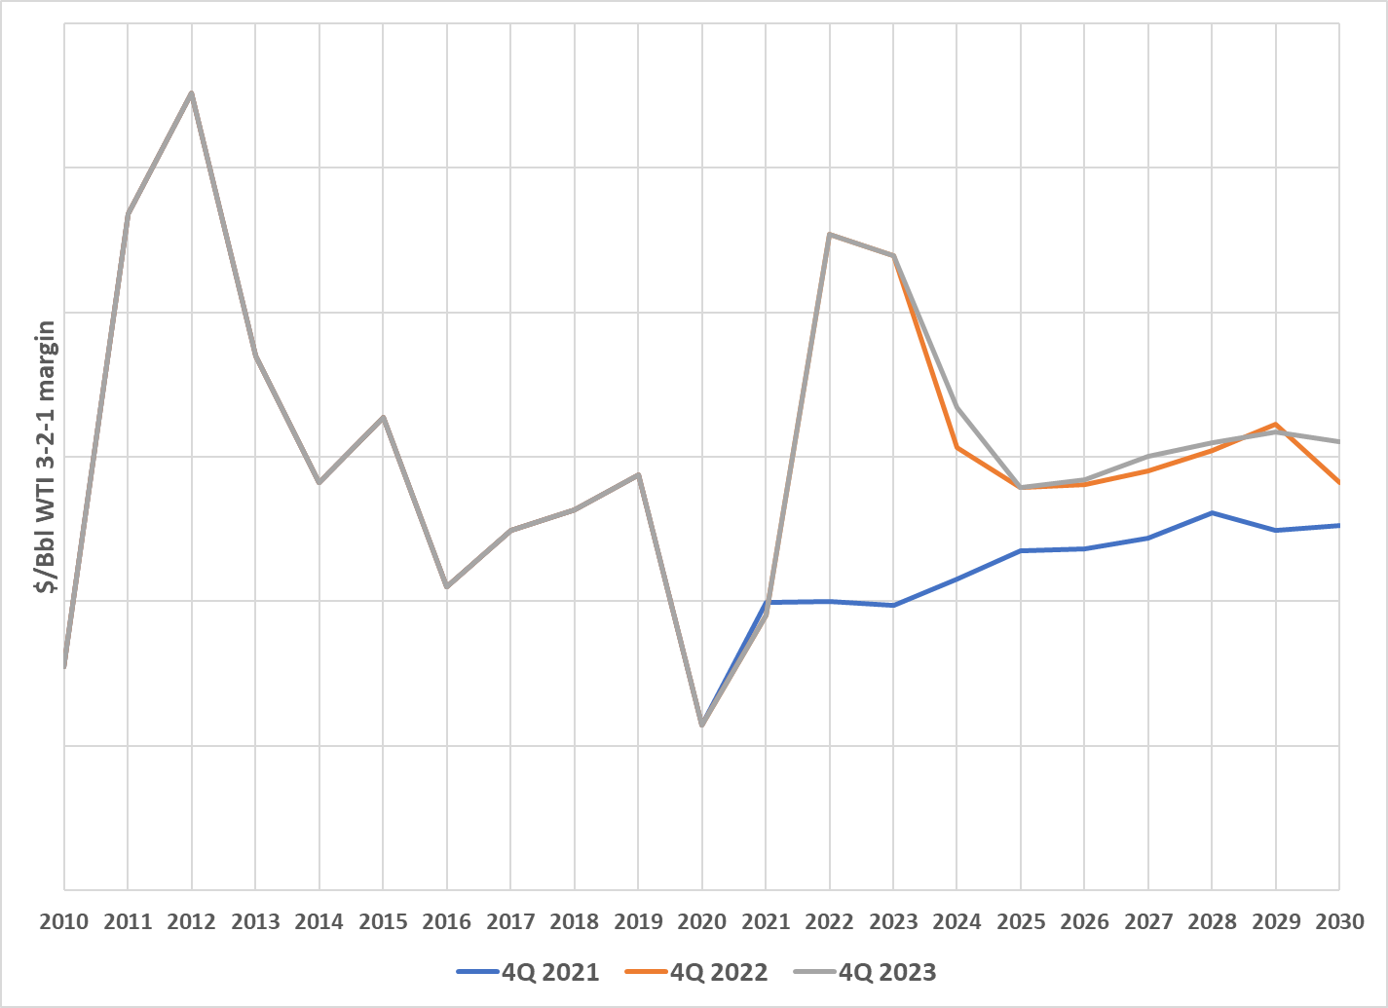
Comparing 3rd party price forecasts 2021-22 vs. 2023
Sources: WM, S&P Global

Slide 18
Key Petrochemical Industry Considerations
2

Slide 19
Petchems peaked early 2021, still facing overcapacity challenges
Sources: Investor websites, author analysis, Platts, ICIS

Slide 20

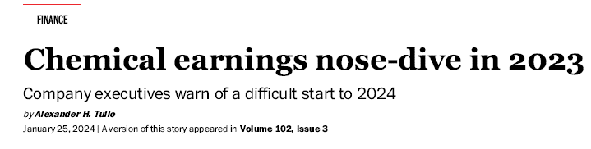
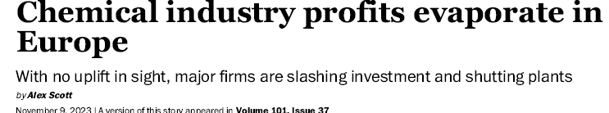
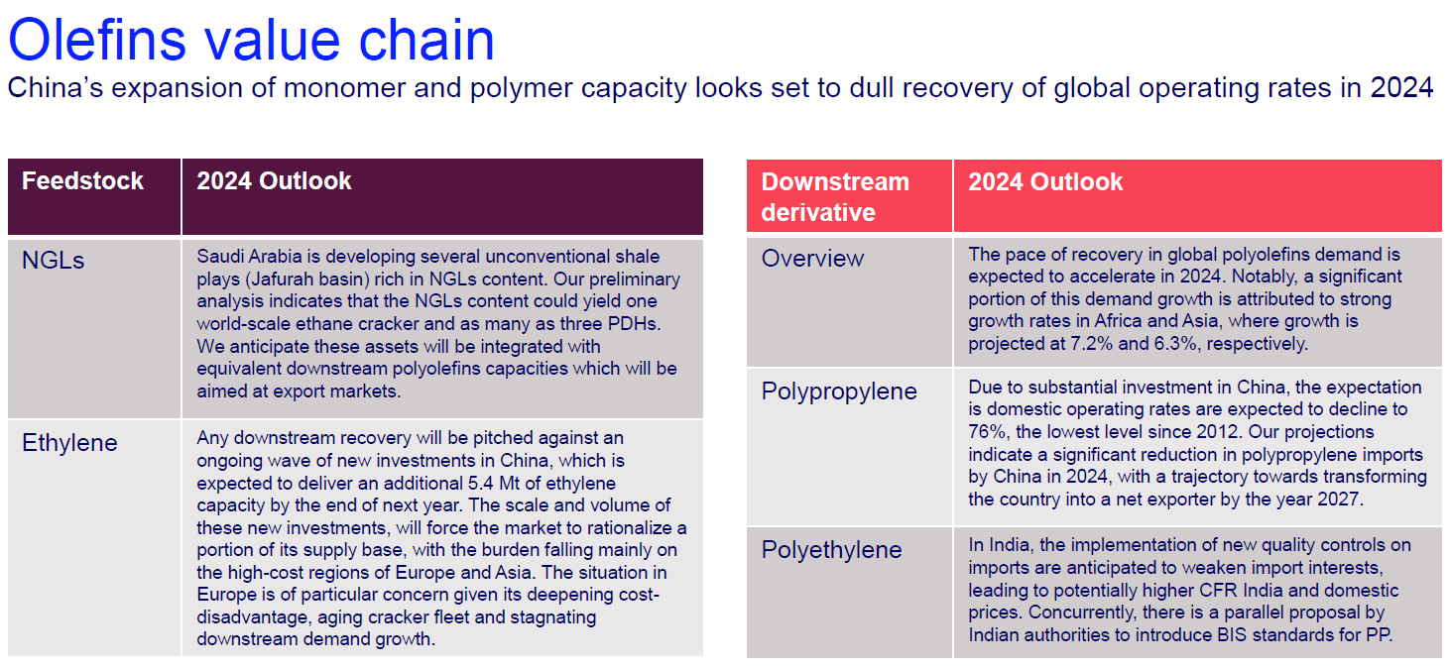
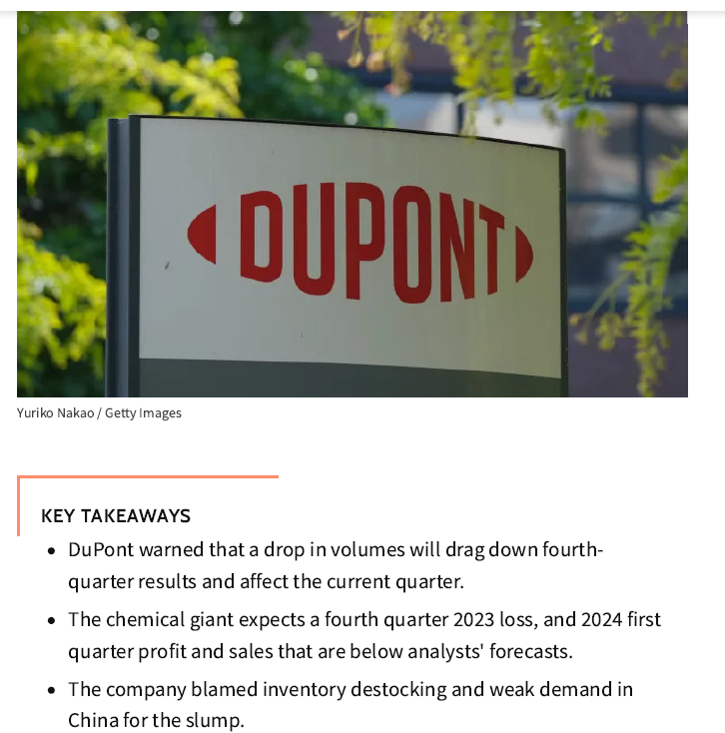
Ethylene, chemicals outlooks
Sources: American Chemical Society, ICIS, Chemical & Engineering News; Wood Mackenzie

Slide 21
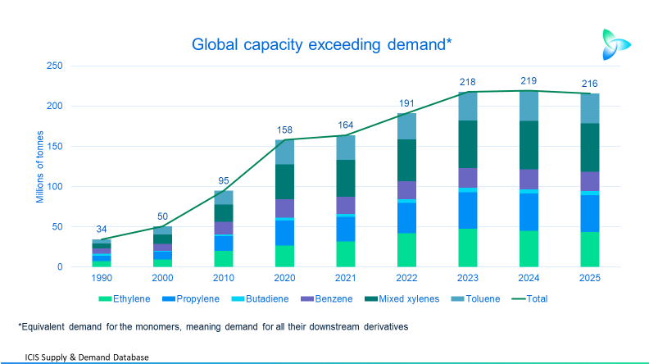
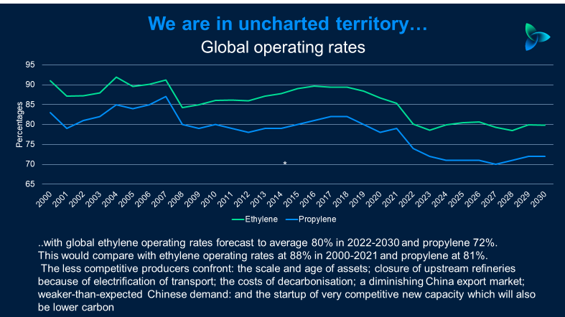
Uncharted waters in excess capacity and utilization rates
Sources: ICIS, Nov 2023

Slide 22
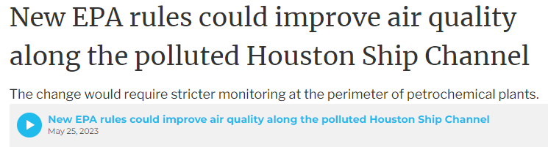
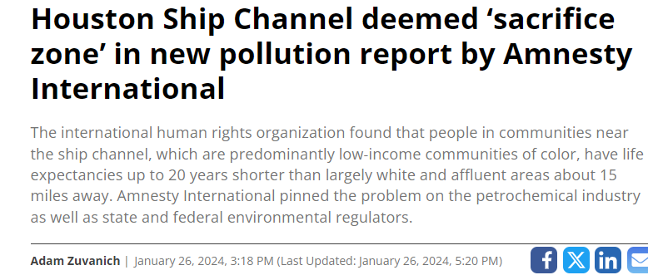
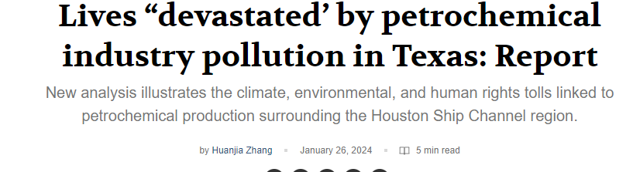
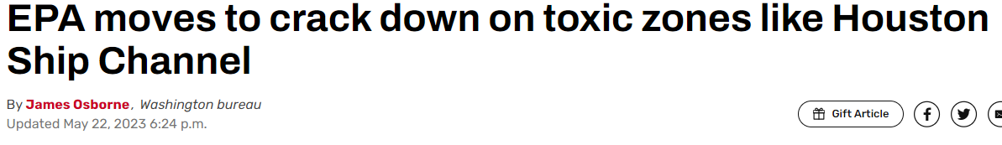
Environmental issues continue to pressure industry
Sources: Environmental Health News

Slide 23
Recap on Petrochemical Industry
  Petrochemicals continue to face very challenging markets
  Still working down new capacity additions (global)
  Margins/earnings continue to drop toward breakeven or worse
  EPA and NGOs continued to tighten focus on petrochemical plant emissions

Slide 24
Questions and Answers

