Slide 1
Texas Oil & Gas Association Mineral Sub-Committee
TXOGA ANNUAL Property Tax Conference
March 7-8, 2024

Slide 2
Committee Members
Scott Emanis – Chevron
Drew Harrold – Merit Advisors
Michael Horne – Occidental
Ron Kane – EOG Resources
Todd Metzgar – Conoco Phillips Co
Lauro Porto- ExxonMobil
Nathan Young – American Ad Valorem Tax Consultants
Notes:
Identify new members

Slide 3
Mineral Sub Committee Activity
Meet to discuss valuation parameters
(This Year) – Circuit Breaker Legislation
Schedule meetings with the Appraisal Firms
Summarize meeting discussions
Report to the Membership
Firm Summary File to be emailed once complete

Slide 4
Texas Production – Crude Oil

Slide 5
Texas Production–Natural Gas

Slide 6
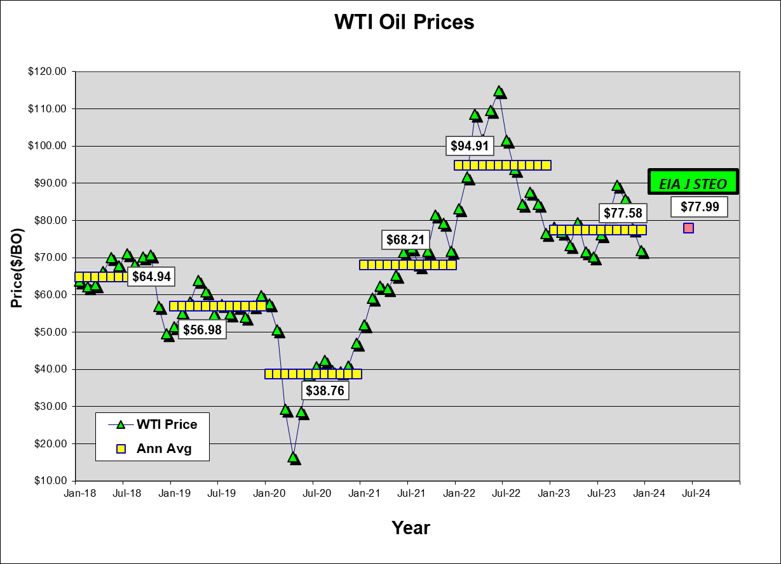

Slide 7
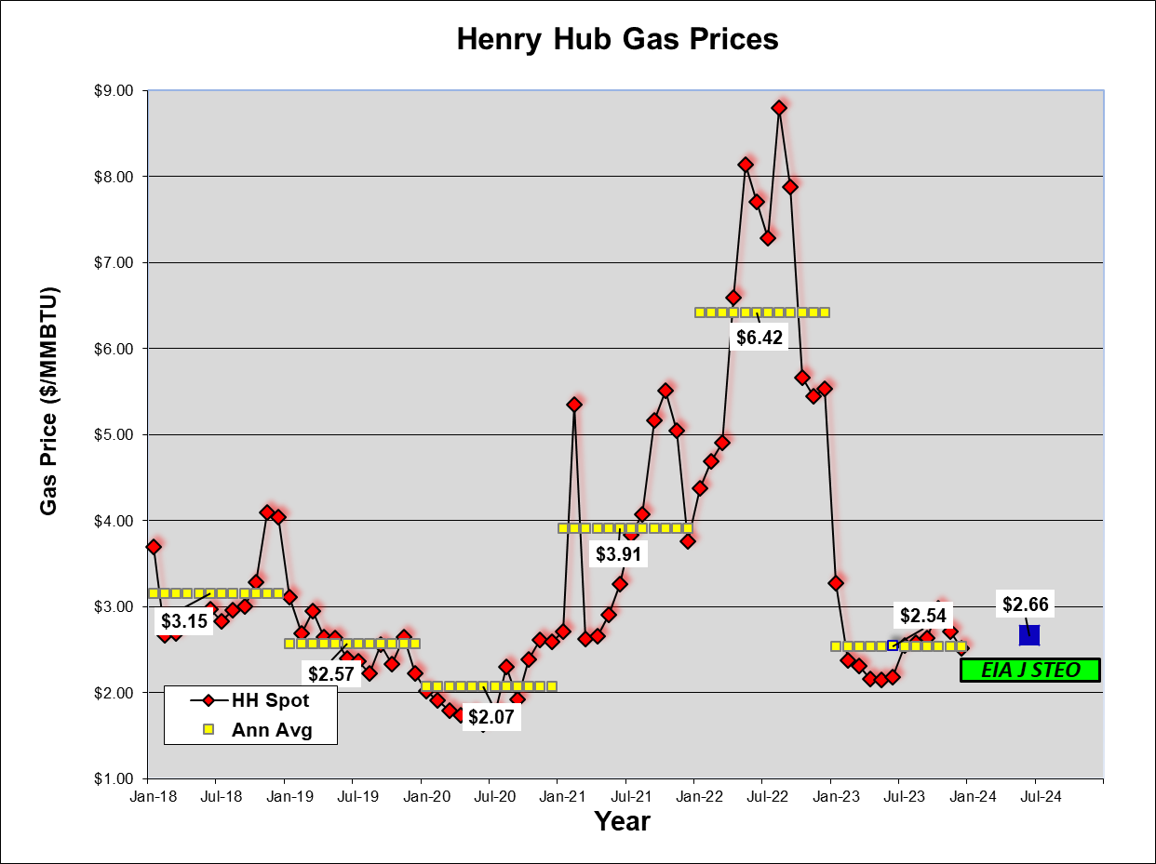

Slide 8
EIA Annual Energy Outlook
Next release date – 2025
Report is undergoing system enhancements – no release in 2024.
§23.175 Texas Property Tax Code
Appraisal Districts must use the EIA AEO data to calculate the Price Adjustment Factors for oil & gas if published by March 1, 2024
Notes:
Years ago, there was a year when EIA issued the AEO before 3/1

Slide 9
EIA January Short Term Energy Outlook
Released on January 9, 2024
§23.175 Texas Property Tax Code
Appraisal Districts must use the EIA January STEO data to calculate the Price Adjustment Factors for oil & gas if most recent AEO published before December 1st of preceding year (12/1/23)

Slide 10
Price Adjustment Factors

Slide 11
EIA STEO ANALYSIS

Slide 12
Producer Price Index

Slide 13
2024 Pricing Escalators
Notes:
WTI & HH refe points. Use average price received per lease.

Slide 14
Appraisal Firm Meeting Notes New Contracts for 2024
CAG – Scurry County
CAD Appraisal – None
H Landrum – None
MAVSI – None
P&A – Gray, Hutchinson, Knox & Ochiltree Counties
TYP – Comanche, Crane, Glasscock, Jeff Davis, & Wharton Counties
WAG – None

Slide 15
Appraisal Firm Meeting Notes
Firms will use the Jan 2024 STEO to determine the PAF for Oil & Gas Pricing. No AEO report will be issued for 2024.
Escalation from BLS – years 2-6
Firms expect mineral values to likely decrease based on pricing scenario.
No projections provided to CAD’s as of meeting times
2023 Lease Operating Expenses – expectations are an increase over 2022 actuals
High levels of inflation during 2023
Gas appraisals, may consider some type of adjustment for current gas price scenario

Slide 16
Capitol Meeting Notes
Appraisers primarily work from home
Office space still in place to meet with agents/reps
In person negotiations are available – schedule with Appraiser.
Discount rate – S&D analysis – ValueLine Companies
2023 base rate – 13.5% plus Ad Val rate.
Expenses – Esc 3% for labor & repairs, 2% other categories (same as 2023)
Request electronic data (excel, csv, etc.)
Mineral appraisers – LeLaina Taylor- Mineral Div. Mgr. Added Hailey Jordan
Assignments on website.

Slide 17
Pritchard & Abbott Meeting Notes
Opened office in Tyler. Henderson office Closed.
Mineral Appraisers – Cindy Fox – Asst. Mgr. - Ft. Worth Div.
AMA – Trevor Sifuentes HOU – Bryan Llornes TYL – Crystal Meadows, Joe Bailey
SAN – Macy Watts, Thomas Stubbs, Randy Prince
Pricing – Jan STEO for PAF Calculation
Oil pricing – Start with County Average (Default $75.31)
Gas Pricing – Start with lease actual average price. (Default $2.48)
LOE – Oil - Hold flat. Gas - Flat year 1, deescalate 1% years 2 – 6
Discount Rates – same range as last year. Oil – 10 – 24% gas 12 – 16%

Slide 18
Thos. Y Pickett Meeting Notes
2024 Valuations – Expect decreases in valuation (esp. gas properties) based on pricing
LOE for 2023 appraisals – 1 % esc for years 2-6. May consider additional escalation
Discount rate – 16% base rate plus the Ad Val rate
New Office in Addison (14665 Midway Road Suite 100)
Appraisers – added Alex Gonzales. Jean Ann Siler retired.
Check website for appraisal cut-off dates

Slide 19
Wardlaw Meeting Notes
Initial change – Mineral equipment value – Move to Personal roll (L2)
Required rendering of Oil & Gas production equipment
Retracted request, moving value to Realty (R2) No PP return required.
Appraiser – Atilio Usseglio departed WAG.
Base Discount Rate – 15.96% Comptroller Manual
Plan to send notices by April 14th. Schedule appointments ASAP
LOE escalation - Use 7% increase over 2023
Requests LOE Detail in EXCEL format – start with Lease # for each category
No intention to use variable cost.

Slide 20
Other Firm Notes
CAD Appraisal LLC – No change in Contracts. Opened office in San Antonio.
Hugh Landrum – Contracts - lost Wharton County
Morgan Ad Valorem – No change in contracts. Default prices TBD.

Slide 21
Circuit Breaker Discussions
SB 2 Circuit Breaker Appraisal Cap and Industry
Oil & Gas Properties (mineral valuations) are “Non-Homestead Real Property” which makes them subject to the 20% appraisal cap.
What was the legislature’s intent regarding mineral valuations?
What is the definition of a “new improvement” as related to a producing mineral lease?
How will well workovers be treated?
How will oil well additions be valued on an existing lease?
How is a sale of an oil & gas property impacted?
How will this impact unknown royalty interests or corrections to the division of interest?
How will right of ways be impacted for midstream assets?
Could downstream assets be impacted?
How do we ensure the circuit breaker will be equally interpreted among appraisal districts?
Summer 2023 – Ad Hoc Circuit Breaker Committee formed to review law and how to apply to mineral, midstream & downstream appraisal and assessment

Slide 22
Circuit Breaker Discussions
February 2024 – Conclusions and recommendations by the Mineral Sub-Committee:
Oil & Gas interests are subject to and qualify under Section 23.231
Applied on and individual account or ownership parcel level
Application will follow jurisdictional boundaries of County / Appraisal District
2023 account value is the base year. 2024 value < $5MM – lessor of FMV or the 2023 value times 1.2 (20%).
Change in Operator per RRC Records – reset of base year.
Corporate restructure or subsidiary does not constitute a reset.
Changes is royalty ownership – reset base year.
Repairs, w/o, fracks, lift mechanisms does not constitute a new improvement
New wells in a combined oil lease – part of the property and NOT a new improvement. (Cannot be identified through public production or pricing info.)

Slide 23
Circuit Breaker Discussions
February 2024 – Conclusions and recommendations by the Mineral Sub-Committee (continued):
All 2024 lease values if under $5MM - – lessor of FMV or the 2023 value times 1.2 (20%).
Gas leases – one lease = RRC # new wells would be set as a base year.

Slide 24
Circuit Breaker Discussions – Firm Meeting Notes
In general the firms agreed with the Committee recommendations.
Notes from committee meetings
CAG –
Talked with Law Firms for opinion.
Met with other Firms to address issues.
WAG –
Agreed new wells in an existing lease is subject to CAP (Reserve right to analyze)
Rescinded BPP rendering requirement for production equipment
2023 value * 1.2 will be 2024 comparable value. Over $5 MM, excluded from measurement
Any 2023 value greater than $4,166,667 would not be subject to Circuit Breaker.
P&A –
Oil & Gas Individual accounts based on tax roll.
TYP –
Limited by software capabilities.

Slide 25
Questions?
Thank You

