Slide 1
AD VALOREM TAX COMMITTEE
ANNUAL CONFERENCE
MARCH 7-8, 2024

Slide 2
ANNUAL ENERGY &
ECONOMIC IMPACT
REPORT
2023
Notes:
2023 was such a blockbuster year that the Texas oil and natural gas industry effectively rewrote its record book, clocking unmatched economic and energy achievements across the board.
Record-breaking performance of the Texas oil and natural gas industry amounts to much more than phenomenal statistical achievements. The natural resources, fuels and essential products produced here cement America’s energy security, fortify Texas’ economic strength and advance global stability at a time when our energy leadership has never been more crucial.

Slide 3
2023
ANNUAL ENERGY &
ECONOMIC IMPACT
REPORT
In FY 2023, the Texas oil and natural gas industry paid state and local taxes and state royalties totaling
$26.3 billion
This number equates to more than $72 million each day.
Notes:
$26.3 billion in state and local tax revenue and royalties from the Texas oil and natural gas industry translates to an extraordinary $72 million every day that pays for Texas’ public schools, universities, roads, first responders and other essential services.

Slide 4
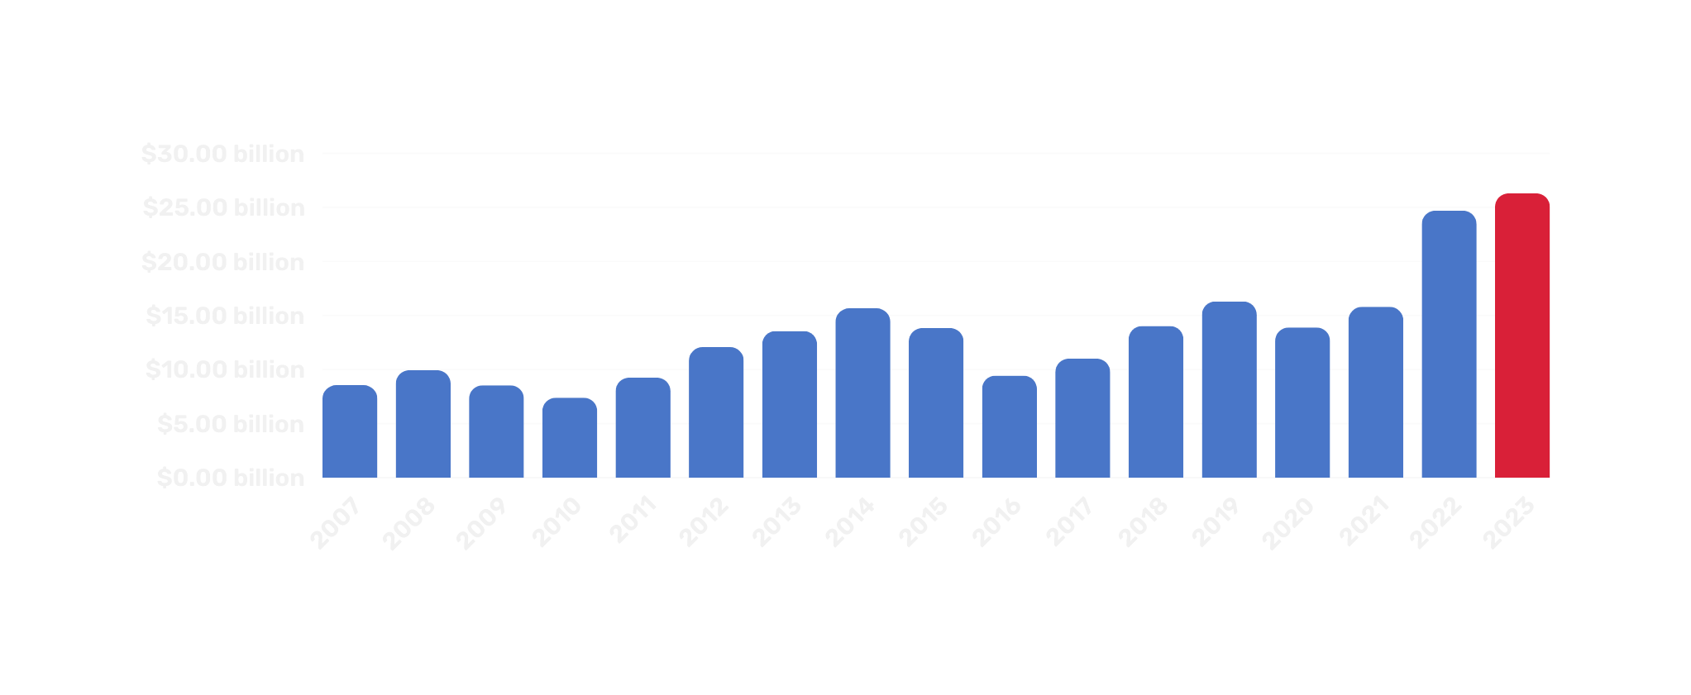
2023
ANNUAL ENERGY &
ECONOMIC IMPACT
REPORT
Since 2007, the Texas oil and natural gas industry has paid more than $230.3 billion in state and local taxes and state royalties.
Notes:
Since 2007, when TXOGA first started compiling this data, the Texas oil and natural gas industry has paid more than $230.3 billion in state and local taxes and state royalties, a figure that does not include the hundreds of billions of dollars in payroll for some of the highest paying jobs in the state, taxes paid on office buildings and personal property, and the enormous economic ripple effect that benefits other sectors of the economy.

Slide 5
2023
ANNUAL ENERGY &
ECONOMIC IMPACT
REPORT
In 2023, Texas rewrote the oil and natural gas record book.
5.6
3.6
9.2
mb/d
mb/d
mb/d
October: Crude Oil Production
October: NGL Production
March: Crude Oil Supply
34
5.6
2.4
bcf/d
mb/d
mb/d
October: Natural Gas Marketed Production
July: Crude Oil Processing
November: NGL exports
19.3
4.1
bcf/d
mb/d
October: Natural Gas Exports
March: Crude and Condensate Exports
Notes:
This type of unmatched, repeat economic performance does not happen by accident. Success is the result of non-stop industry innovation, investment and operational efficiencies that shattered a string of oil and natural gas production, supply, refining and export records last year – all while achieving world-leading environmental progress.
Texas hit production records in six of 12 months in 2023,
and new record-highs in natural gas marketed production occurred in seven of 12 months in 2023.
Texas refineries processed a record 5.6 million barrels of crude oil per day in July 2023. And as Texas produced and exported record amounts of natural gas liquids (NGLs) in 2023, refineries also utilized record amounts of NGLs.
Texas also broke records for crude oil supply and crude oil and condensate exports.
This past year’s achievements define Texas oil and natural gas’ impact in ways never conceived just a few years ago, thanks to this industry’s commitment to innovation and technology and the famed Texas wildcatting spirit that continues to thrive in this new era.

Slide 6
2023
ANNUAL ENERGY &
ECONOMIC IMPACT
REPORT
In FY 2023, the Texas oil and natural gas industry employed
480,176
texans
and for every direct job in the Texas oil and natural gas industry creates an additional two Texas jobs.
Notes:
In 2023, the industry employed more than 480,000 Texans.
Conservative estimates indicate that each of these jobs generates approximately two more jobs, with more than 1.4 million total jobs supported across the Texas economy.
Some economists say this number could be as high as three more jobs supported and total over 2 million jobs in Texas.

Slide 7
2023
ANNUAL ENERGY &
ECONOMIC IMPACT
REPORT
$124,158
$70,738
Texas oil and natural gas employees
Other Texas private sector employees
Texas oil and natural gas employers paid an average of $124,158 per job in 2023. Other private sectors averaged $70,738, roughly 43 percent less than what oil and natural gas companies paid their employees.
Notes:
Jobs in the Texas oil and natural gas industry are not your ordinary job. The 480,000 Texans who were directly employed by the industry earned an average of $124,000 a year – nearly twice the average paid by the rest of Texas’ private sector.

Slide 8
2023
ANNUAL ENERGY &
ECONOMIC IMPACT
REPORT
In FY 2023, the Permanent University Fund and Permanent School Fund each fund received over
$1.8 billion
the second highest on record and more than double the amounts from FY 2021.
Notes:
In 2023, 99 percent of the state’s oil and natural gas royalties were deposited into the Permanent School Fund and the Permanent University Fund, which support Texas public education. Each fund received $1.8 billion.

Slide 9
2023
ANNUAL ENERGY &
ECONOMIC IMPACT
REPORT
Texas ISD received oil and natural gas property taxes totaling
$2.81 billion
and Texas counties received oil and natural gas property taxes totaling over
$885 million
Notes:
In FY 2023, Texas school districts received $2.81 billion in property taxes from mineral properties producing oil and natural gas, pipelines, and gas utilities. Counties received an additional $885.6 million in these property taxes.

Slide 10
2023
ANNUAL ENERGY &
ECONOMIC IMPACT
REPORT
Out of FY 2023’s production taxes paid, the Rainy Day Fund and the State Highway Fund each received
$3.3 billion
funding a wide variety of important initiatives across the Lone Star State.
Notes:
Out of FY 2023’s production taxes paid, the Economic Stabilization (“Rainy Day”) Fund, or ESF, and the State Highway Fund (SHF) each received $3.3 billion.
Without the direct funding from taxes paid by the Texas oil and natural gas industry, support for retired teachers, disaster recovery, healthcare services, and numerous other priority items would not have received the substantial dollars allocated to meet essential needs.

Slide 11
2023
ANNUAL ENERGY &
ECONOMIC IMPACT
REPORT
The Texas oil and natural gas industry is the primary funding source for the Rainy Day Fund, contributing more than
$31.2 billion
since the Fund’s inception in 1987. This amounts to 82 percent of the ESF revenue over time.
Notes:
Since its inception in 1987, the Rainy Day Fund has received over $31.2 billion from oil and natural gas production taxes. All of these are funded almost exclusively with taxes and state royalties paid by the oil and natural gas industry.

Slide 12
POLITICS vs. POLICY
Notes:
The United States is not only the world’s number one producer of oil and natural gas – led by Texas – we also lead the world in emission reductions and environmental progress.
Yet, policies coming out of Washington continue to throw roadblocks in the way of world-leading environmental efforts and unmatched responsibility in oil and natural gas development.
Such ill-conceived policies hurt American consumers and stifle our ability to deliver energy freedom and security around the world.
Even as the #1 oil and natural gas state in the world’s leading energy nation, Texas has some challenges to address if we want to maintain our position as a global energy leader.
Producers in the Permian Basin need infrastructure and more power generation as they electrify their operations.
A growing Texas needs more pipelines and a cost-effective electrical power generation market that puts consumers’ needs first and incentivizes dispatchable power.
Finally, we need policy that allows Texas to lead the emerging carbon capture and storage industry.
We know that policy can promote prosperity or hinder it. We look forward to working to ensure that the American energy leadership that starts in Texas, stays in Texas.

Slide 13
POLITICS vs. POLICY
Federal
Delays
Methane Fee
NAESB - Natural Gas Regulation
LNG Permit “Pause”
Primacy Class VI Wells
Notes:
Federal initiatives aimed at the oil and gas industry has been centerstage over the last four years. With new issues coming everyday.
Delays (Pipeline approvals, Leases, ETC.)
Methane Fee
-Long awaited rules are out and there are significant challenges to address.
NAESB – Natural Gas Regulation
LNG Permit “Pause” – Impacting Louisiana and Texas the most, but this is purely a
Primacy Efforts – TXOGA passed legislation to apply for primary for Class VI Wells in 2021 but the process continues to be slow and we are not sure much movement will occur before November elections.

Slide 14
POLITICS vs. POLICY
Texas
Property Tax Relief
Big vs. Small Taxpayers
Voting & Appraisals Districts vs. Valuation Methodology
Economic Development (Sound Bites vs. Competition)
New Technologies vs. Polarized Politics
Notes:
PROPERTY TAXES
Property Tax Relief
Homesteads vs. Across-the-Board Rate Reductions
Homestead Exemptions
Provided there is sufficient state revenue available, more help for homesteaders should continue to be popular.
Big vs. Small Taxpayers
Appraisal caps and exemptions for lower values like SB 2 Circuit Breaker
We can also expect that there will be a race to file legislation to make the temporary circuit-breaker permanent.
Voting & Appraisals Districts vs. Valuation Methodology
We can expect pressure will continue to be brought on politicizing the appraisal process.
Top legislators filed bills (which did not pass) that would make elective the currently appointed offices of Chief Appraiser, ARB, and CAD board.
This is more dangerous than helpful for us and other large holders of non-homestead taxable property.
All of these policies are encroaching on the gold standard of "all property on the rolls at full value"
Economic Development
Sound Bites vs. Competition
HB 5 – JETI Act – Economic Development
We can also expect that there will be a race to file legislation to make the temporary circuit-breaker permanent. And, provided there is sufficient state revenue available, more help for homesteaders should continue to be popular.
In other words, the gold standard of "all property on the rolls at full value" is becoming tarnished or ignore
HB 5 – JETI Act – Economic Development
The program is now accepting applications. As you know, many concerns about the details in the version the finally passed.
Most concerning are the job requirements, performance bonds and growing concerns over wage calculations.
There is concern that the wage calculations are too high and that the new Workforce Development Area wage may be higher than the old COG wages under the old program and add 110% requirement and that is difficult to meet for many companies.
Job requirements are higher than most industries would have liked. And Louisiana has already capitalized on this with its governor using an executive order to remove the jobs requirements from its eco devo programs.
Status on program:
Two applications to JETI have been received thus far.
Galena Park ISD - Summit Next Gen, LLC (BIOFUEL)
Northwest ISD - Bell Textron, Inc (Advanced Manufacture for Airline parts) Ft. Worth
New Technologies & Meeting Customer Demands
Customers at home and abroad are demanding lower carbon and alternative products.
Over-inflated mandates are not good and using ESG and other mechanisms to force product development is bad.
However, consumer demand must be met, or we will lose to other states or nations if we can’t market our products to our customers demands.
We must gear our business policies to be able to meet demands without capitulating to a forced narrative.

Slide 15
What can we do?
Engage
480,176
1.4M
direct employees
indirect employees
Engage in local politics
Become an energy advocate
Vote in every election
Participate in Texas Energy Day at the Capitol
Text “TXOGA” to 52886 for industry updates
Notes:
What can we do?
ENGAGE
The Texas oil and natural gas industry directly pays over 400,000 employees and indirectly impacts another 2 million employees around the state.
Visit with your local elected officials.
Become an ambassador for your industry. It’s not just about taxes…but all policies impact the MATH!
Good Public Support = Good Policies = Good Math
Participate in Elections each vote counts!
Join us for Energy Day at the Capitol each session to show the impact of this amazing industry.
Like, share and repost..
Text 52886 to stay informed.

Slide 16
“Do you want to know who you are?
Don't ask. Act!
Action will delineate and define you.”

Slide 17
Questions?
Follow us on Social Media
@TXOGA

