Slide 1
TXOGA 2024 Property Tax Conference Legislative Subcommittee

Slide 2
Legislative Subcommittee Members
Darren Owen (chair) – ExxonMobil
Bernard Hajny – BP America
Matthew Kuhl – Chevron
Greg Cardwell – ConocoPhillips
Kelley Stewart – Hilcorp
Michael Horne – OXY
Andrea Carter-Virtanen – Cheniere Energy
Greg Maxim – Cummings Westlake

Slide 3
88th Legislative Session Recap
Regular session
Governor Abbott vetoed many bills (76; 49 ptax) in reaction to no ptax relief bill
HB 796 passed
Public data on protest hearings (ARB members, acct #, property category, CAD value, property owner value, ARB determination)
Effective 1/1/24; data available by Oct 1 each year; 5 years of data
2nd Special Session
Property Tax Relief HJR 2, SB 2, SB 3
School tax rate compression 10.7¢ in addition to 10¢ in regular session
Only covers current fiscal budget thru Sept 2025
20% appraisal cap on non-homestead real properties under $5M (3-yrs)
3 elected CAD board members in counties over 75k population

Slide 4
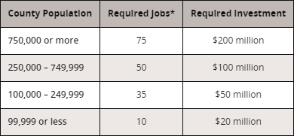
JETI - Jobs, Energy, Technology and Innovation
10-year ptax incentive: school district maintenance and operations (M&O) portion
Benefits: 50% of M&O tax (75% if in qualified opportunity zone)
Eligible categories (NAICS: manufacturing, natural resources, etc.)
Job and Investment Requirements:
Jobs at project site
No job waivers
Wages >110% of county, region or state average (NAICS; TX Workforce Comm)
Compelling factor determination (“but for” test): proof of alternate sites outside TX
Performance bond required (10% of estimated gross tax benefit to the applicant)
$30k application fee; $$ Economic Benefit Statement
Comptroller determines application; Agreement w/applicant, school, and governor
Biennial compliance reporting requirements

Slide 5
Looking Ahead
Next session:
Budget surplus ~$20B
Appraisal caps (20% cap – adjustments, make permanent)
JETI revisions
CCS (TCEQ)
Elected officials
Sales / Property tax swap
Equal & Uniform
Sales price disclosure
ARB reform
House Select Study Committee on Sustainable Property Tax Relief

