Slide 1
How Can Emerging Technologies Help Your Property Tax Function?
March 7, 2024
Jeff York, Partner, Deloitte Tax LLP
Cheryl Gordon, Manager, Deloitte Tax LLP

Slide 2
Agenda
Changing Roles and Expectations of the Tax Department
Data Wrangling and Extract, Transform, Load (ETL)
Data Analytics and Visualizations
Robotic Process Automation (RPA)
AI and Generative AI (GenAI)

Slide 3
Changing Roles and Expectations of the Tax Department

Slide 4
Roles and Expectations of the Tax Department
Notes:
4
4

Slide 5
Tax Trends and Technology
Tax department trends
Related emerging technologies
Data management and process automation
Big Data
Disparate systems
Need for speed
Global integration
Regulatory changes and scenario planning
Suite expectations
Data Wrangling and Extract Transform Load (ETL)
Analytics
Robotic Process Automation (RPA)
Optical Character Recognition (OCR)
Cognitive computing (AI/ML/GenAI)
Cloud ERP migration
Notes:
5
5

Slide 6
Data Wrangling and Extract, Transform, Load (ETL)

Slide 7
Data Wrangling
Data Wrangling is the process of retrieving raw data and making it useful for analysis and reporting
2
Potential Benefits of Data Wrangling
Data Integration and Governance
Process Automation
Data Accessibility
Support Data for Audits
Data Validation
Staging and Preparation
1
Analysis
Extraction
3
Integration Layer
Applicability of Data Wrangling
Apportionment
Compliance (Indirect, Direct, Corporate, Pass-Through etc.)
Provide seamless workflow across modules to simplify user experience
Notes:
7
7

Slide 8
Data Wrangling Ideas to Get Started
Reconciliation of GL accounts
Data management for compliance
Tax accruals
Data standardization
Visualization/analytics
Other items …
Notes:
8
8

Slide 9
Data Analytics and Visualizations

Slide 10
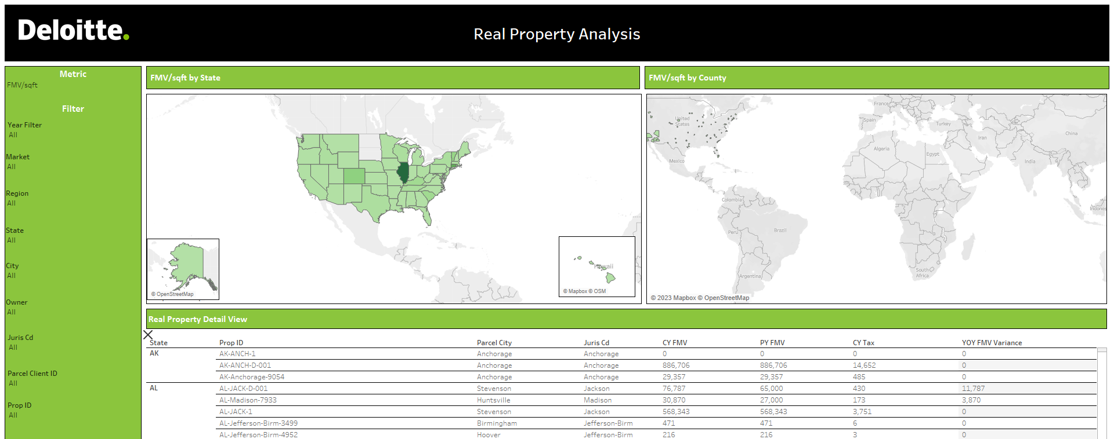
Data Analytics
Notes:
10
10

Slide 11
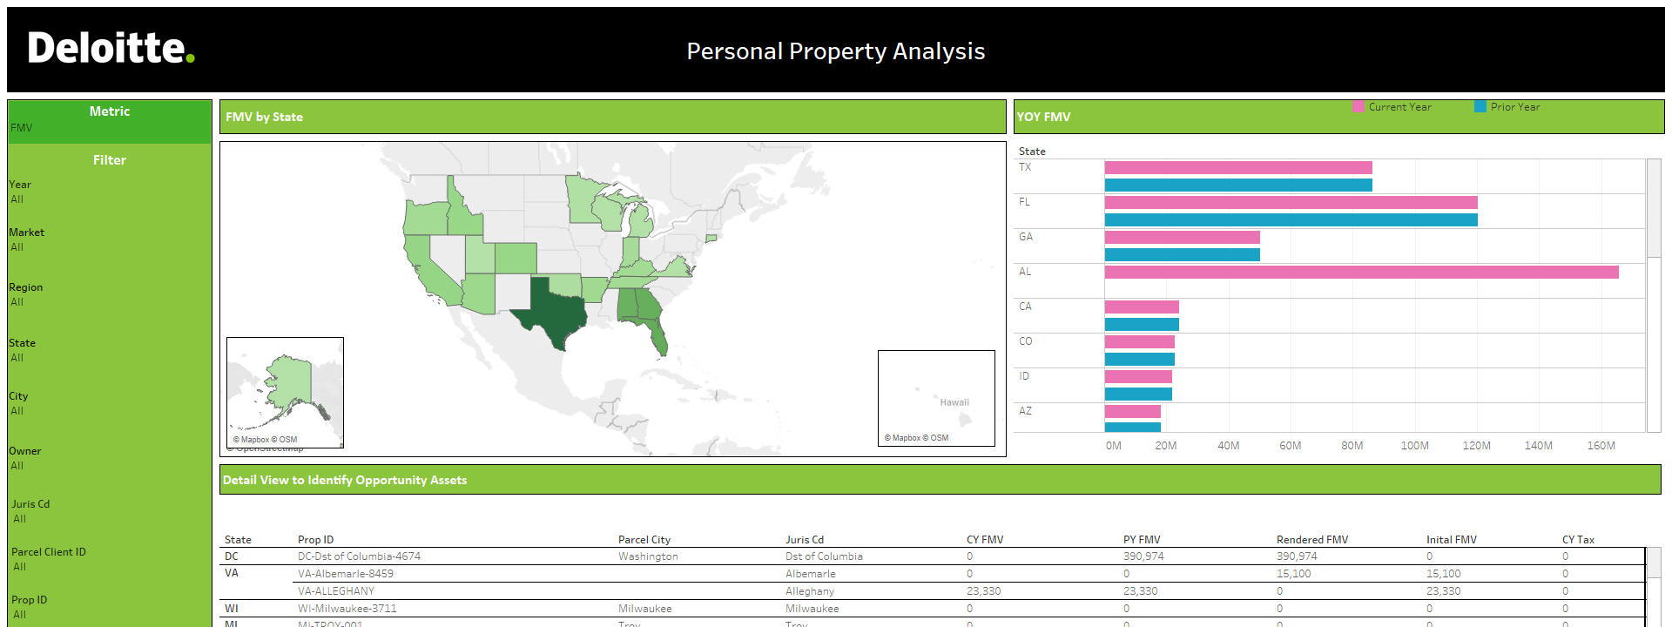
Data Analytics
Notes:
11
11

Slide 12
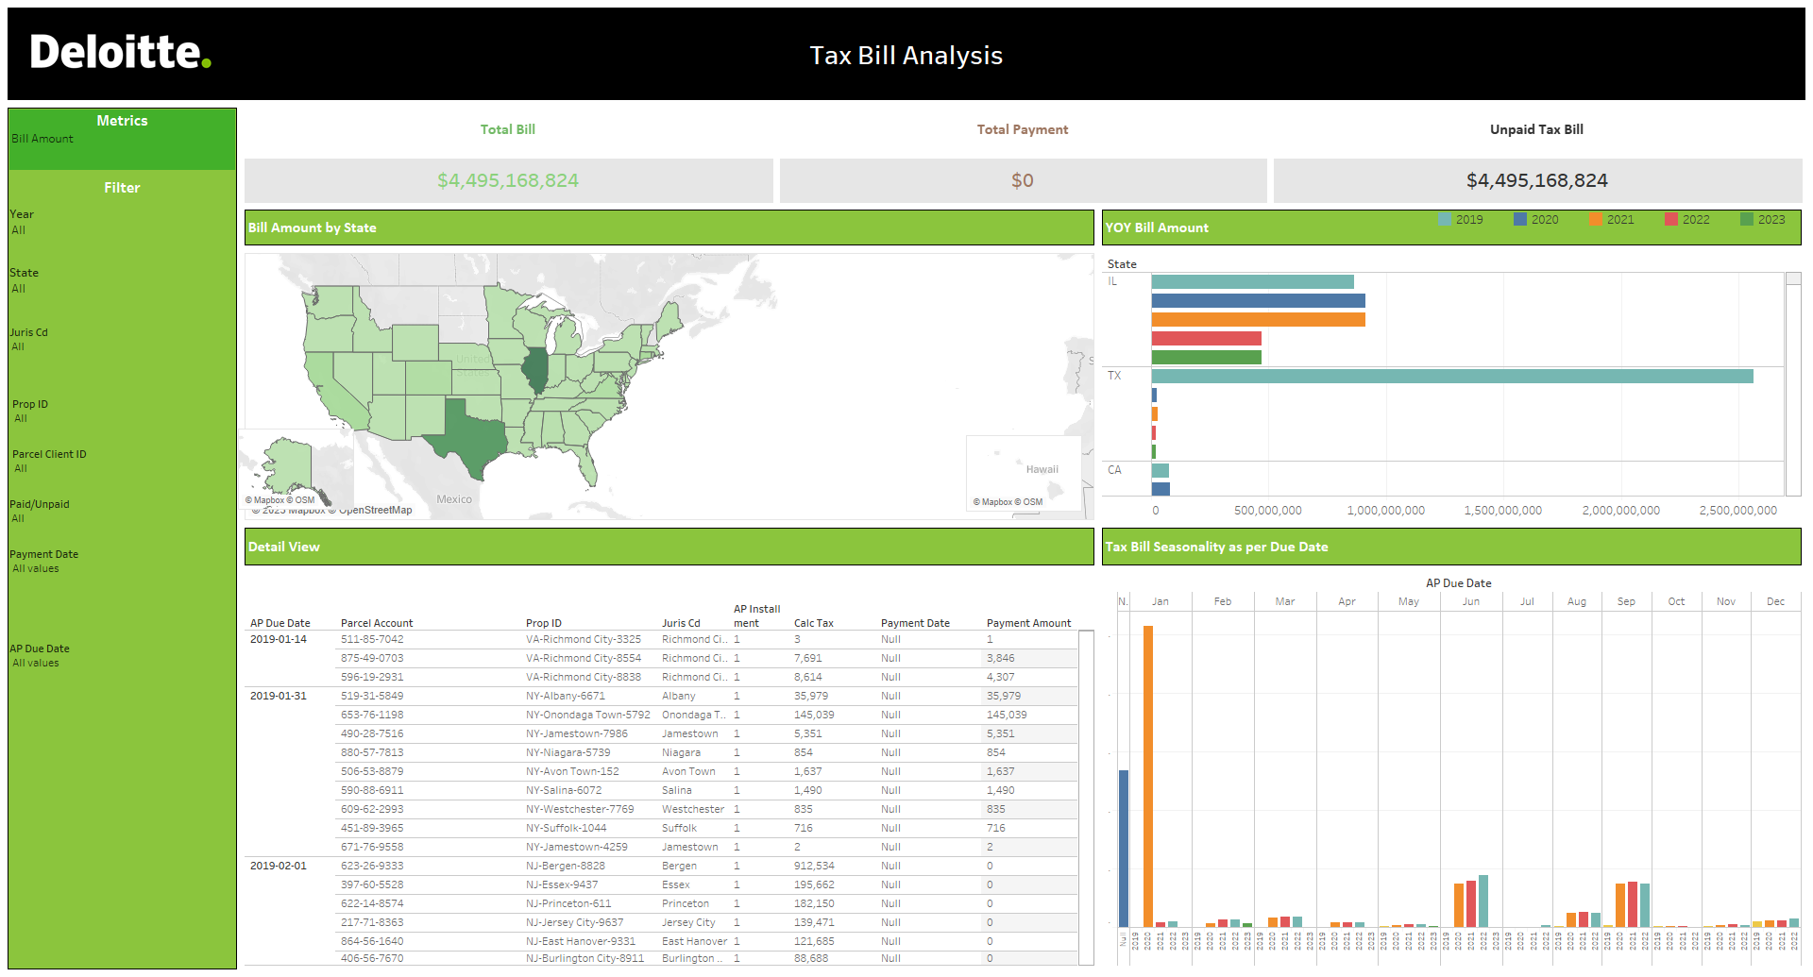
Data Analytics
Notes:
12
12

Slide 13
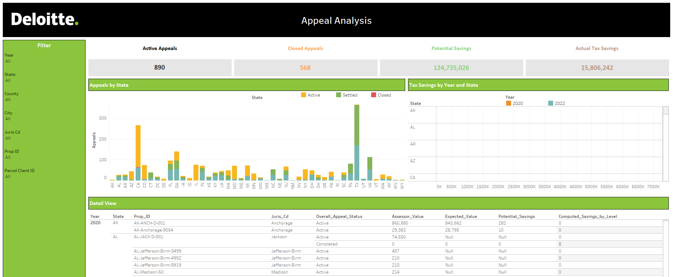
Data Analytics
Notes:
13
13

Slide 14
Common Uses for Data Analytics
Visual Representation of Data
Trend Analysis
Project Tracking
Project Success
Variance Analysis
Other items …
Notes:
14
14

Slide 15
Robotic Process Automation (RPA)

Slide 16
Robotic Process Automation
What it can do
Potential Benefits
RPA is …
Lower labor costs/labor redeployed to higher value activities
Increased process throughput
Improved process quality
Greater delivery model flexibility
Better scalability
Better payback/ROI—relatively low cost to implement
Computer-coded software
A potential means to save time and cost by automating processes
Cross-functional, cross-application macros
Open, read, and create emails
Copy/Paste
Log into web/enterprise apps
Extract data from docs
Obtain human input via email/workflow
Fill in forms
Collect statistics
RPA is not …
Make calculations
Read/Write to DBs
Physical hardware
A multiyear technology deployment
Artificial intelligence
Move files and folders
Follow “if/then” decision rules
Notes:
16
16

Slide 17
Common Uses for RPA
Data extraction and compilation
Mailbox monitoring
Use tax reconciliation
Retrieval of invoices
PDF and attachment creation
Electronic filing steps
Notes:
17
17

Slide 18
Generative AI (GenAI)
What is it?

Slide 19
What is Generative AI (GenAI)?
Artificial
Intelligence (AI)
Imitating human behavior
Machine
Learning (ML)
Very complex to understand, train, and maintain = used by data scientists
Identifying patterns in data without direct computer programming
Deep
Learning
Creating complex maps of data relationships based on features and hierarchies
Generative
AI (GenAI)
Models largely pre-built = accessible to general developers and users
Generating new content/data based on relationships in existing data

Slide 20
GenAI – What is it?
What it is
A tool for augmenting and improving certain business tasks
A more natural way to interact with information, data, and documents
A means of quickly providing contextually relevant content (within limits)
An assistant for drafting summaries and other documents to be further reviewed and refined
A method of generating outputs that are as close as possible to those a human might produce
What it is not
A complete repository of all information available on the internet or the world
A fully reliable method of creating final documents and summaries
An end-to-end replacement for all human activities within a given process
A replacement for human creativity
A means to “automatically” upskill resources

Slide 21
The GenAI Journey

Slide 22
The GenAI journey – today and tomorrow
We are Here
Today
Tomorrow
Functionality
End-to-End Process
Scale Solutions
Analyze data
Perform functions
Easy Interaction
Generate summaries
Generate values
Flexible Workflow
Automation
Flexible data sourcing
Flexible outputs
Flexible Platforms
Multi-process
Multi-model
Proprietary data / IP
Use Cases
On-demand Capabilities
Enabled
Expense
Analytics
Expense Decision Support
Expense Management
Value

Slide 23
The GenAI journey for the tax function
Cost Journey
Crawl
Walk
Run
Fly
Explore
Augment
Accelerate & Automate
Industrialize
6 – 12 months
12 – 24 months
24 – 36 months
36+ months
Proof of concept/s
Sandbox environments
AI Capability development
Risk evaluation
Data security & controls
Production MVPs
Technology optimization
Standardized deliver approach
Governance and sustainment
Talent Augmentation
Foundry model/s
Enterprise adoption
Functional enhancements
Org & Talent realignment
Scaled AI function
Enterprise enablement
Business model evaluation
New businesses / revenue streams
Key Enablers
Technology Strategy
Data maturity, availability & quality
Innovation and experimentation culture
Talent Development (Data Science, LLMs)
Risk &
Governance

Slide 24
GenAI Use Case Example - Property Tax
[Placeholder for potential video]

Slide 25
GenAI Use Cases for Tax

Slide 26
Generative AI models unlock new use cases previously thought to be too complex for traditional AI models…
Characteristics of Traditional AI
Simple FAQ chatbots & voice agents
Personalized omni-channel experience
Characteristics of
Generative AI
Fraud Detection
Auto-actuarial Diagnostic Reviews
Marketing Content Creation
Traditional AI enables operational automation & providing actionable insights
Generative AI enhances capabilities for existing AI use cases, and unlocks new use cases by creating content across all data formats and types
Document Comparison
Document Extraction
Instant answers on enterprise data
Traditional AI has typically focused on middle and back- office operational efficiencies
Document Extraction & Generation
Generative AI enables workers to
supervise AI on first drafts and audit
content allowing greater
productivity
ML Pricing engines
Policy Document
Creation
Use cases above are illustrative
Generative AI has unlocked new use cases previously thought as too complex and augmented the capabilities of known use cases. While leveraging out-of-the-box Generative AI models may not lead to competitive differentiation, finding and experimenting with the right use cases can.

Slide 27
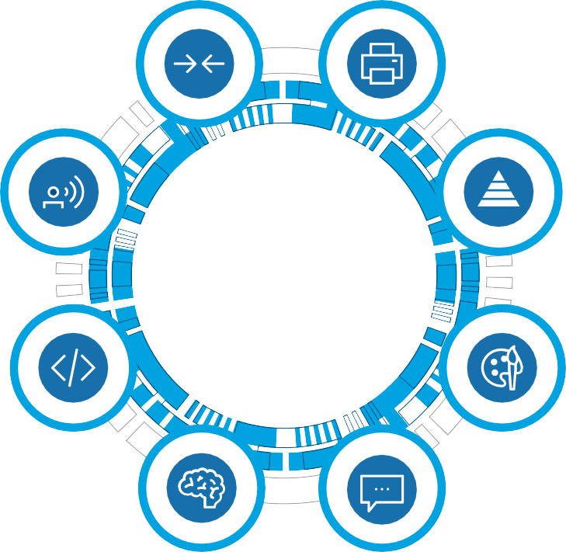
Examples of GenAI use cases for tax
Summarization
Generate a concise and coherent summary of data from a long text or collection of texts
E.g., meeting minutes, workshop summary, document summary (planning, controversy, transfer pricing)
Content Generation
Generate content based on a set of input examples, documents, data and/or a specific theme or topic
E.g., tax reporting and analytics, standard templates
Q&A
Generate a natural language answer to a natural language question based on a given tax data or tax rules & regulations
E.g., policy document review, regulation search, process chatbot, rule training, system maintenance
Classification
Generate a category or label to a given input
E.g., sentiment analysis, tech vendors classification, indirect taxability classification, system mappings, tax sensitive analysis
Gen AI AI capable of generating novel content such as text, images and codes from existing tax data
Transformation
Generate content by converting tax data into a new specified type, format or style
E.g., tax rules to code, document transfer and personalization, text to table, data engineering
Standard Report Generation
Generate reports from tax compliance and analytics data
E.g., training data augmentation for computer vision models
Reasoning
Generate logical analysis (inference, deduction, and/or explanation of relations) given a context or knowledge base.
E.g., legislation impact analysis
Monitoring & Anomaly Detection
Locate abnormal trends in data via statistical analysis to identify potential misstatements that may otherwise not be able to be identified
E.g., identifying duplicate expenses, fake purchases, non-verified vendors with transactions in ERP

Slide 28
Contact information
Jeff York
Tax Partner
Deloitte Tax LLP
Multistate Data & Technology
jeyork@deloitte.com
Cheryl Gordon
Tax Manager
Deloitte Tax LLP
Multistate Tax Services - Property Tax
chegordon@deloitte.com

Slide 29
This presentation contains general information only and Deloitte is not, by means of this presentation, rendering accounting, business, financial, investment, legal, tax, or other professional advice or services. This presentation is not a substitute for such professional advice or services, nor should it be used as a basis for any decision or action that may affect your business. Before making any decision or taking any action that may affect your business, you should consult a qualified professional advisor. Deloitte shall not be responsible for any loss sustained by any person who relies on this presentation. The services described herein are illustrative in nature and are intended to demonstrate our experience and capabilities in these areas; however, due to independence restrictions that may apply to audit clients (including affiliates) of Deloitte & Touche LLP, we may be unable to provide certain services based on individual facts and circumstances.

Slide 30
Deloitte refers to one or more of Deloitte Touche Tohmatsu Limited, a UK private company limited by guarantee (“DTTL”), its network of member firms, and their related entities. DTTL and each of its member firms are legally separate and independent entities. DTTL (also referred to as “Deloitte Global”) does not provide services to clients. In the United States, Deloitte refers to one or more of the US member firms of DTTL, their related entities that operate using the “Deloitte” name in the United States and their respective affiliates. Certain services may not be available to attest clients under the rules and regulations of public accounting. Please see www.deloitte.com/about to learn more about our global network of member firms. Copyright © 2024 Deloitte Development LLC. All rights reserved.

