Slide 1

Siting 101
you want to build What?!?
© 2024 Harris, DeVille & Associates

Slide 2
Harris, DeVille & Associates
Full-service communications firm specializing in issues management, established in 1984 with personnel in Louisiana and Texas
20+ professional staff with unique skill sets: expertise including environmental science, research, public relations, journalism, governmental relations and politics
Focus of business - Issues management and governmental affairs
Work across U.S. and North America, but primarily Gulf Coast; large industrial client base
Significant work in managing controversial issues, usually in environmental, regulatory, political and public arenas
Nearly 40 years of experience siting energy, petrochemical and transportation industries
www.hdaissues.com

Slide 3
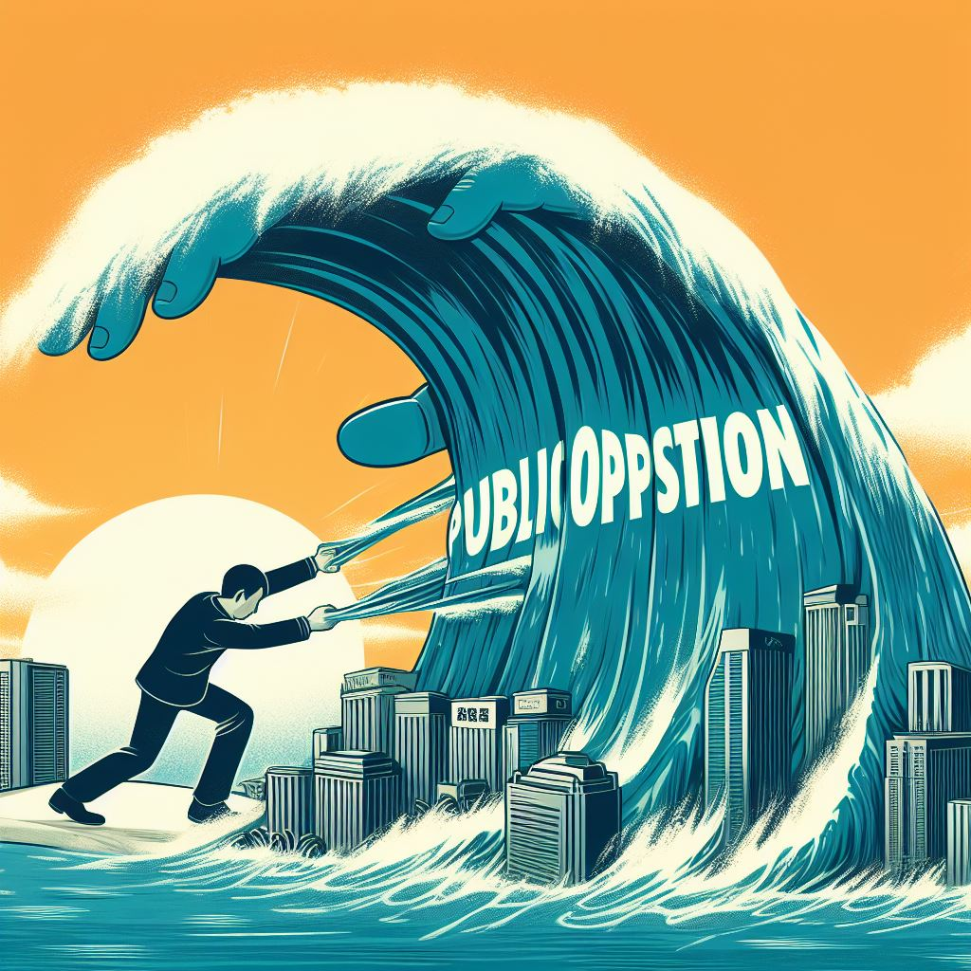
This is my day job!

Slide 4
What am I sharing today?
Insights on siting challenges based on decades of success and months of failure
Perspective on public expectations of industrial facilities
Perspective on industrial expectations of public engagement
Unique POV, based on real world experience, on where “tax” can help or hurt the siting cause
Lessons learned

Slide 5
Abatement 101
Abatement = Exemption of all or portion of PROPERTY TAXES over given period of time.
STATUTORILY AUTHORIZED and IMPLEMENTED at the state and local governmental level.
NATURE AND TERMS are UNIQUE to each taxing authority.
IMPLEMENTED as a tax exemption or reduction, a cap on taxable value or as a payment in lieu of taxes (PILOT).
ARE NOT REQUIRED – they are a “GIFT” from governments to incentivize investment.
PUBLIC INVESTMENT in the project – therefore the approval process is PUBLIC.
Abatements come with STRINGS ATTACHED.
Abatements are CONTRACTS with local government – if we don’t comply, we don’t get the benefits of the abatements.
Abatements are “AFTER THE FACT.”

Slide 6
Site selection screening criteria
Site buildability: size, wetlands, soils, flooding
Transportation infrastructure
Access to raw materials/supply chain
Workforce: Cost, skills and availability
Utilities [Power & Water]: Cost, reliability
Zoning and regulatory requirements
Taxes and incentives

Slide 7
What’s missing?
Site buildability: size, wetlands, soils, flooding
Transportation infrastructure
Access to raw materials/supply chain
Workforce: Cost, skills and availability
Utilities [Power & Water]: Cost, reliability
Zoning and regulatory requirements
Taxes and incentives
Community license to operate (acceptance)

Slide 8
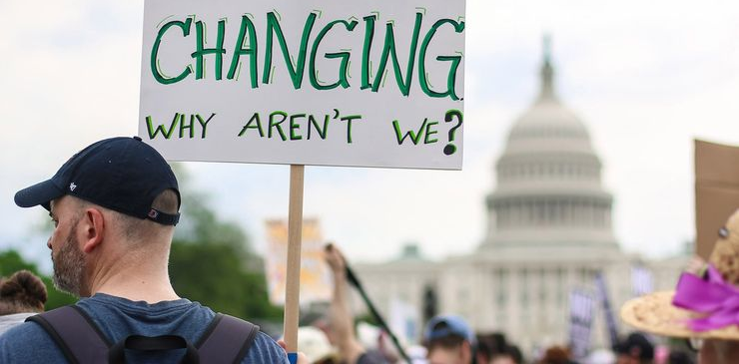
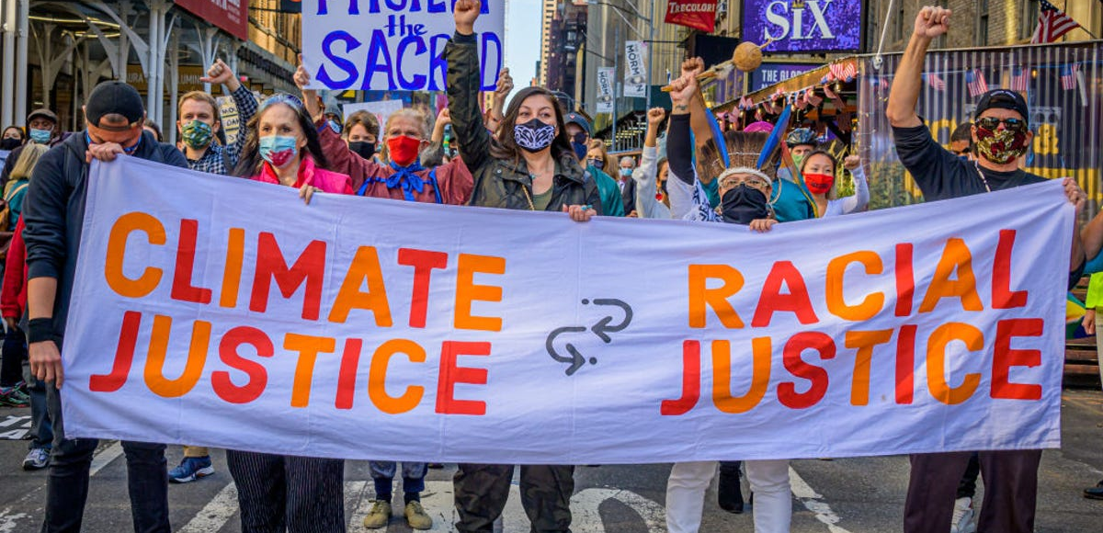
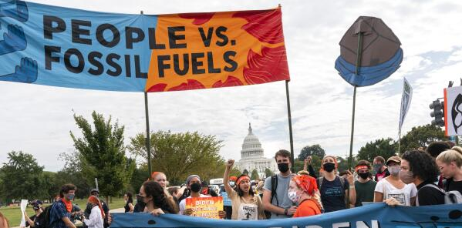
What really stops projects?
Site buildability: size, wetlands, soils, flooding
Transportation infrastructure
Access to raw materials/supply chain
Workforce: Cost, skills and availability
Utilities [Power & Water]: Cost, reliability
Zoning and regulatory requirements
Taxes and incentives
Community license to operate (acceptance)

Slide 9
What does that have to do with me? I just do tax stuff!

Slide 10
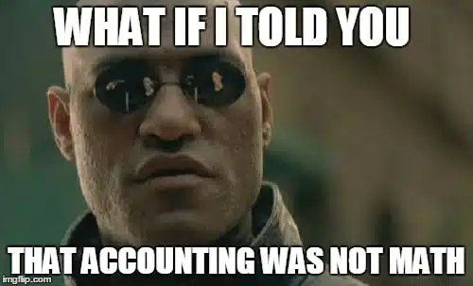
What does that have to do with me? I just do tax stuff!

Slide 11

What if I told you that you are critical path in facility siting?
Project planning and feasibility
Site selection, incentives and permitting
Design and engineering
Procurement and materials management
Construction
Commissioning and Start up
Operations

Slide 12
What if the opposition figured out that you are critical path!
Oh oh, now what?

Slide 13
How to oppose siting an industrial plant
Permitting
Prove that it will cause unacceptable environmental injury
Slow it down enough that the permitting ‘rules’ can be changed to stop it
Place enough ‘conditions’ so it can’t operate efficiently and economically
Cost
Political pressure results in no, reduced or conditioned abatements
Slow it down enough that construction costs go up excessively
Slow it down enough for the market to change
Reputation
Pressure the developer to the point where reputation damage exceeds financial gain
Make it so publicly ‘toxic’ that no one will loan it money or buy its products

Slide 14
If we know we’re critical path, how do we mitigate the risk?
Answer, “What’s in it for me?”
Listen
Impacts are real and we own them
Situations change – so should solutions
Opportunity to engage is critical
Respect is the basis for success

Slide 15
Impact Categories
Direct demands on public and private infrastructure | In-direct demands on public and private infrastructure | Disruption in lifestyle/ quality of life | Demands on local governance | Cultural integration
Streets, roads, bridges (heavy haul) Pipelines and utilities Ports and wharfage build out Workforce training | Traffic Streets, roads, bridges (general use) Utilities Housing – temporary and permanent Subdivision development Schools Hospitals Fire and Police and Emergency Response Neighbor relocation | Traffic disruption School class headcount More competition for limited resources Housing demands – man camps, hotels Perceived increased health risk | Near term financial demands versus cash flow Infrastructure planning and building codes Pace - Government time vs developer time Political turmoil Myopic vision versus longer term vision Empowerment | School demographics Churches Shopping Real estate /neighborhoods New people in town – they may look different, think differently, eat different foods.
Public sector demands cost money and there is a lag in public sector revenue generation. Abatements can aggravate both the demand side and the revenue generation side.

Slide 16
What can you do, as a tax professional, to mitigate project siting risk?
Recognize that you may be the front line of offense
Do your homework – know what you’re selling – benefits, risks and timing
Read the field – know the plays before the game
Respect the situation – and the politics – and adapt
Understand the history – you may be in a game that already started
Recognize that money can buy you things that are for sale – but not everything is for sale
Establish and nurture relationships
Limit self-inflicted wounds
Always do the right thing

Slide 17
© 2024 Harris, DeVille & Associates, Inc.
225.344.0381 • www.hdaissues.com

